Slide 1
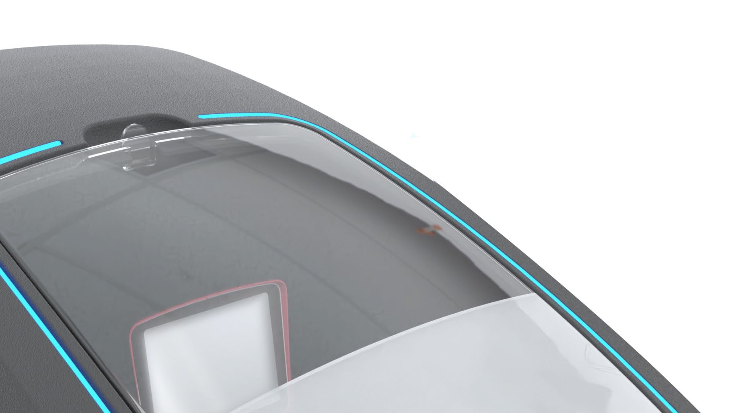

SOFTENERS & PERSONALISATION

Slide 2
0
CONTENT
  Softener Categories
  Levels of personalisation
  Personalisation techniques
  Examples in our market
  MOQ & Price Indication
  Practical information

Slide 3






PERSONALISATION MENU CARD
1
SOFTENER
CATEGORIES
PWG
MIX & MATCH SOFTENERS
PWG SOURCED SOFTENERS
PWG
TAILORED
SOFTENERS
PWG OWN
MANUFACTURED SOFTENERS
2
LEVELS OF PERSONALISATION
LEVEL 1
LEVEL 2
LEVEL 3
LEVEL 4
  Full own design
  Own mould
  Integrated valve
  Own user interface
  Own App
  ...
3
  Stickers
  Dome Labels
  Lettering
  ...
  Valve Labels
  Define quality in
    Finishing
    Print Procedure
    Embossing
  ...
  Special sleeves
  Tampon printing
  Specific cabinet colors
  ...
PERSONALISATION
TECHNIQUES
4
MOQ &
PRICE INDICATION
From 50 to...
From € 0,5 to...

Slide 4
1
SOFTENER CATEGORIES

Slide 5

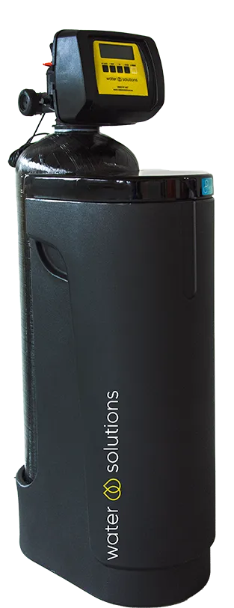
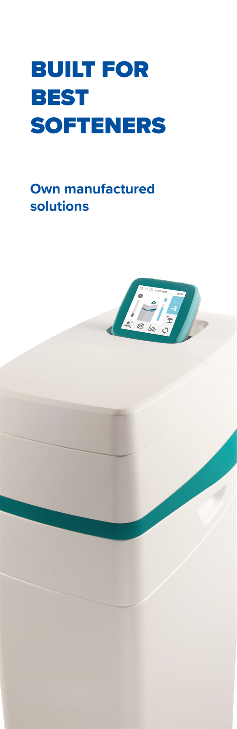
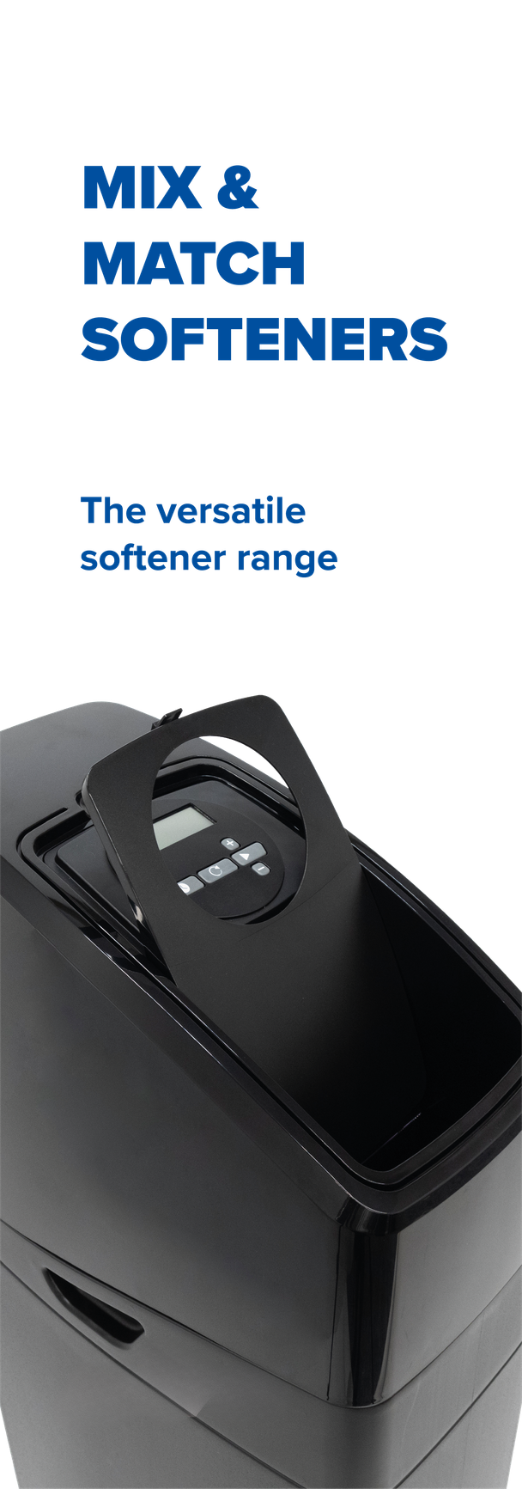
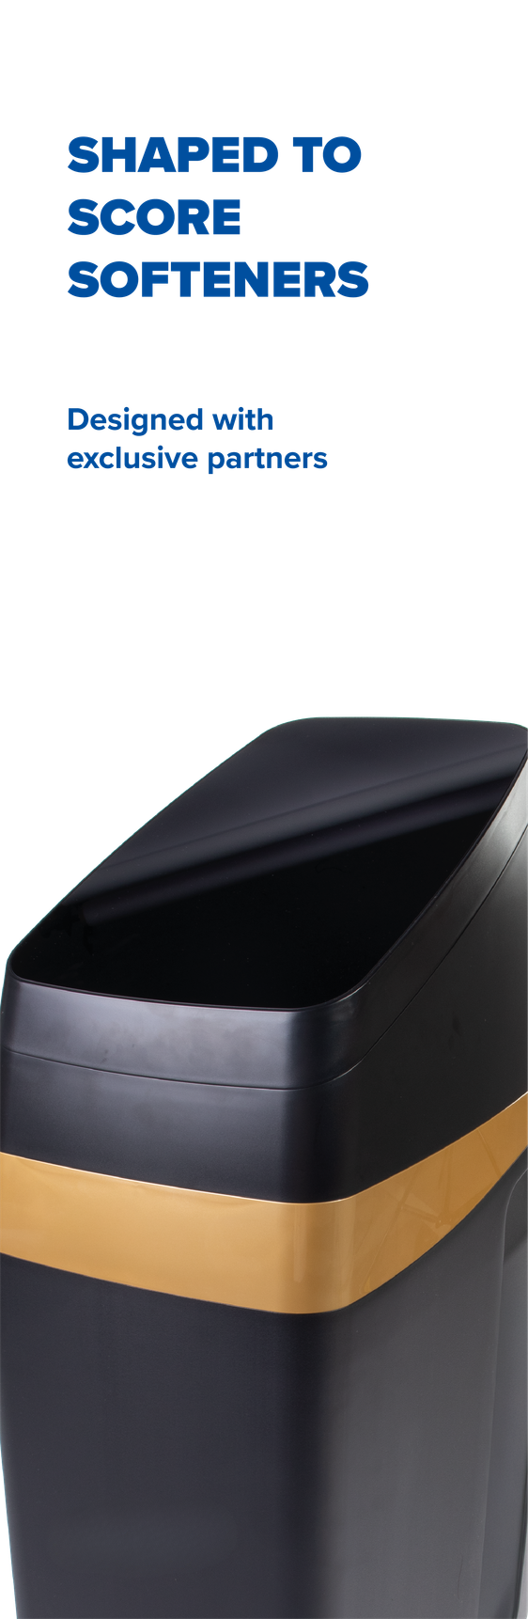
1
SOFTENER CATEGORIES
PWG
MIX & MATCH SOFTENERS
PWG SOURCED SOFTENERS
PWG
TAILORED
SOFTENERS
PWG OWN MANUFACTURED
SOFTENERS
The versatile
softener range
Shaped to score
softener range
Designed to differentiate
softener range
Built for best
softener range

Slide 6
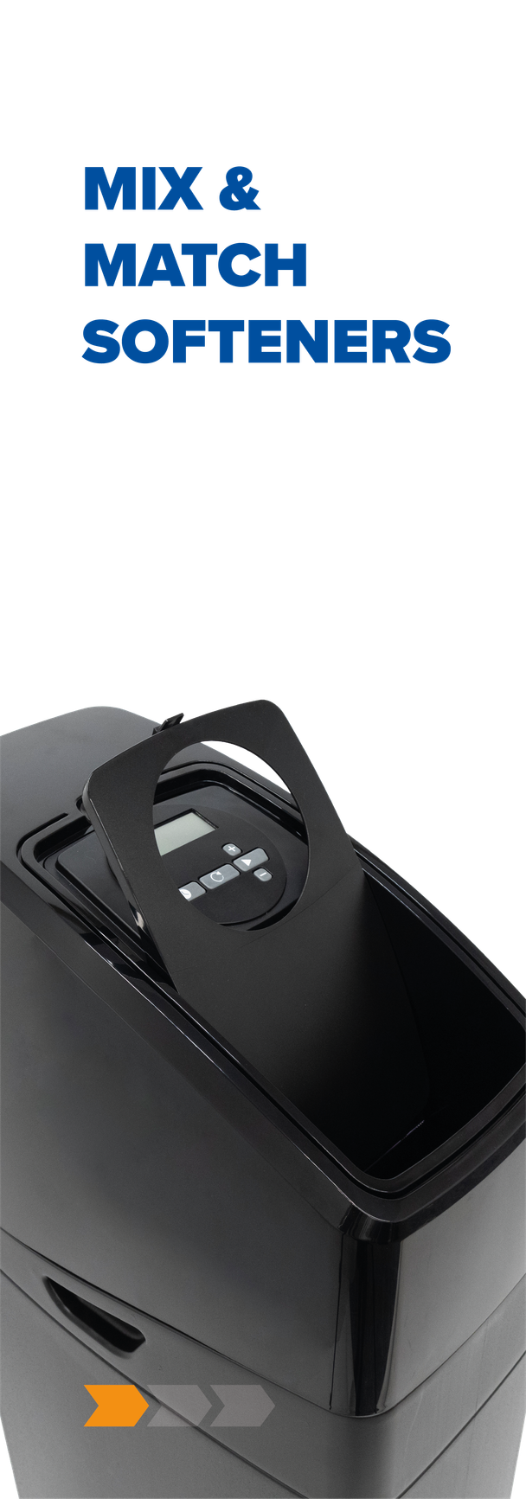
PWG
MIX & MATCH SOFTENERS
1
The versatile softener range
A range of water softeners based on
  a wide variety of PWG cabinets
  in combination with control valves
  personalisation options
  limited MOQs
Notes:
Missing categorie: PWG tailored
moderate MOQ's - easy instap

Slide 7
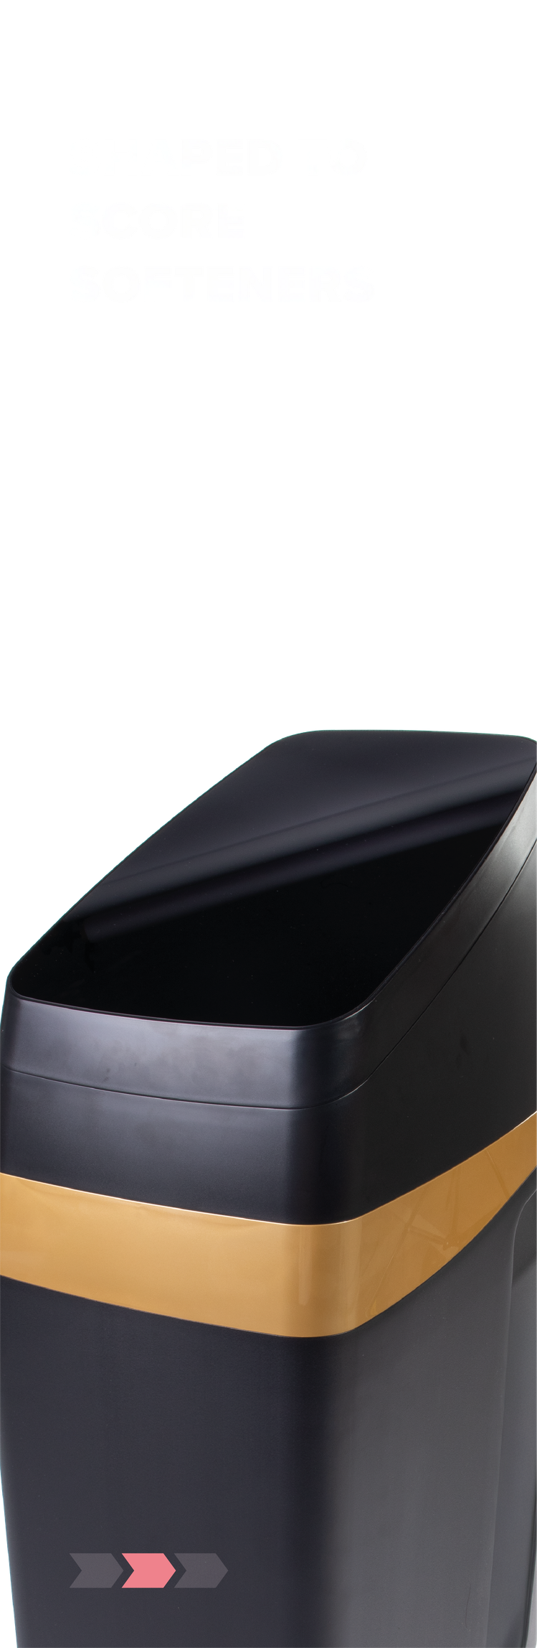
PWG SOURCED SOFTENERS
1
Shaped to score softener range
  designed by our PWG product XPRTS with exclusive partners
  offering you a highly personalised softener range
  high MOQs

Slide 8
PWG
TAILORED SOFTENERS
Designed to differentiate
softener range
  PWG developed softeners
  device based on existing valve technology
  personalisation options
  moderate MOQs

Slide 9

PWG OWN MANUFACTURED SOFTENERS
1
Built for best softener range
  designed, developed & produced in our European manufacturing companies
  offering you most exclusive and distinctive solutions.
  high MOQs

Slide 10
2
LEVELS OF
PERSONALISATION

Slide 11
2
LEVELS OF
PERSONALISATION
2
Why PWG is your best partner for personalised softener solutions:
  We are the best in the market in personalization
  We have a lot of experience in private labeling
  Private labeling exists from low end to high end, from price sensitive to very exlusive
  It is important to be distinctive
  There’s always a solution. We can always personalize!

Slide 12
2
LEVELS OF
PERSONALISATION
LEVEL 1
Personalisation with logo
LEVEL 2
Personalisation with logo on exclusive valve & cabinet combination
LEVEL 3
Personalisation on a special product solution or product
LEVEL 4
Full-customisation on an exclusive softener or product

Slide 13
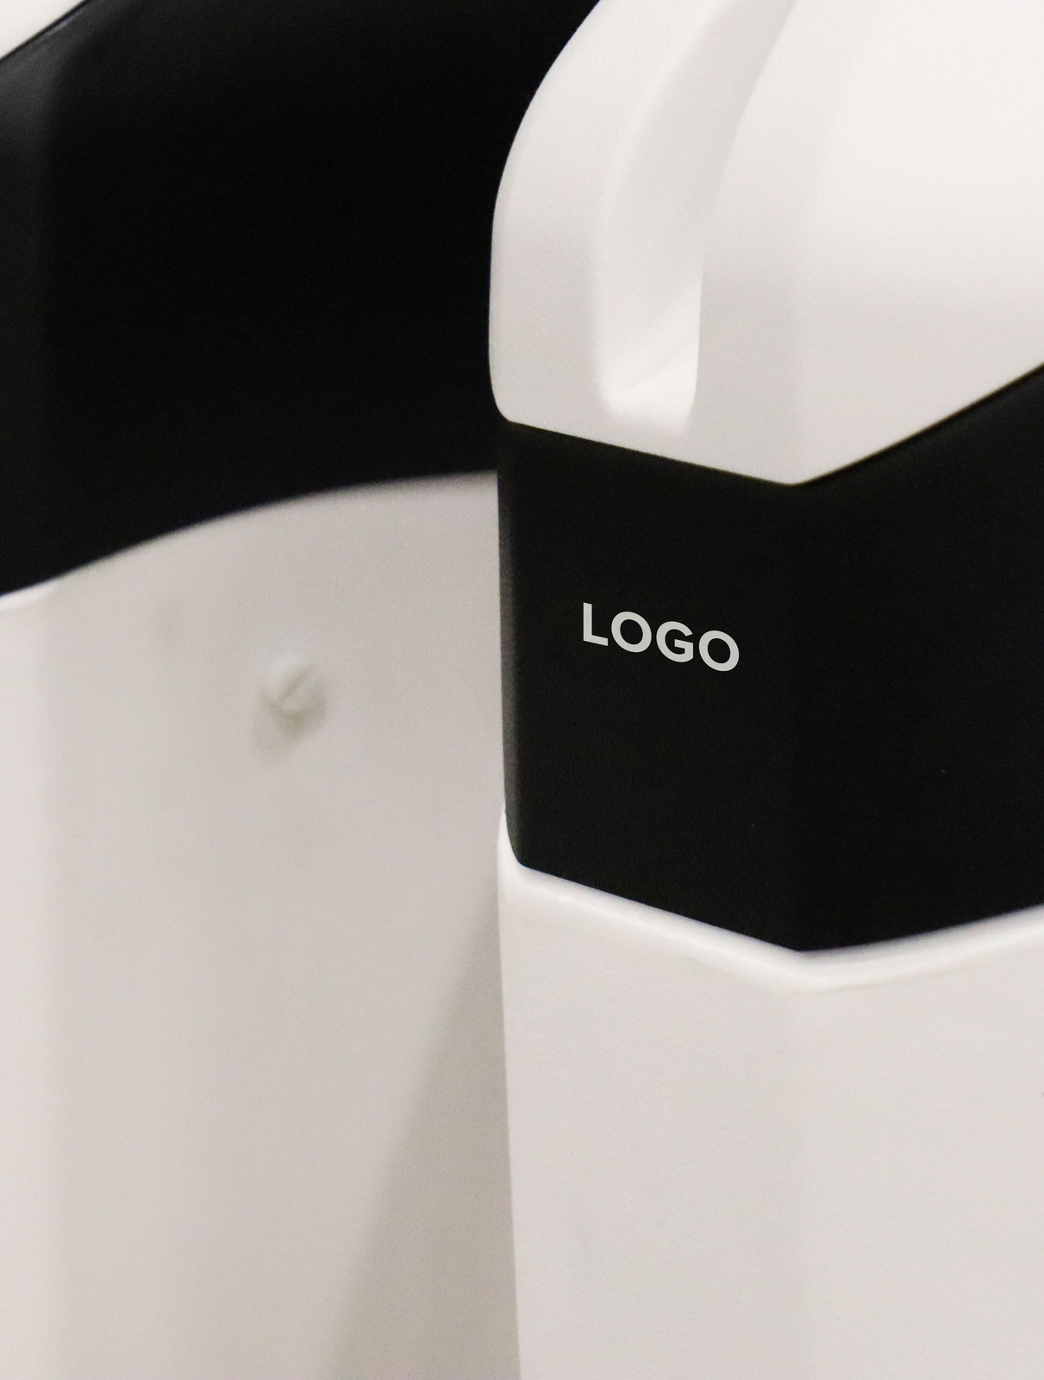
LEVEL 1
PERSONALISATION WITH LOGO
  Select your preferred combination of valve & cabinet
  Define one of our (standard) colour combination of your cabinet
  Personalise your valve or your cabinet with your logo or type label
  You supply an own design or PG Marketing creates a design for you
  Limited MOQ’s - low entry level
Notes:
limited MOQ

Slide 14
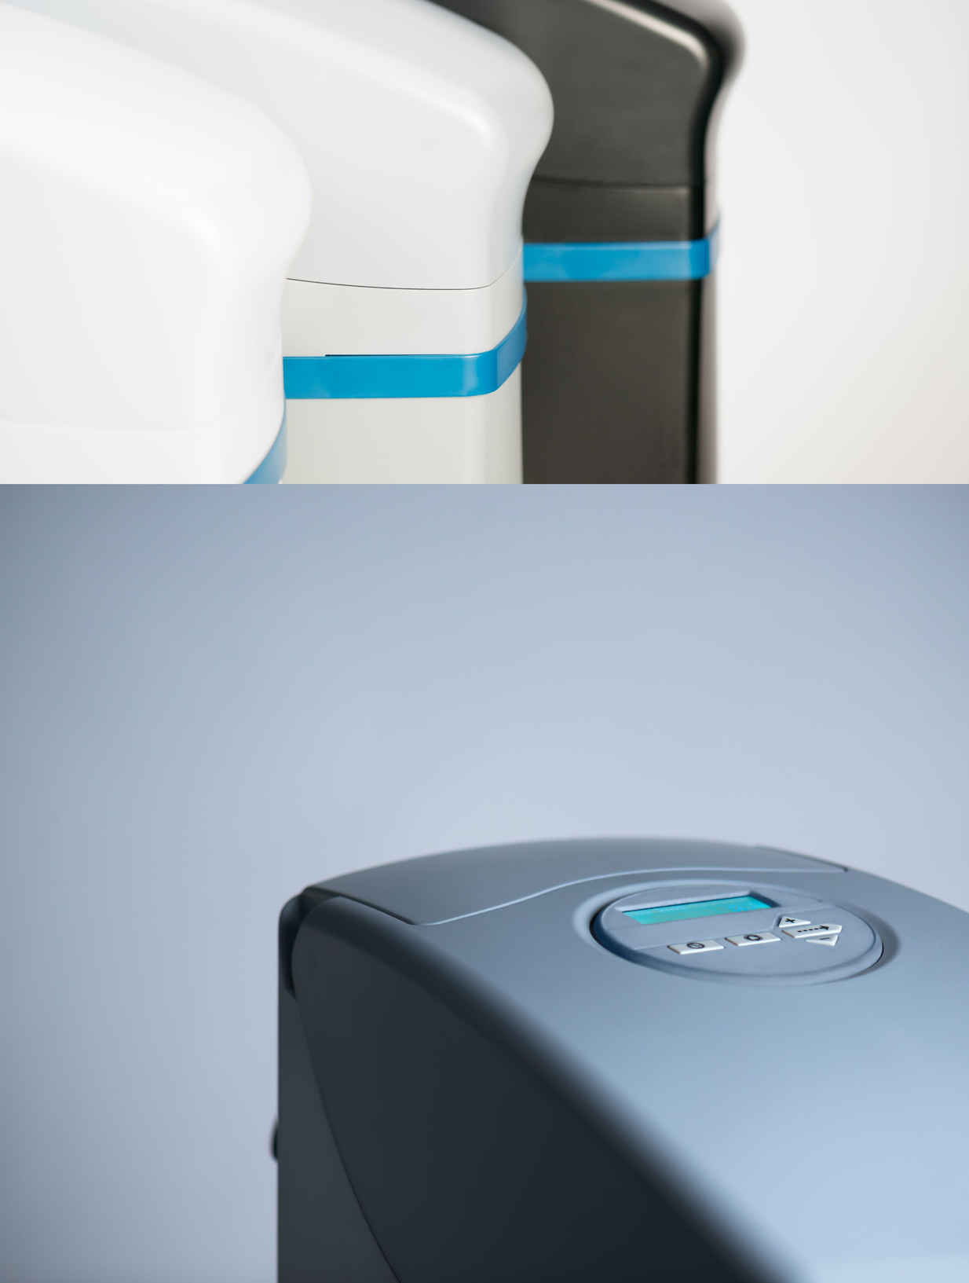
LEVEL 2
PERSONALISATION WITH LOGO ON EXCLUSIVE VALVE & CABINET COMBINATION
  You select an exclusive softener or an exclusive cabinet/ valve combination for a certain region
  Your softener can be extra personalised with labelling, transfers,...
  You supply an own design or our marketing department creates a design for you
  Discuss with your customer on MOQ

Slide 15
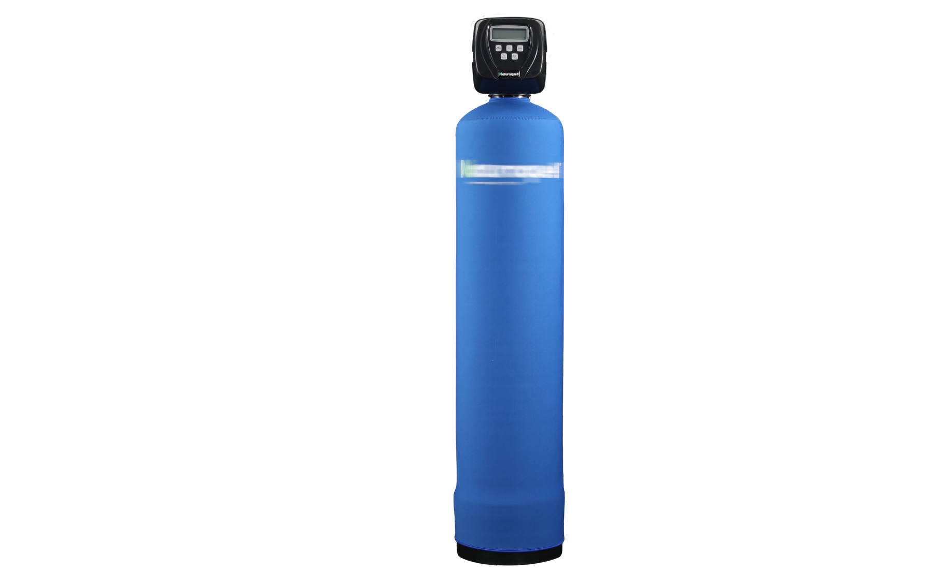
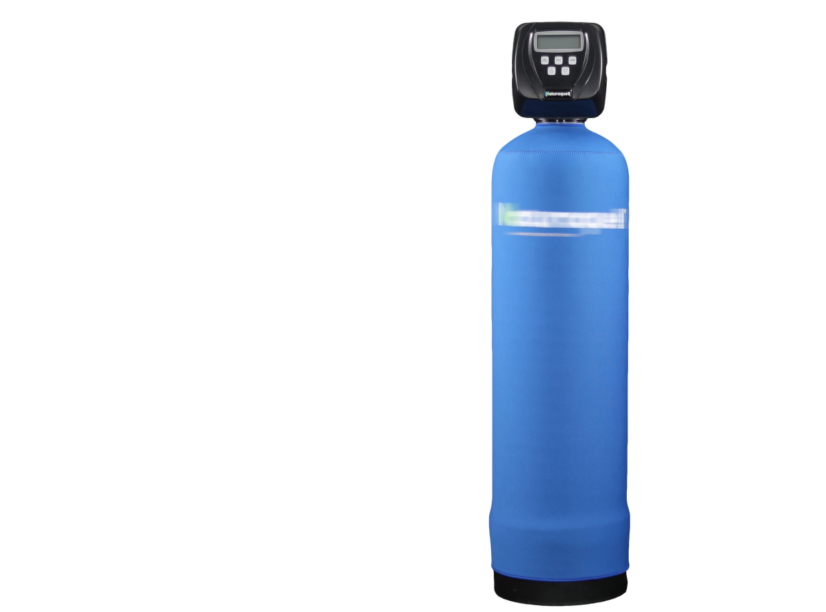
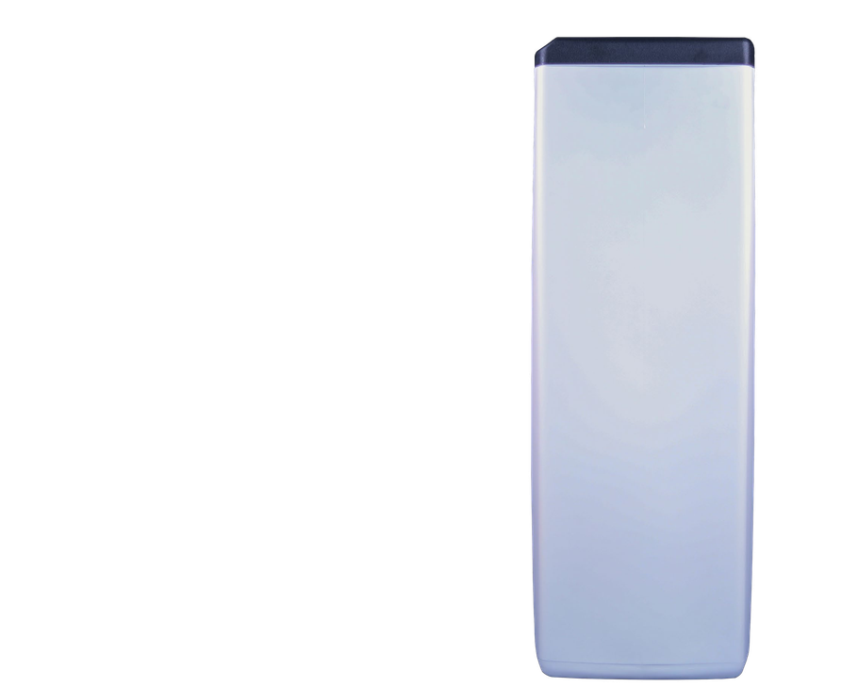
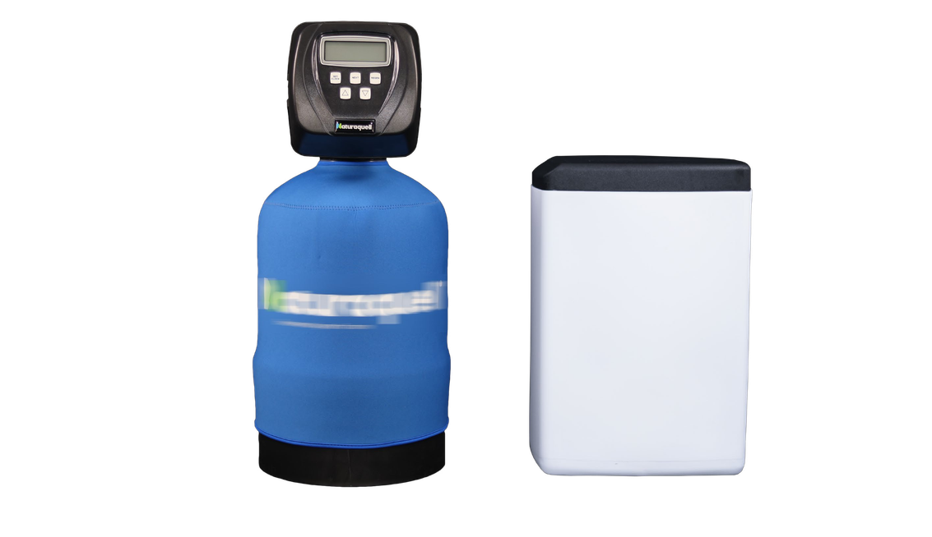
LEVEL 3
PERSONALISATION ON A SPECIAL PRODUCT SOLUTION
‘Jacket’ - ‘Personalisation’
  Based upon your requirements, we define a specific solution
  Your personalised range is a combination of unique new features with customization on labelling, colours,..
  You supply an own design or PG Marketing department creates a design
  Discuss on MOQ

Slide 16
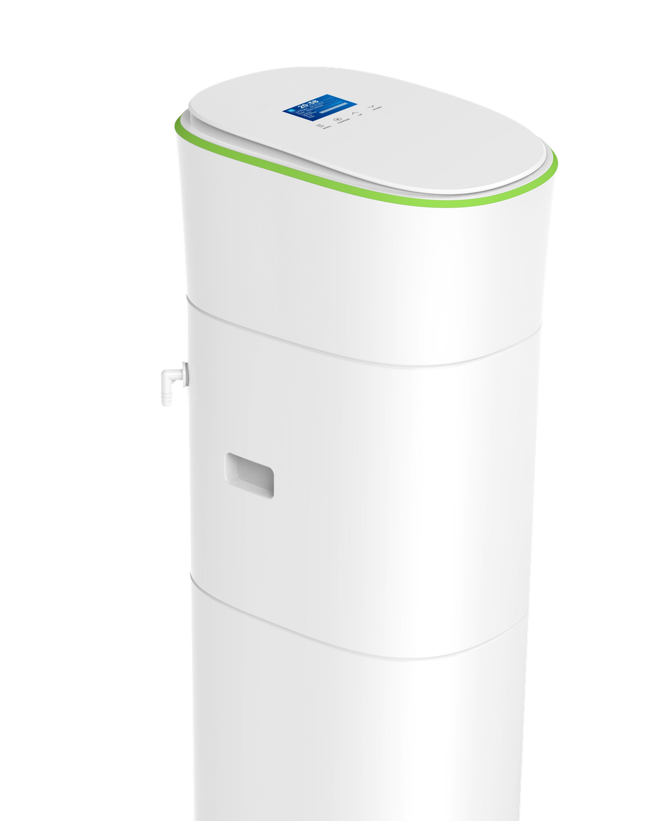
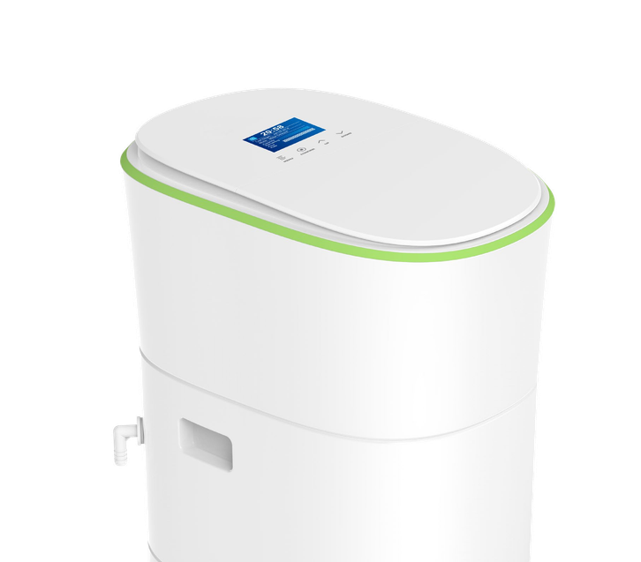
LEVEL 4
FULL-CUSTOMISATION ON AN EXCLUSIVE SOFTENER
  You receive exclusivity of a type of softener for a certain market based upon the potential
  High customisation is possible
  We design together a highly desired look & feel
  Project to work out in cooperation with your customer
  MOQ 500pcs

Slide 17
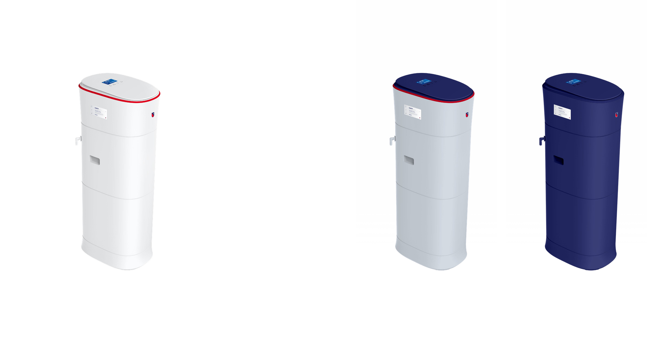
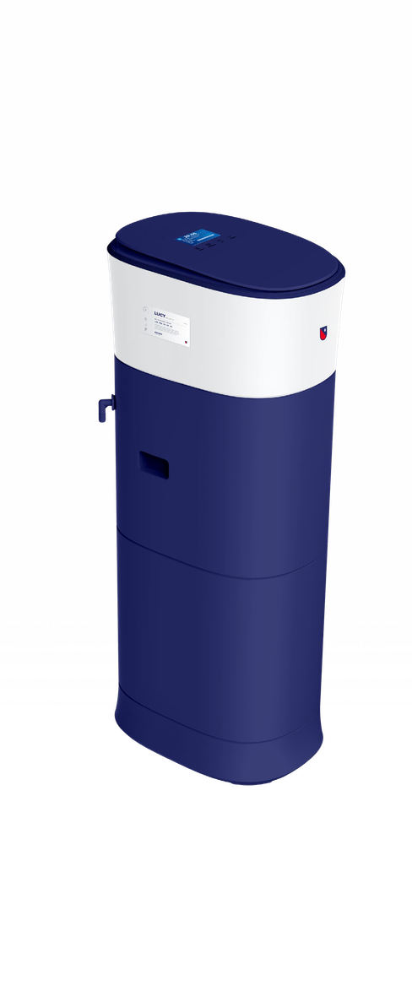
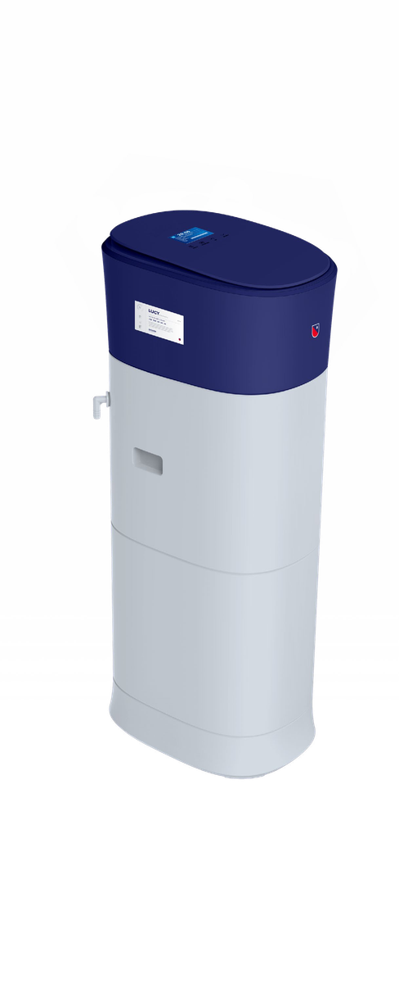

Slide 18
3
PERSONALISATION
TECHNIQUES

Slide 19
3
PERSONALISATION
TECHNIQUES
LEVEL 1
LEVEL 2
LEVEL 3
LEVEL 4
No changes to the complete product except for
  Stickers
  Dome Labels
  Lettering / Labeling
Small changes to the parts of the product, mainly valve with:
  Valve Labels
  Define quality in
    Finishing
    Print Procedure
    Embossing
Bigger changes to the standard product thanks to for example
  Special sleeves
  Specific cabinet colors
  Tampon print
  ...
Complete changes to the look & feel of the product thanks to:
  Own colours of cabinets
  Integrated valve
  Look & feel of controler
  ...

Slide 20
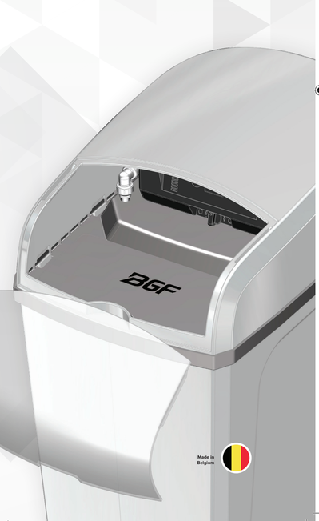
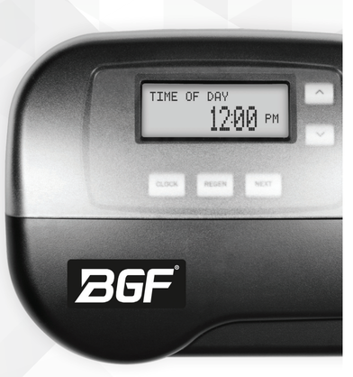
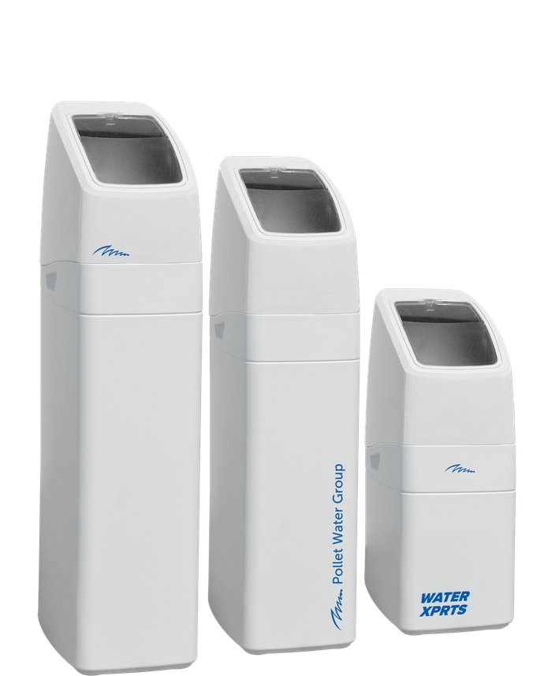
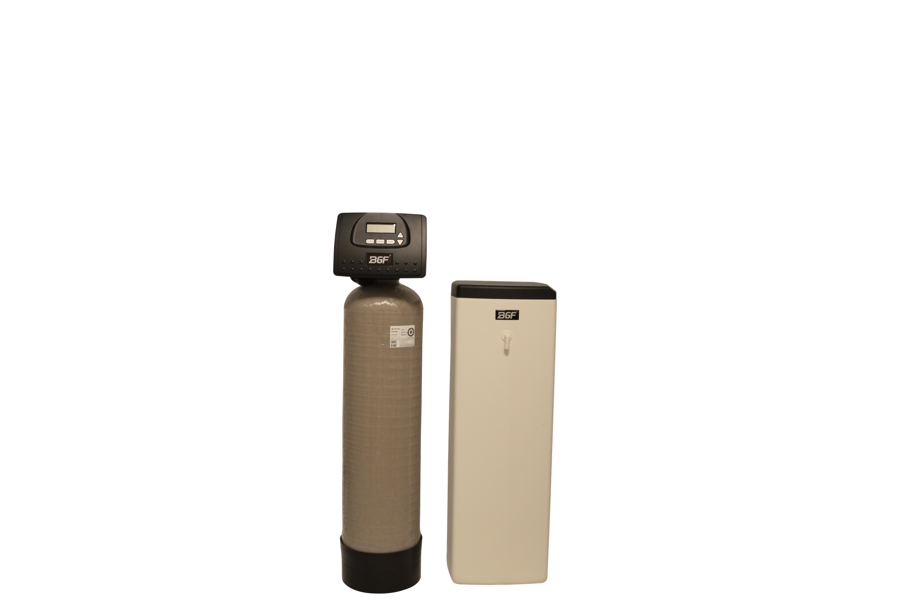





3
PERSONALISATION
TECHNIQUES
Lettering
LEVEL 1
No changes to the complete product except for
  Stickers
  Dome Labels
  Lettering / Labeling
Price indications & MOQs
Stickers
Dôme Labels & sticker
Lettering
EXAMPLES

Slide 21
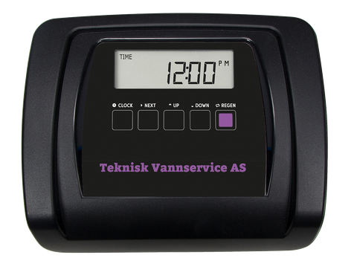
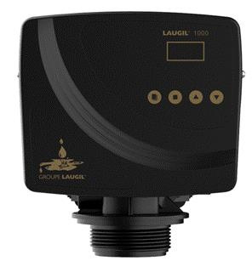
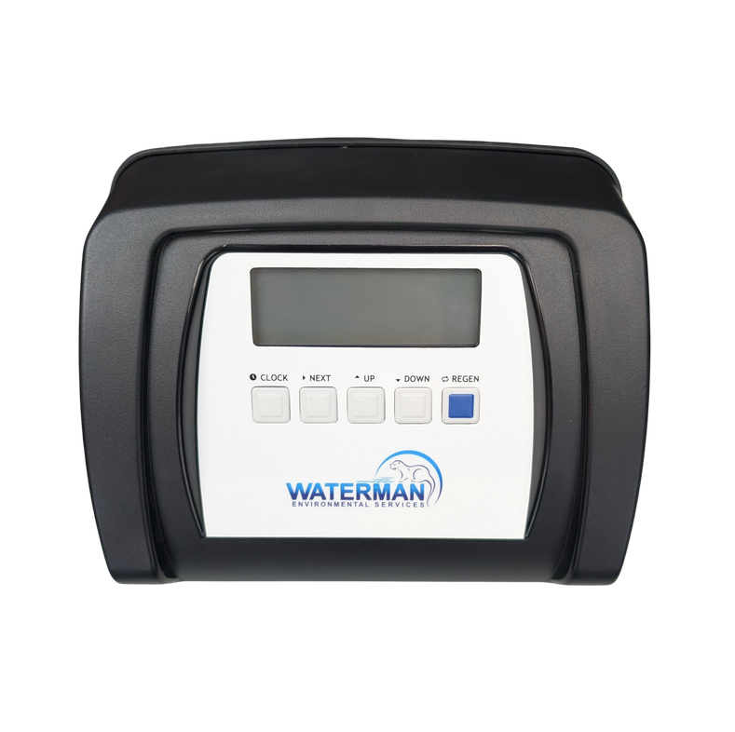
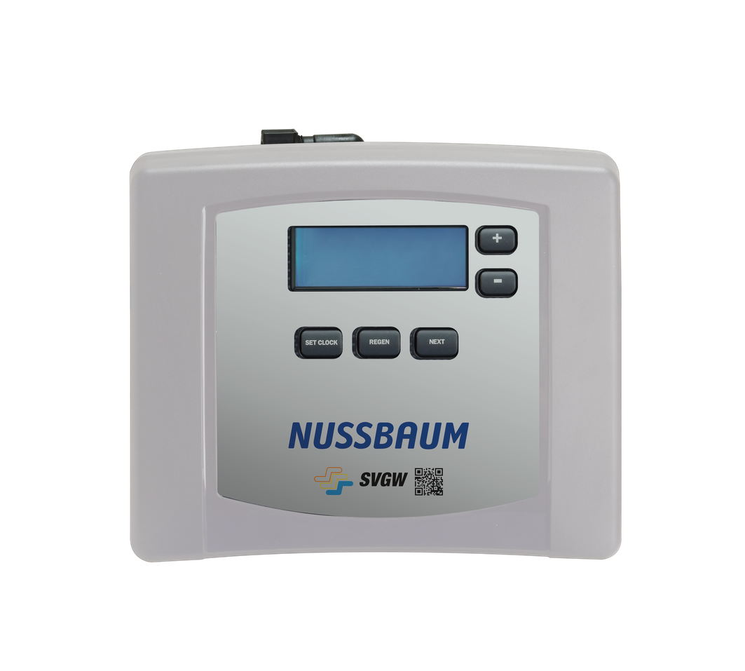
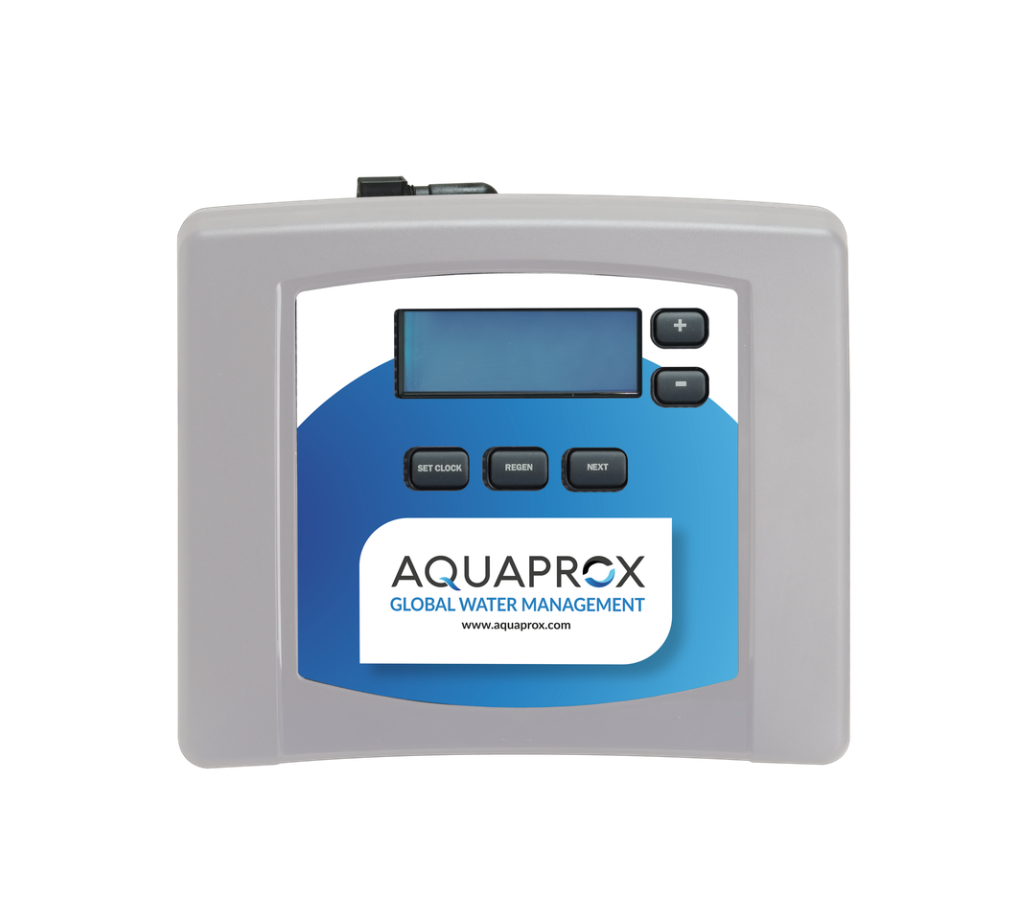
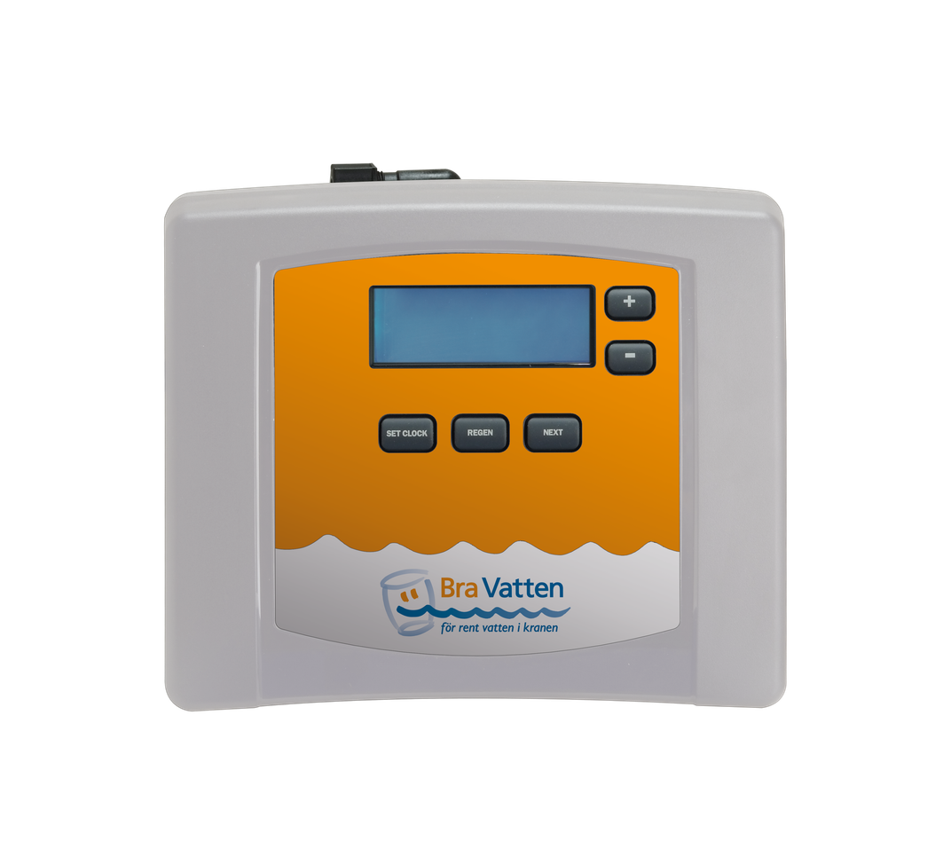
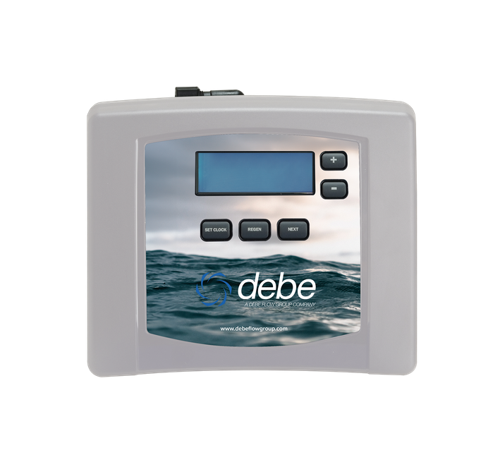
CN EMBOSSED LABEL
3
PERSONALISATION
TECHNIQUES
LEVEL 2
CANATURE/RUNXIN LABEL
Small changes to the parts of the product, mainly valve with:
  Valve Labels
  Define quality in
    Finishing
    Print Procedure - offset, digital or silk screen print
    Embossing
Price indications & MOQs
CN LABEL
EXAMPLES
IMPRESSION VALVE LABEL
Offset Print + 100 pcs
Digital Print - 50pc to 100pc
Silk Screen Print - 100% exact colour
Notes:
valve tonen vb pallas cn aquaprotect / veolia impression

Slide 22
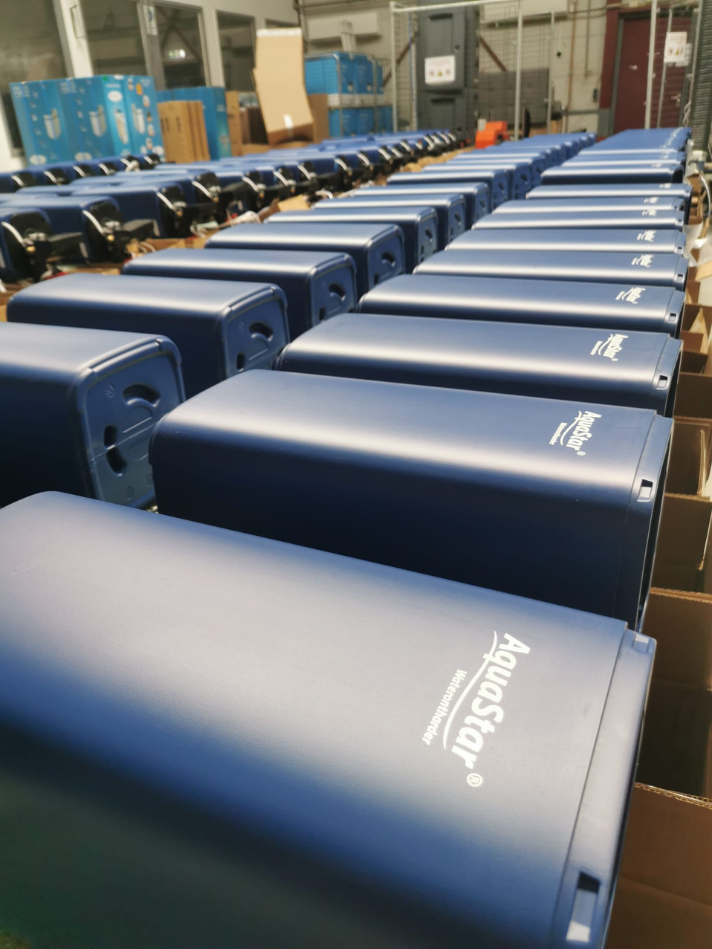
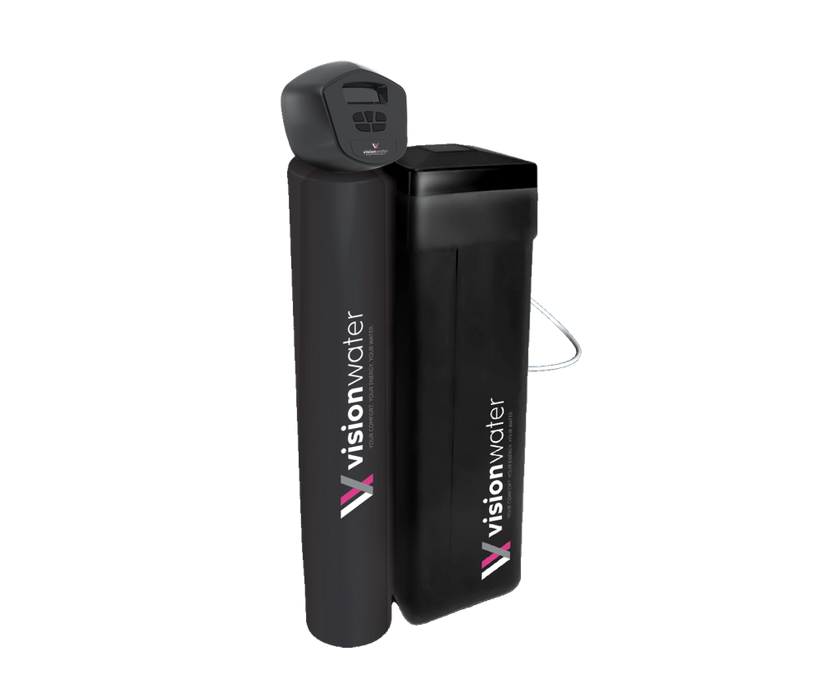
3
PERSONALISATION
TECHNIQUES
LEVEL 3
Bigger changes to the standard product thanks to for example
  Specifc lettering
  Tampon print
  Special sleeves
  Specific cabinet colors
  ...
Price indications & MOQs
EXAMPLES
Tampon Print
Special Sleeves
Lettering

Slide 23
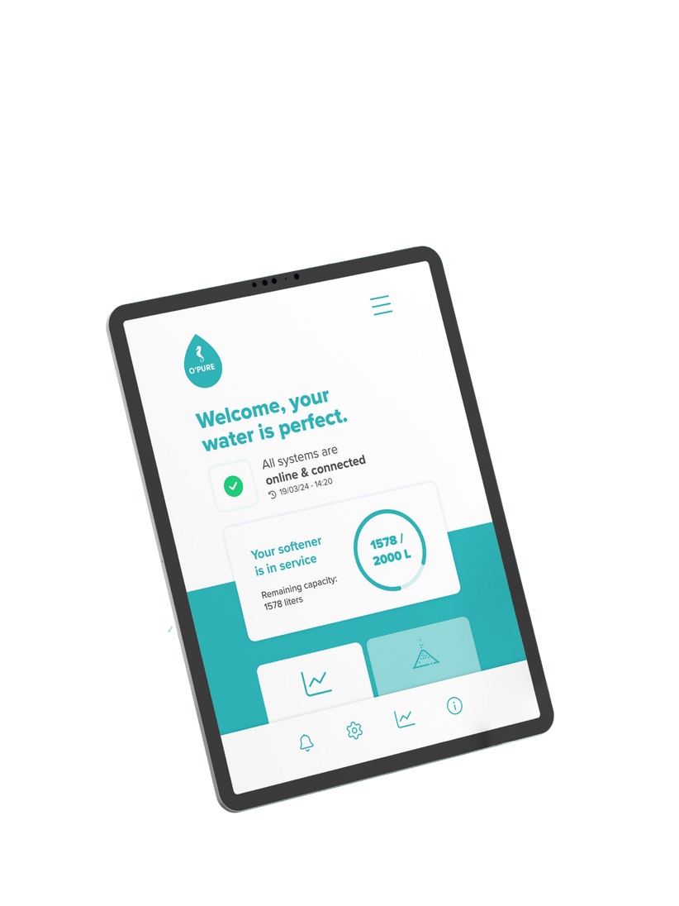
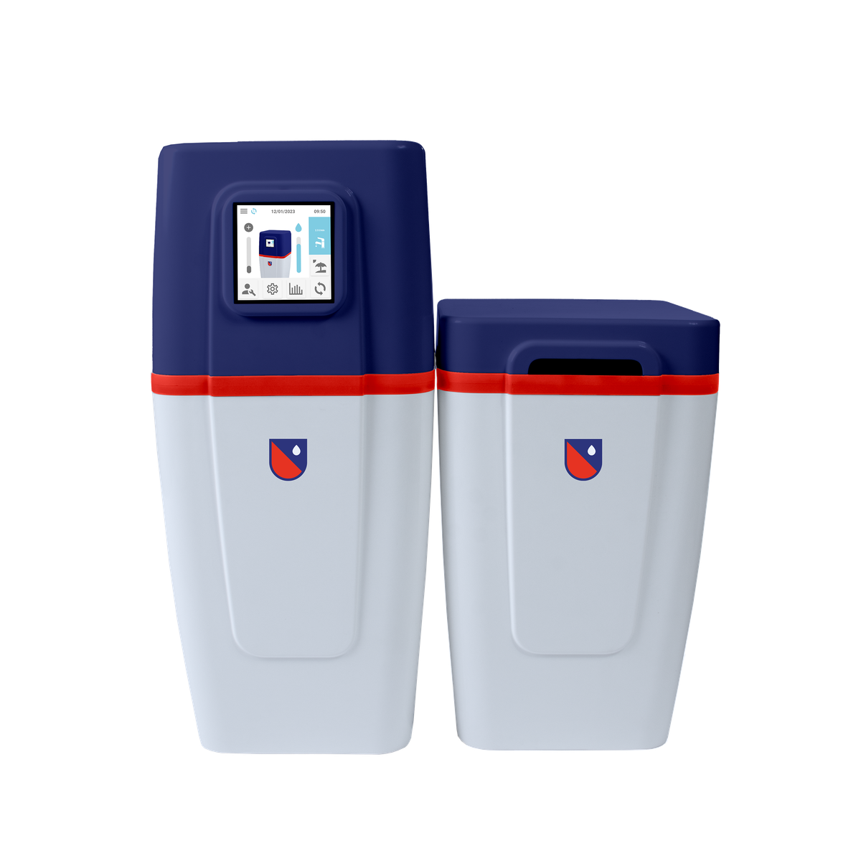
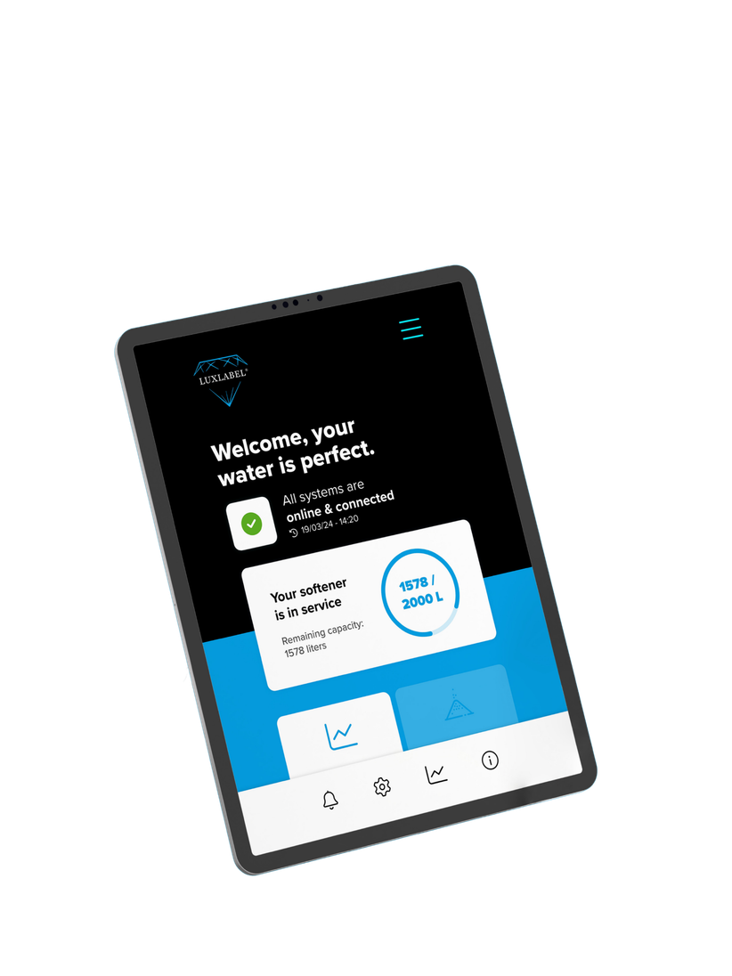
3
PERSONALISATION
TECHNIQUES
Full Own Design
Integrated valve
Own user interface
...
LEVEL 4
Complete changes to the look & feel of the product thanks to:
  Full own design
  Own mould
  Integrated valve
  Look & feel of controler
  Own user interface
  Own App
  ...
Project to be defined in cooperation
with product manager & marketing
Prices on request & MOQ
EXAMPLES
Own App

Slide 24

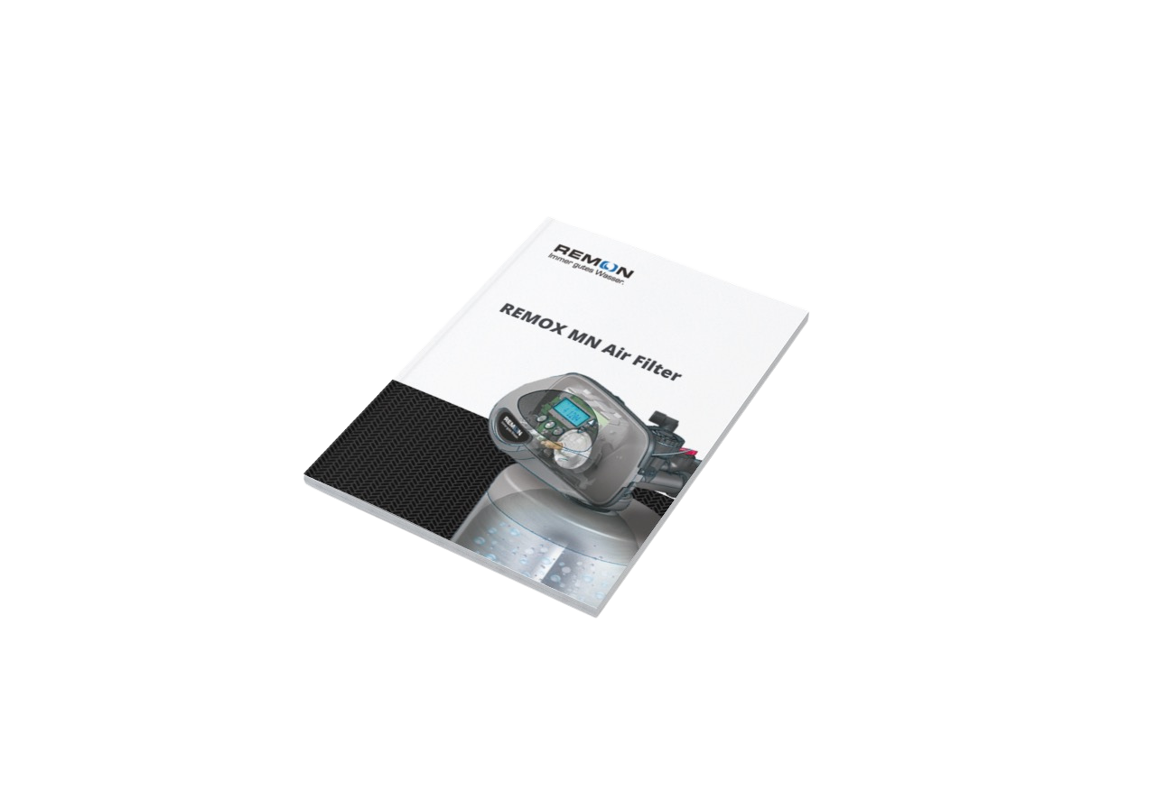
3
PERSONALISATION
TECHNIQUES
GENERAL
General Personalisation Techniques
  Manuals
  Quick Start Guides
  Packaging
  ...

Slide 25
4
EXAMPLES
IN OUR MARKET

Slide 26
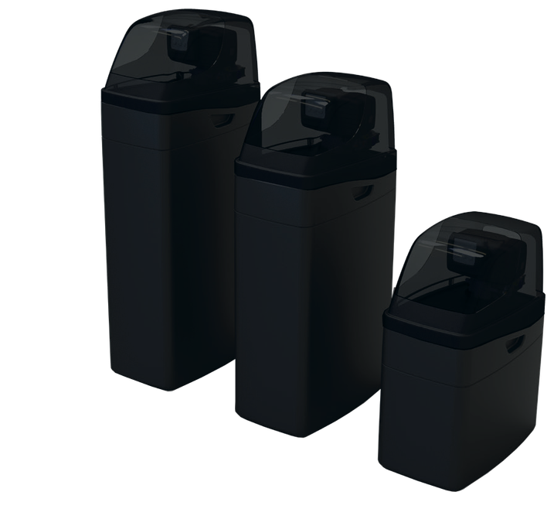
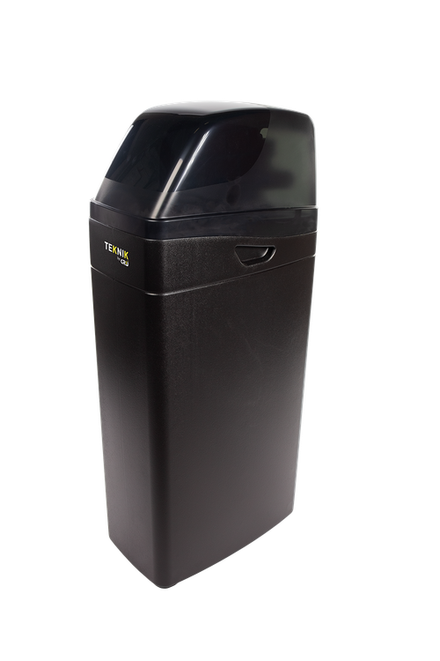
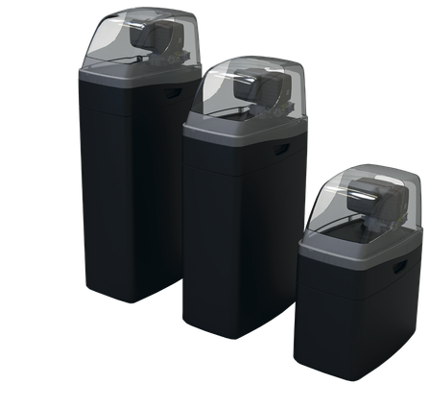
PWG MIX & MATCH SOFTENERS
LEVEL 1
PERSONALISATION WITH LOGO
BONNIE 2.0
•
Select your preferred combination of valve & cabinet
•
Select one of our standard cabinet colour
combinations
cabinet
cover
  PWG exclusive cabinet
  Complete range: midi - midi - maxi
  Semi-transparant cover - good visibility of valve
  Compatible with a great number of valves & vessels
  Small footprint Ergonomic handles to easily move the unit
  Cost competitive
semi-ransparent
•
Personalise the valve and/or cabinet with
your logo or type label
•
Discuss with your PWG Company on MOQ
• • • •

Slide 27
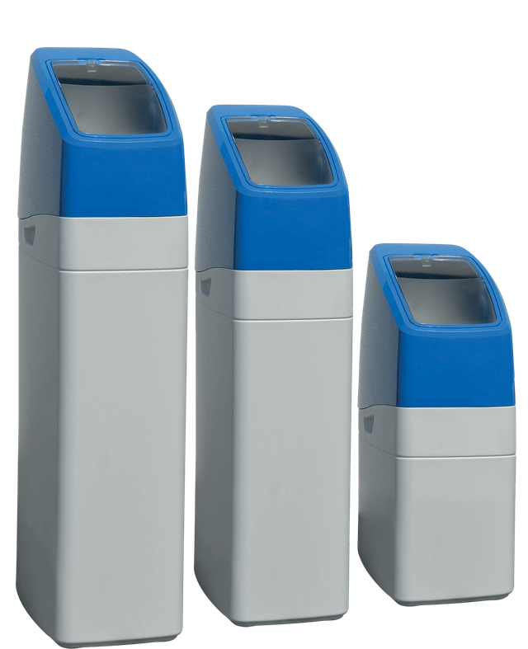
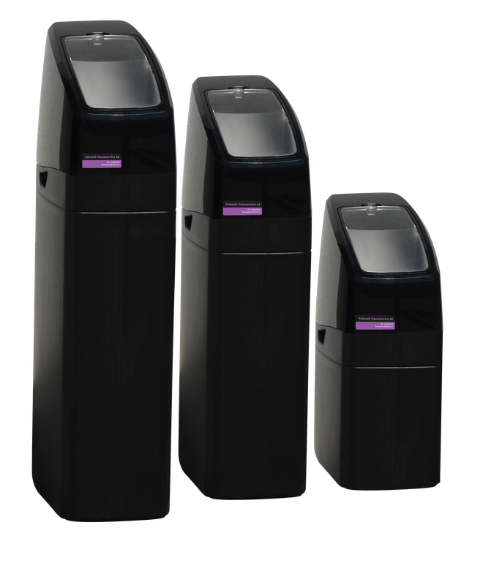
PWG MIX & MATCH SOFTENERS
LEVEL 1
PERSONALISATION WITH LOGO
EVA
•
Select your preferred combination of valve & cabinet
•
Select one of our standard cabinet colour
combinations
cabinet
cover
  PWG exclusive cabinet
  Versatile cabinet, compatible with a great number of valves & vessels
  Great looking cabinet with glossy cover Small footprint
  User-friendly assembling
  Complete range: mini / midi / maxi Optional valve protection
  Ergonomic handles to easily move the unit
•
Personalise the valve and/or cabinet with
your logo or type label
•
Discuss with your PWG Company on MOQ

Slide 28
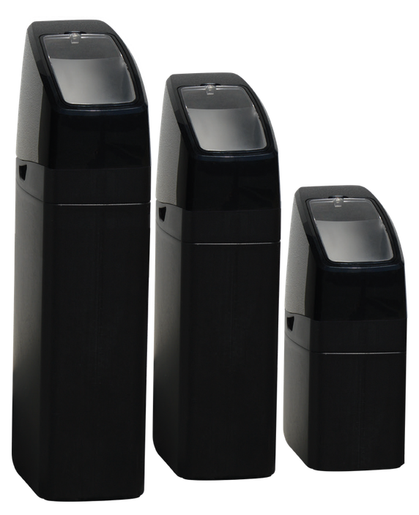
PWG MIX & MATCH SOFTENERS
LEVEL 2
PERSONALISATION WITH LOGO ON EXCLUSIVE VALVE & CABINET
EVA
•
Select an exclusive cabinet/valve combination for a certain region
  PWG exclusive cabinet
  Versatile cabinet, compatible with a great number of valves & vessels
  Great looking cabinet with glossy cover
  Small footprint
  User-friendly assembling
  Complete range: mini / midi / maxi Optional valve protection
  Ergonomic handles to easily move the unit
•
Select one of our standard cabinet colour
combinations
cabinet
cover
•
Your softener can be extra personalised
with labelling, transfers, …
IMPRESSION PRO
•
Discuss with your PWG Company on MOQ

Slide 29
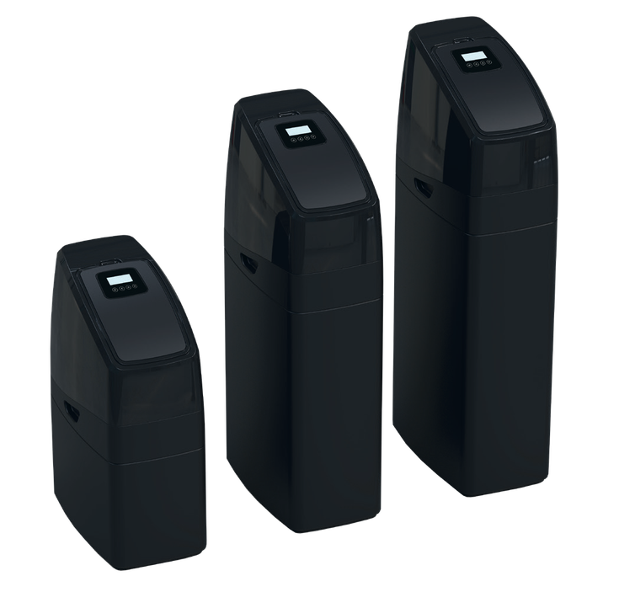
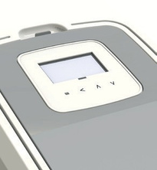
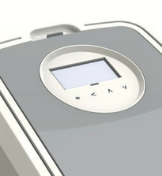
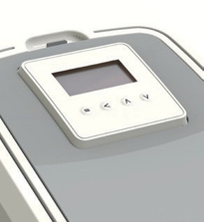
PWG MIX & MATCH SOFTENERS
LEVEL 2
PERSONALISATION WITH LOGO ON EXCLUSIVE VALVE & CABINET
JANE CDK
•
Select an exclusive softener or an exclusive cabinet/valve combination for a certain region
  PWG exclusive softener
  Complete range: midi - midi - maxi
  Integrated Runxin F79 valve in cabinet cover
  Perfect integration cover & cabinet
  Clean & modern design (shiny cover)
  Easy salt filling due to tilting salt lid
  Handles on unit for easy handling
  Premium LCD touch screen display
  Chlorinator for disinfection
  3 Different timer designs
• • • • • • • • • •
•
Select a colour combination. Standard:
cabinet / cover
salt lid
•
Your softener can be extra personalised
with labelling, transfers, …
•
Discuss with your PWG Company on MOQ

Slide 30
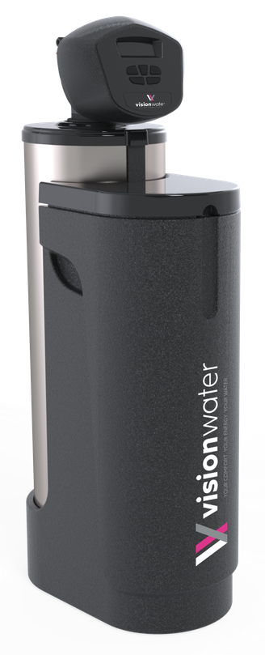
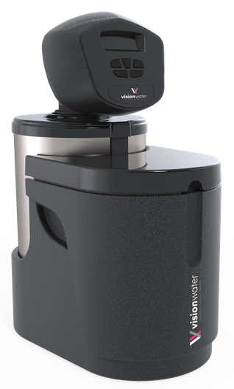
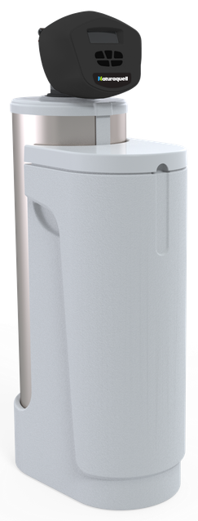
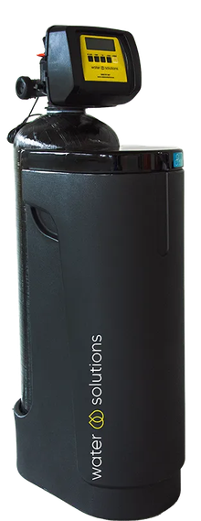
PWG TAILORED SOFTENERS
LEVEL 3
PERSONALISATION ON A SPECIAL PRODUCT SOLUTION
VISION WATER
•
Based upon your requirements, we define a specific solution
  PWG exclusive softener
  Complete range: mini - maxi
  Classic or integrated duobloc
  Versatile cabinet, compatible with a great number of valves
  Small footprint
  Separate vessel
  Option inox sleeve on vessel
•
Your personalised range is a combination of unique new
features with customization on labelling, colours,..
•
Discuss with your PWG Company on MOQ
Notes:
Level 3 voorbeelden: Veolia, Visionwater, aquaprotect

Slide 31
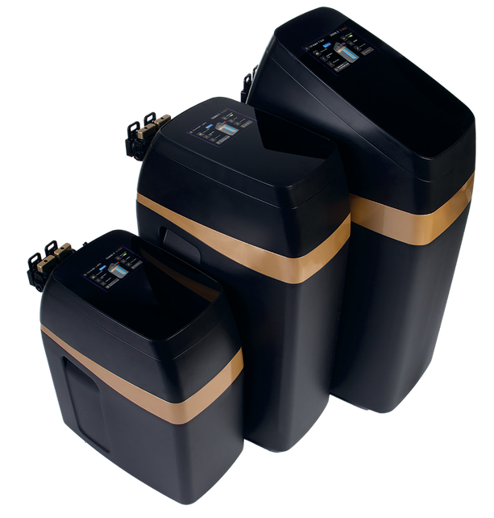





PWG SOURCED SOFTENERS
LEVEL 4
FULL-CUSTOMISATION ON A EXCLUSIVE SOFTENER
UMA
•
You receive exclusivity of a type of
  PWG exclusive softener
  Intelligent softener with proportional regeneration technology
  Complete range: midi - midi - maxi
  Integrated touch screen
  Real-time view of the softener’s operation
  Bluetooth application to monitor the softener from a distance
  Territory exclusivity (commitment on volume) No internet sales
softener for a certain market based upon
the potential and the yearly order
quantity vs MOQ
•
High level of customisation is possible
PERSONALISATION APP & INTERFACE
Follow-up on your water consumption and manage your softener from a distance with our Bluetooth application. Download, log in and access all your water data.
Notes:
Level 3 voorbeelden: Veolia, Visionwater, aquaprotect

Slide 32







PWG SOURCED SOFTENERS
LEVEL 4
FULL-CUSTOMISATION ON A EXCLUSIVE SOFTENER
UMA WALL MOUNTED
LUCY
•
You receive exclusivity of a type of
softener for a certain market based upon
the potential and the yearly order
quantity vs MOQ
•
High level of customisation is possible
ROBIN
LILY
SELENA

Slide 33







PWG OWN MANUFACTURED SOFTENERS
LEVEL 4
FULL-CUSTOMISATION ON A PROPRIETARY SOFTENER
UMI
•
  PWG in-house manufactured solution
  Proprietary PWG design & technology
  Mini 10L
  Very compact duobloc softener
  4” touch screen integrated or remote mounting
  Intuitive programming
  Bluetooth connectivity with smartphone App
  Made in Europe
You receive exclusivity of a type of
softener for a certain market based upon
the potential and the yearly order
quantity vs MOQ
•
High level of customisation is possible
PERSONALISATION APP & INTERFACE

Slide 34





PWG OWN MANUFACTURED SOFTENERS
LEVEL 4
FULL-CUSTOMISATION ON A PROPRIETARY SOFTENER
LUCA
ATHENA
•
You receive exclusivity of a type of
softener for a certain market based upon
the potential and the yearly order
quantity vs MOQ
•
High level of customisation is possible
ONEGA

Slide 35
5
MOQ &
PRICE INDICATION

Slide 36
5
MOQ &
PRICE INDICATION
LEVEL 1
Personalisation with logo
LEVEL 2
Personalisation with logo on exclusive valve & cabinet combination
  Stickers
    Price - approx. €
    MOQ - approx. pcs
  Dome Labels
    Price approx. €
    MOQ - approx. pcs
  Lettering / Labeling
    Price approx. €
    MOQ - approx. pcs
Back to level 1
  Valve Labels
    Price - approx €
    Finishing
    Print Procedure
      digital - MOQ min. pcs
      silk screen - MOQ & prices on request
    Embossing
  Other labels on request
Back to level 2
Notes:
Level 4: ON request + MOQ indicatie (vanaf 500 pcs)

Slide 37
5
MOQ &
PRICE INDICATION
LEVEL 3
Personalisation on a special product solution or product
LEVEL 4
Full-customisation on an exclusive softener
  Specific lettering
    Price - approx. €
    MOQ’s - pcs
  Tampon print
    Price - approx - €
    MOQ - pcs
  Special sleeves
    Price - approx - €
    MOQ - pcs
  More options on request
Back to level 3
  Project based
  In cooperation with the customer
  MOQ & prices on request
Back to level 4

Slide 38
6
PRACTICAL INFO

Slide 39
2
PRACTICAL INFO
6
Supply your logo & corporate/brand guidelines to create the perfect personalisation
  Logo - vector file (SVG, AI, EPS or a vector-based PDF)
  Fonts
  Colors
  ...

Slide 40
Q
QUESTIONS
REMARKS
Notes:
add slide where to find the ppt. Use this presentation as an external communication tool and use slides corresponding to type of client
Extra slide: take aways
kort stappenplan - practical implementation

