Slide 1
New Runlucky Residential Products
June 2021

Slide 2
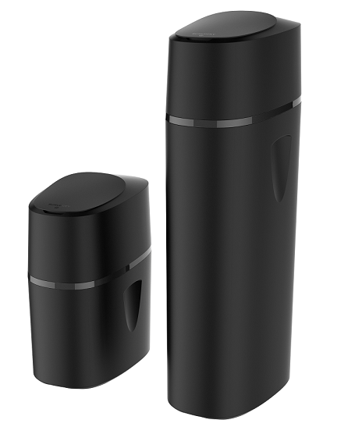
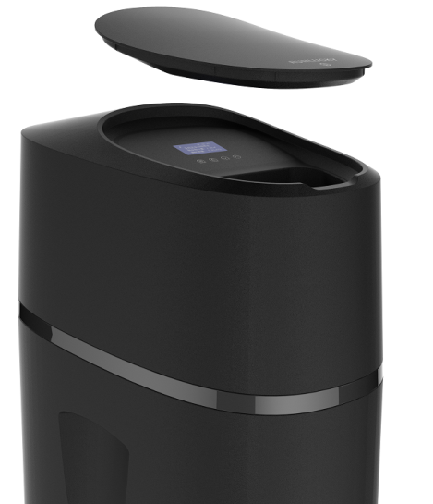
New Residential Softener (Q series)
Characteristics
Using 3.5 inch LCD display, touch buttons;
Suitable to 0913/1013 and 1035 resin tanks;
Can be connected to wifi, and controlled by mobile app;
Intelligent anti-leakage and real-time anti-leakage functions;
Product size: length 450mm*width 320mm*height 555(1116)mm.
Notes:
Q系列软水机特点
1. 采用3.5寸LCD显示，触摸按键；
2. 适配0913/1013和1035树脂罐；
3. 可连接wifi，手机app操控；
4. 智能防泄漏和实时防泄漏功能;
5. 产品尺寸长450mm*宽320mm*高555(1116)mm

Slide 3
New Residential Softener (Q series)
Specification
Model | R60Q/80Q | R150Q
Service flow rate m3/h | 0.5-1.2/0.8-1.5 | 1.0-3.0
Working pressure MPa | 0.15-0.6 | 0.15-0.6
Inlet/outlet | G3/4 | G3/4 or G1
Tank（in） | 0913/1013 | 1035
Resin (L) | 8/10 | 28
Total water treatment capacity m3 | 2.1/2.5 | 7.0
Outlet water hardness mmol/L | ≤0.6 | ≤0.6
Appearance (length*width*height) | 450*320*555 | 450*320*1116
Application | Family of 2-3 people, medium and small-sized house with 1 bathroom) | Family of 3-5 people, apartment/villa and small commercial house with 1-2 bathroom
Notes:
Q系列软水机特点
1. 采用3.5寸LCD显示，触摸按键；
2. 适配0913/1013和1035树脂罐；
3. 可连接wifi，手机app操控；
4. 智能防泄漏和实时防泄漏功能;
5. 产品尺寸长450mm*宽320mm*高555(1116)mm

Slide 4
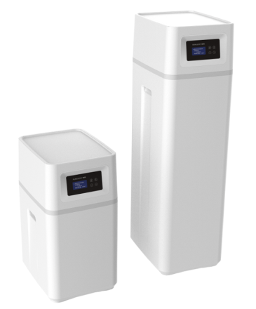
New Whole House Water Filter(S series)
Characteristics
Model is matched with S water softener;
Suitable to 1015 and 1035 resin tanks;
Can be connected to wifi, and controlled by mobile app;
Intelligent anti-leakage and real-time anti-leakage functions;
Product size: length 380mm*width 300mm*height 537(1047)mm.
Model | RL-J55S | RL-J120S
Suggested flow rate m3/h | 0.5-1.2 | 0.8-2.0
Working pressure MPa | 0.15-0.6 | 0.15-0.6
Inlet/outlet | ¾” | ¾”
Tank（in） | 1015 | 1035
Filter material(L) | 10L activated carbon | 4L quartz sand +22L activated carbon
Appearance (length*width*height) | 380mm*300mm*537mm | 380mm*300mm*1047mm
Notes:
S系列中央净水机特点
1. 机型与S款软水机配套；
2. 树脂罐为1015和1035；
3. 可连接wifi，手机app操控；
4. 智能防泄漏和实时防泄漏功能;
5. 产品尺寸长380mm*宽300mm*高537(1047)mm

Slide 5
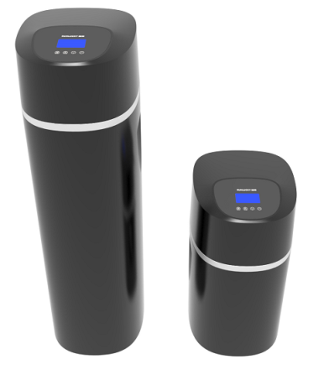
New Whole House Water Filter(Q series)
Characteristics
Model is matched with Q water softener;
Suitable to 1017 and 1035 resin tanks;
Can be connected to wifi, and controlled by mobile app;
Intelligent anti-leakage and real-time anti-leakage functions;
Product size: length 360mm*width 318mm*height 588(1049)mm.
Model | RL-J60Q | RL-J120Q
Suggested flow rate m3/h | 0.6-1.5 | 0.8-2.0
Working pressure MPa | 0.15-0.6 | 0.15-0.6
Inlet/outlet | ¾” | ¾”
Tank（in） | 1017 | 1035
Filter material(L) | 4L quartz sand+7L activated carbon | 4L quartz sand+22L activated carbon
Appearance (length*width*height) | 360mm*318mm*588mm | 360mm*318mm*1049mm
Notes:
S系列中央净水机特点
1. 机型与Q款软水机配套；
2. 树脂罐为1017和1035；
3. 可连接wifi，手机app操控；
4. 智能防泄漏和实时防泄漏功能。
5. 产品尺寸长360mm*宽318mm*高588(1049)mm

Slide 6
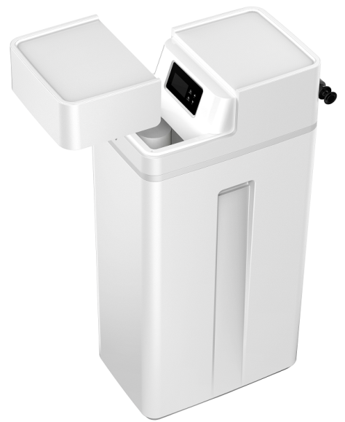
Complete Machine Combined Filtration and Softening(R120S)
Characteristics
The first grade is the parallel connection of two carbon fiber membranes, and the independent water outlet is used in the kitchen. The filtration accuracy is: 0.2-0.3um, and the carbon fiber membrane can be replaced quickly.
The second grade is soften water for other bathing water in the whole house. The regeneration method is soft water regeneration, and it has dry salt mode, raw water bypass during regeneration, and salt shortage alarm functions;
Water inlet and outlet ports are 3/4” screw, and the product size is: length 520mm*width 355mm*height 1048mm.
Notes:
第一级为两支碳纤维膜并联出水，独立的出水接口供厨房使用,过滤精度为：0.2-0.3um、碳纤维膜快速更换设计；
第二级软化出水供全屋其它洗浴等用水， 再生方式为补软水再生、干盐箱模式、再生时出原水、缺盐提醒功能；
进出水接口为6分外螺，产品尺寸为：长520mm*宽355mm*高1048mm

Slide 7
Complete Machine Combined Filtration and Softening(R120S)
The calculation formula of the total water capacity of complete machine combined filtration and softening:
Total water capacity (unit L) = residual chlorine adsorption capacity value (g/L)*1000/raw water residual chlorine value (mg/L)
Set according to the test data of parallel double tanks: the residual chlorine adsorption value is 100g/L.
For example: the residual chlorine value of raw water is 0.5mg/L
Total water capacity L=100*1000/0.5=200000L, that is, 200T.
Add a sub-menu at the foreground:
Raw water residual chlorine content setting, the setting range is: 0.1-10mg/L, the default is: 0.5mg/L;
Add a sub-menu in the background:
Filter material residual chlorine adsorption capacity value setting, unit: g/L, the setting range is: 50-200g/L, the default is: 100g/L;
Notes:
净软一体机总制水量计算公式：
总制水量（单位L）=余氯吸附能力值（g/L）*1000/原水余氯值（mg/L）
根据并联双罐测试数据设定：余氯吸附值能力值为100g/L
例如：原水余氯值0.5mg/L
则总制水量L=100*1000/0.5=200000L,即200吨。
前台增加一个子菜单：
原水余氯含量设置，设置范围为：0.1-10mg/L，默认为:0.5mg/L；
后台增加一个子菜单：
A)滤料余氯吸附能力值设置，单位为：g/L，设置范围为：50-200g/L，
默认为：100g/L；

Slide 8
Complete Machine Combined Filtration and Softening(R120S)
Model | RL-R120S
Suggested flow rate m3/h | 1.0-2.0
Working pressure MPa | 0.15-0.6
Inlet/outlet | ¾”
Tank（in） | 0935
Filter material(L) | 23L resin
Carbon rod specification | 15 inch
Power adapter | Input: AC100-240V/50-30Hz Output: DC12V,1.5A
Appearance (length*width*height) | 520mm*355mm*1048mm

Slide 9
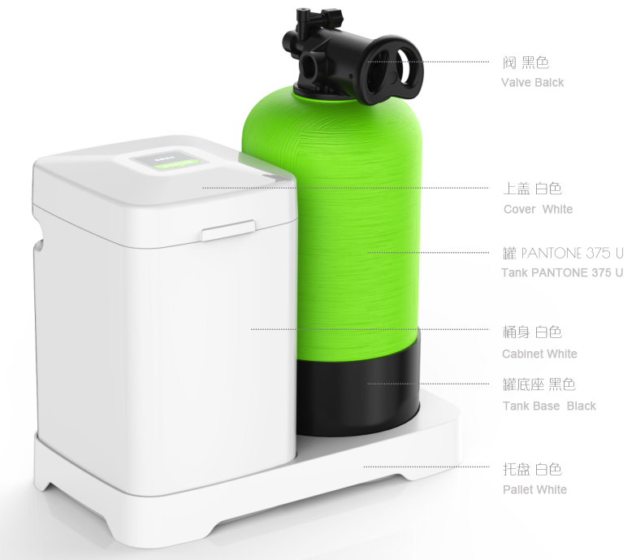
T Series Residential Softener(RL-R60T)
Characteristics
Configuration: 0817 FRP tank, F64BC manual control valve
Specification: length 475mm*width 265mm*height 535mm;
Characteristics: manual control, no electricity needed; small, economical and practical.
Notes:
配置：0817玻璃钢罐，F64BC手动控制阀
规格：长475mm x 宽265mm x 高535mm
特点：手动控制，无需用电；小巧、经济、实用。

Slide 10
T Series Residential Softener(RL-R60T)
Model | RL-R60
Suggested flow rate m3/h | 0.5-1.2
Working temperature ℃ | 5~38
Working pressure MPa | 0.15-0.6
Inlet/outlet | ¾”
Tank（in） | 0817
Resin(L) | 8L
Total water treatment capacity m3 | 2.1
Outlet water hardness mmol/L | ≤0.6
Appearance (length*width*height) | 475mm*265mm*535mm
Application | Family of 1-3 people, apartment with 1 bathroom，medium and small-sized house
Notes:
配置：0817玻璃钢罐，F64BC手动控制阀
规格：长475mm x 宽265mm x 高535mm
特点：手动控制，无需用电；小巧、经济、实用。

Slide 11
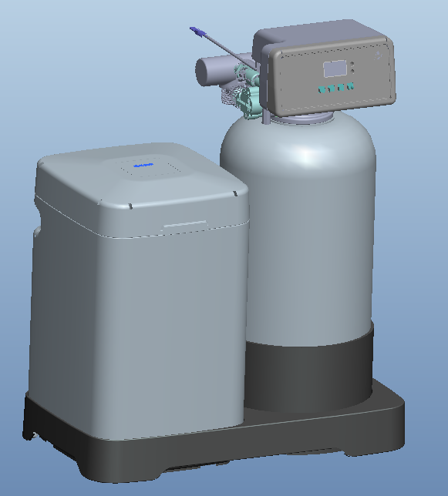
T Series Residential Softener(RL-R60T)
Characteristics
Configuration: 0817 FRP tank, F117Q3 control
Specification: length 475mm*width 265mm*height 566.5mm;
Characteristics: automatic control regeneration, no electricity needed; small, economical and practical.
Notes:
配置：0817玻璃钢罐，F64BC手动控制阀
规格：长475mm x 宽265mm x 高535mm
特点：手动控制，无需用电；小巧、经济、实用。

Slide 12
T Series Residential Softener(RL-R60T)
Model | RL-R60
Suggested flow rate m3/h | 0.5-1.2
Working temperature ℃ | 5~38
Working pressure MPa | 0.15-0.6
Inlet/outlet | ¾”
Tank（in） | 0817
Resin(L) | 8L
Total water treatment capacity m3 | 2.1
Outlet water hardness mmol/L | ≤0.6
Power adapter | Input: AC100-240V/50-30Hz Output: DC12V,1.5A
Appearance (length*width*height) | 475mm*265mm*566.5mm
Application | Family of 1-3 people, apartment with 1 bathroom，medium and small-sized house

Slide 13
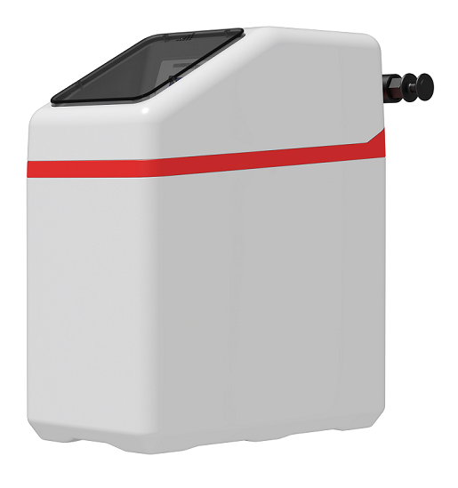
Residential Softener under Cabinet
Model | RL-R55P
Suggested flow rate m3/h | 0.5~1.0
Working pressure MPa | 0.15-0.6
Inlet/outlet | ¾”
Tank（in） | 0815
Filter material(L) | 7L resin
Carbon rod specification | 15 inch
Power adapter | Input: AC100-240V/50-30Hz Output: DC12V,1.5A
Appearance (length*width*height) | 430mm*240mm*506mm

Slide 14
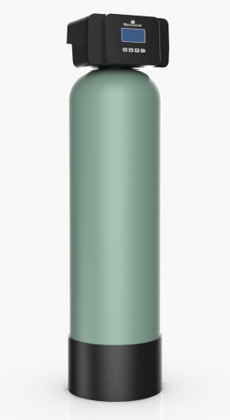
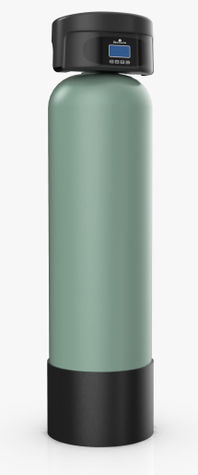
New Appearance Residential Valve
3.5 inch LCD display;
Suitable for control valve F67、F63、F68.
New Appearance A
New Appearance B
Notes:
配置：0817玻璃钢罐，F64BC手动控制阀
规格：长475mm x 宽265mm x 高535mm
特点：手动控制，无需用电；小巧、经济、实用。

Slide 15
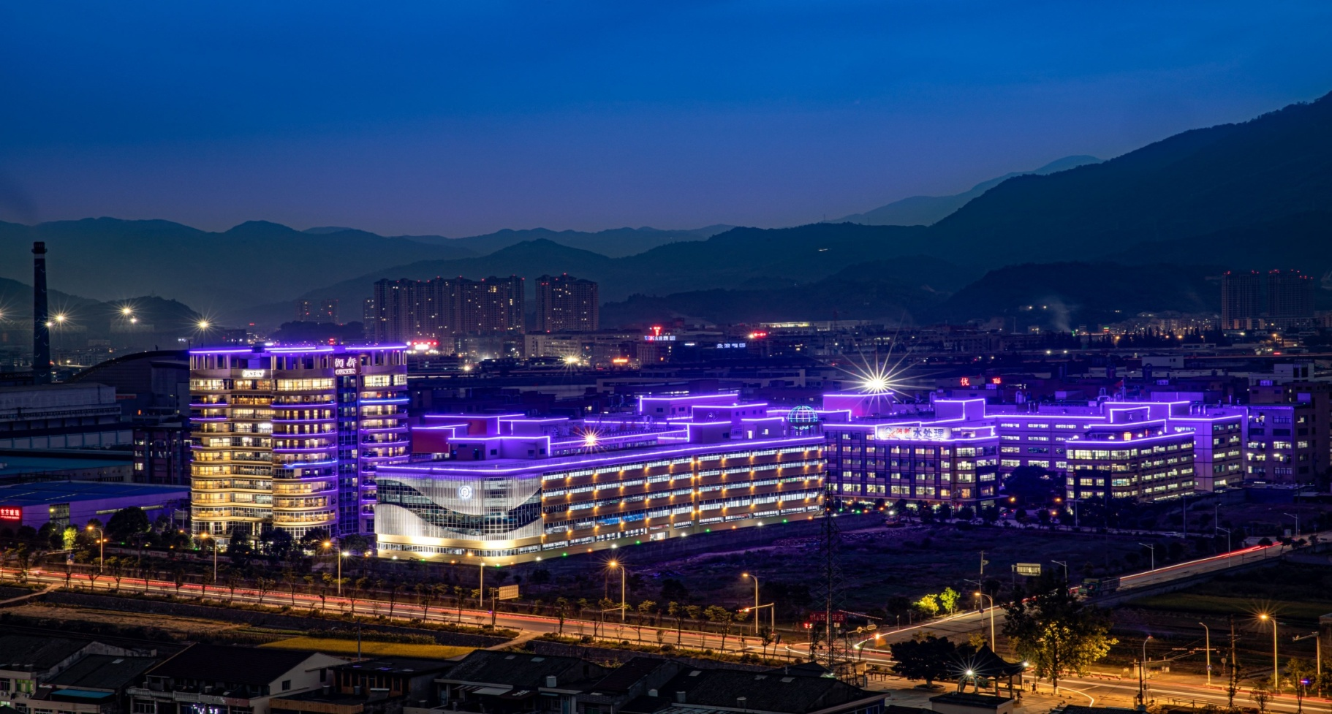
Thank you for your attention!

