Slide 1
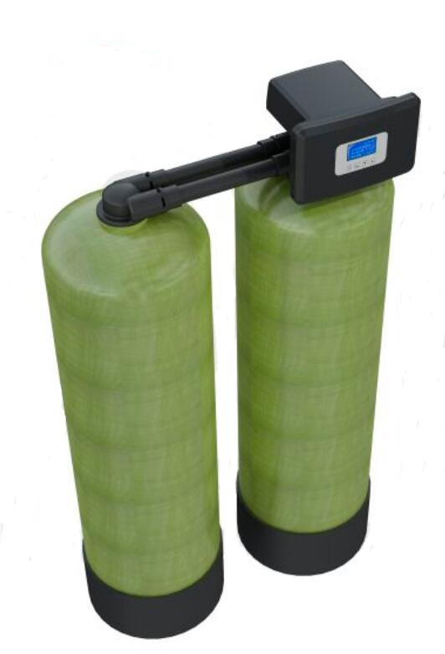
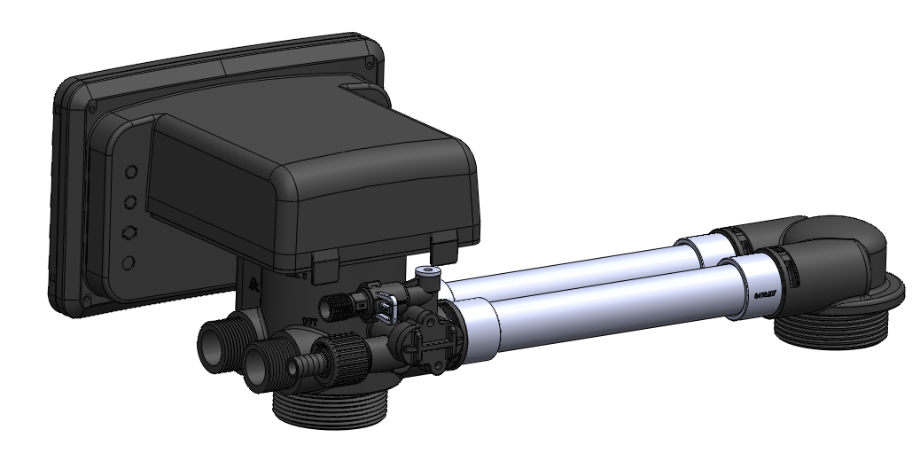
F142 One Valve on Duplex Tanks, Working in Series for Variety Usage
Domestic Initative
Invention Patent
Leading Technology
June 2021

Slide 2
F142 Control Valve
Characteristics
01
Patented design: one valve on duplex tanks,
working in series
02
Under 0.1MPa pressure drop, the flow rate is 4m3/h
03
Filtration + softening duplex tanks system working in series
04
Ozone aeration+ filtration duplex tanks system working in series (for iron and manganese removal)
05
Softening duplex tanks system working in series
06
Three or more tanks can be realized in series

Slide 3
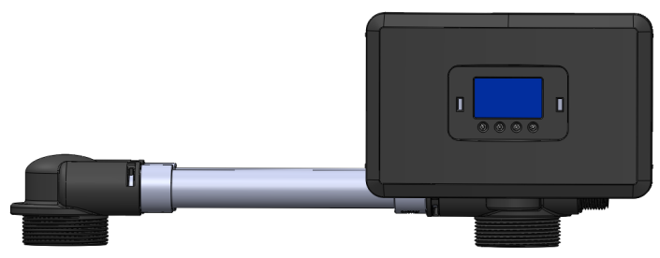
F142 Control Valve Structure
The principle of F142 is same as F116, all the spare parts are same as F116, except valve body, back cover and front cover.
1” Inlet
1” Outlet
G3/8 Brine Tank Connector
Φ20 Drain
2.5”-8NPSM Base
1”D-GB （Ø32）Riser pipe

Slide 4
F142 Control Valve Parameters
Technical Parameters
Model | Inlet | Outlet | Drain | Brine Tank Connector | Base | Riser Pipe | Flow Rate m3/h @0.1MPa | Regeneration Mode
F142 | G1 | G1 | Φ12 | G3/8 | 2.5”-8NPSM | 1”D- GB （Ø32） | 4.00 | Down-flow

Slide 5
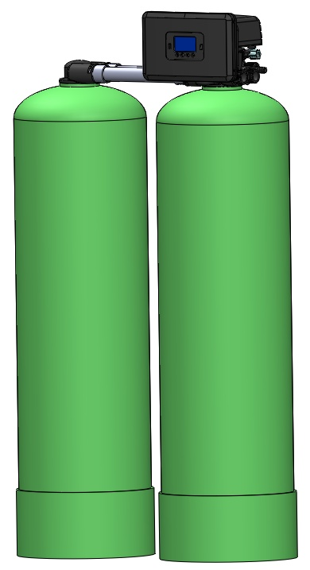
F142 Control Valve Application
One valve control two tanks, working in series, regeneration at same time
Application:
● Duplex tanks softener system works in series
● Filtration + softening duplex tanks system working in series
● Ozone aeration+ filtration duplex tanks system working in series (for iron and manganese removal)
U2 Tank
U1 Tank (Main tank)

Slide 6
Characteristics
● Softening(U2 tank) + softening (U1 tank): service, backwash, brine & slow rinse and fast rinse in series.
●The principle is same as F116, down-flow regeneration.
● Suitable for two-grate series softening of high hardness water with high cost performance.
Softening Duplex Tanks System Working in Series
U2 Tank: Softening Tank, First Grade
U1 Tank: Softening Tank, Second Grade
Notes:
软化+软化双罐串联水处理系统
特点：
●软化（副罐）+软化（主罐）串联运行、反洗、吸盐慢洗、正洗再生。
●控制阀原理与F116相同，顺流吸盐再生。
●适用于高硬度水两级串联软化，性价比高。

Slide 7
Filtration + Softening Duplex Tanks System Working in Series
Characteristics:
● Filter(U2 tank) + softening (U1 tank) service and regeneration in series.
● The principle is same as F116, down-flow regeneration, brine water flows from filter tank, then softening tank, effective inhibition of bacteria breeding in filter tank
● Suitable for complete machine combined filtration and softening which the inlet water is municipal tap water, high cost performance.
U2 Tank: Filter Tank, First Grade
U1 Tank: Softening Tank, Second Grade
Notes:
净化+软化双罐串联水处理系统
特点：
●净化（副罐）+软化（主罐）串联运行和再生。
●控制阀原理与F116相同，顺流吸盐再生，盐水依次流经净化罐和软化罐，有效抑制净化罐内的细菌滋生。
●适用于以市政自来水为水源的家用净软一体机，性价比高。

Slide 8
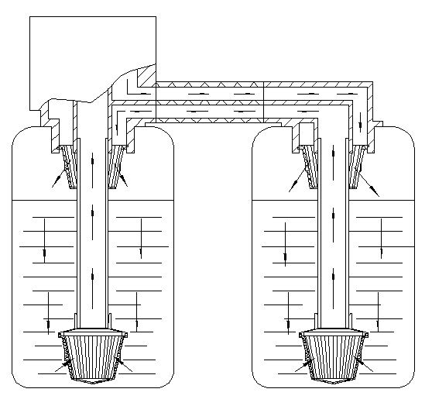
The Working Flow Chart of Filtration + Softening Duplex Tanks System Working in Series--Service
Inlet
Outlet
The inlet water is purified by filter tank and then softened by softening tank.
U1 Tank: Softening Tank, Second Grade
U2 Tank: Filter Tank, First Grade
Notes:
净化+软化双罐串联水处理系统工作流程——串联运行
进水先经过净化罐净化处理后，再经软化罐进行软化处理。

Slide 9
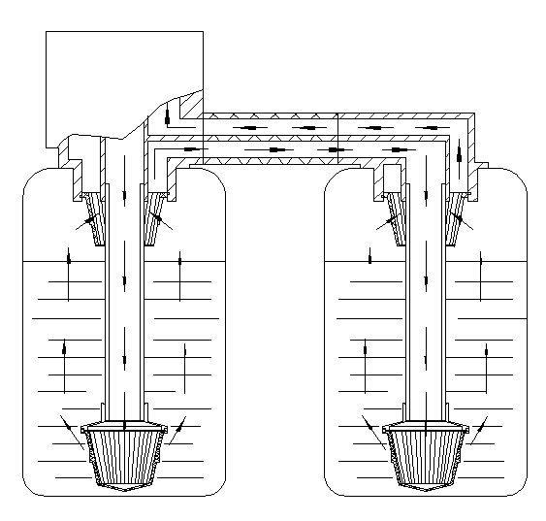
The Working Flow Chart of Filtration + Softening Duplex Tanks System Working in Series-Backwash
Inlet
Outlet
The inlet water flows to the softening tank for backwashing, then to the filter tank for backwashing.
U1 Tank: Softening Tank, Second Grade
U2 Tank: Filter Tank, First Grade
Notes:
进水先经过软化罐反冲洗后，再经净化罐进行反冲洗。

Slide 10
The Working Flow Chart of Filtration + Softening Duplex Tanks System Working in Series Brine& Slow Rinse (Down-flow)
Brine
Inlet
Inlet water flows together with brine water into filter tank through injector, then flows to softening tank for regenerate the resin, The brine water flows through the filter tank to kill bacteria and inhibit the growth of bacteria.
Drain
U1 Tank: Softening Tank, Second Grade
U2 Tank: Filter Tank, First Grade
Notes:
进水经射流器吸入盐水后先流经净化罐，再流经软化罐进行再生树脂处理。盐水流经净化罐，起到杀菌和抑制细菌滋生的作用。

Slide 11
The Working Flow Chart of Filtration + Softening Duplex Tanks System Working in Series-Fast Rinse
Inlet
Outlet
Inlet water flows to filter tank for fast rinse, then flows to softening tank for fast rinse.
U1 Tank: Softening Tank, Second Grade
U2 Tank: Filter Tank, First Grade
Notes:
进水先经过净化罐正洗处理后，再经软化罐进行正洗处理。

Slide 12
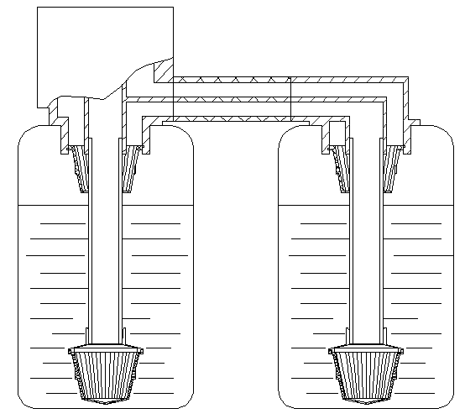
The Working Flow Chart of Filtration + Softening Duplex Tanks System Working in Series—Brine Refill
Brine Refill
Inlet
U1 Tank: Softening Tank, Second Grade
U2 Tank: Filter Tank, First Grade

Slide 13
Ozone Aeration+ Filtration Duplex Tanks System Working in Series (for iron and manganese removal)
Characteristics:
● Ozone aeration (U2 tank) + Filtration (U1 tank): Service, backwash, ozone inhalation , fast rinse in series
● The principle is same as F116, set brine refill time as O.
● Filter tank filled with cr26 filter material of Aldex company from Canada (The operation characteristics is similar as resin).
● Ozone has strong oxidation property, and its solubility in water is 13 times of oxygen. Ozone has the functions of disinfection, sterilization, decomposition of organic matter and micro flocculation in water treatment, which reflects multiple process effects.
U2 Tank, Ozone Aeration, First Grade
U1 Tank, Filter Tank, Second Grate
Notes:
特点：
●臭氧曝气（副罐）+净化过滤（主罐）串联运行、反洗、吸入臭氧、正洗。
●控制阀原理与F116相同，补水时间设置为零。
●净化过滤罐装填加拿大Aldex公司牌号为 cr26的滤料（运行特性类似树脂）。
●臭氧有极强的氧化性，在水中的溶解度是氧的13倍，臭氧在水处理中同时具有消毒、杀菌、分解有机物和微絮凝等作用，体现了多重工艺效果。

Slide 14
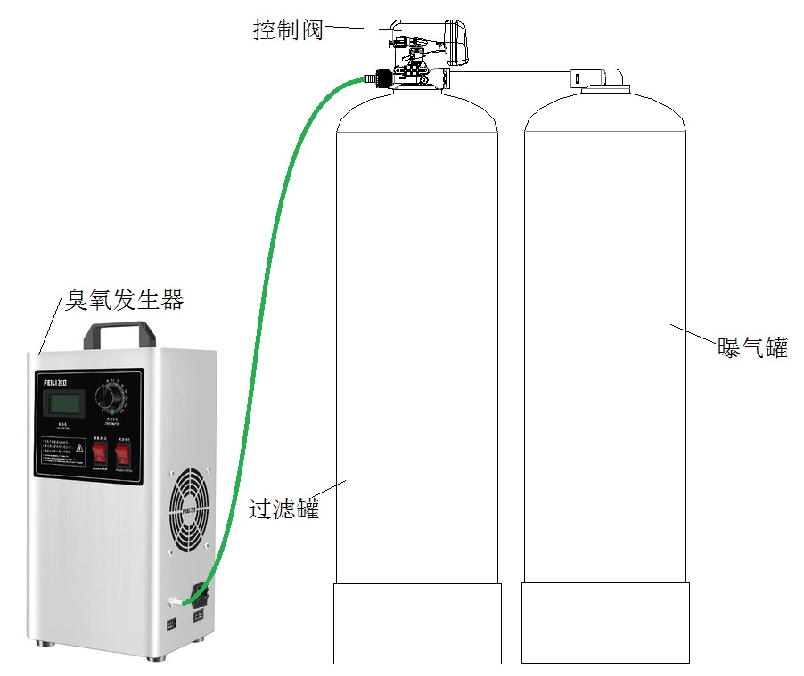
Ozone Aeration+ Filtration Duplex Tanks System Working in Series (for iron and manganese removal)
Control Valve
Ozone Generator
Aeration Tank
Filter Tank

Slide 15
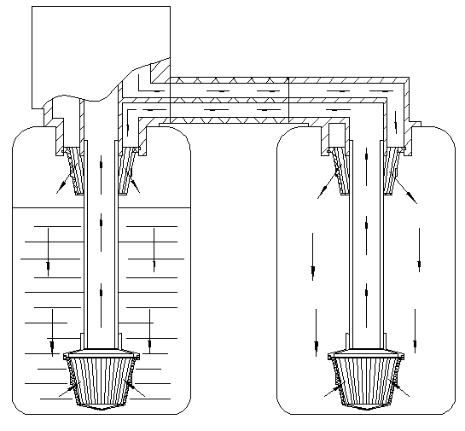
The Working Flow Chart of Ozone Aeration+ Filtration Duplex Tanks System Working in Series -Service
The ozone inhalation in the brine refill status is in the first grade aeration tank. After the inlet water is oxidized by ozone aeration, low valence iron and manganese are oxidized to high valence iron and manganese and form oxide. After clarification and precipitation in the aeration tank, the inlet water is further filtered and treated to remove iron and manganese through the filter material of the filter tank.
Inlet
Outlet
U1 Tank, Filter Tank, Second Grate
U2 Tank, Ozone Aeration, First Grade
Notes:
臭氧曝气+净化过滤双罐串联除铁锰水处理系统工作流程——运行：
在吸盐工位吸入的臭氧，存在第一级的曝气罐里，进水经臭氧曝气氧化后，低价铁锰被氧化成高价铁锰并形成氧化物，在曝气罐内澄清沉淀后，再经净化过滤罐的滤料进一步抛光过滤处理去除铁锰。

Slide 16
The Working Flow Chart of Ozone Aeration+ Filtration Duplex Tanks System Working in Series -Backwash
The ozone inhalation in the brine refill status is in the first grade aeration tank. After the inlet water is oxidized by ozone aeration, low valence iron and manganese are oxidized to high valence iron and manganese and form oxide. After clarification and precipitation in the aeration tank, the inlet water is further filtered and treated to remove iron and manganese through the filter material of the filter tank.
Inlet
Outlet
U1 Tank, Filter Tank, Second Grate
U2 Tank, Ozone Aeration, First Grade
Notes:
在吸盐工位吸入的臭氧，存在第一级的曝气罐里，进水经臭氧曝气氧化后，低价铁锰被氧化成高价铁锰并形成氧化物，在曝气罐内澄清沉淀后，再经净化过滤罐的滤料进一步抛光过滤处理去除铁锰。

Slide 17
The Working Flow Chart of Ozone Aeration+ Filtration Duplex Tanks System Working in Series —Backwash in Series
Inlet
Drain
Duplex tank series backwashing can effectively remove iron and manganese oxide deposits.
U1 Tank, Filter Tank, Second Grate
U2 Tank, Ozone Aeration, First Grade
Notes:
臭氧曝气+净化过滤双罐串联除铁锰水处理系统工作流程——串联反洗：
双罐串联反洗，有效清除铁锰氧化沉淀物。

Slide 18
The Working Flow Chart of Ozone Aeration+ Filtration Duplex Tanks System Working in Series Ozone Absorption
Ozone Absorption (Supply by Ozone Generator)
Inlet
Drain
The inlet water absorb the ozone through injector, Ozone empty the water of the the aeration tank, and stored in the aeration tank.
U1 Tank, Filter Tank, Second Grate
U2 Tank, Ozone Aeration, First Grade
Notes:
臭氧曝气+净化过滤双罐串联除铁锰水处理系统工作流程——吸臭氧：
进水经射流器吸入臭氧，臭氧排空曝气罐里的水存于曝气罐内。

Slide 19
The Working Flow Chart of Ozone Aeration+ Filtration Duplex Tanks System Working in Series—Fast Rinse
Inlet
Inlet water flows to the aeration tank for aeration, then flows to the filter tank for fast rinse.
Drain
U1 Tank, Filter Tank, Second Grate
U2 Tank, Ozone Aeration, First Grade
Notes:
进水先经过曝气罐曝气后，再经净化过滤罐对滤料进行正洗处理。

Slide 20
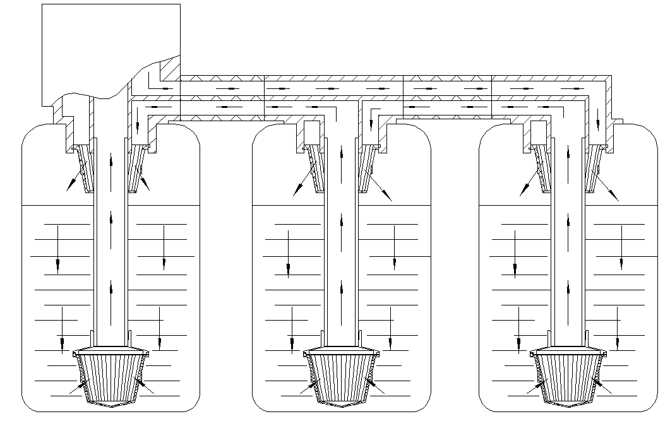
Three or More Tanks can be Realized in Series
Last Grade
Second Grade
First Grade

Slide 21
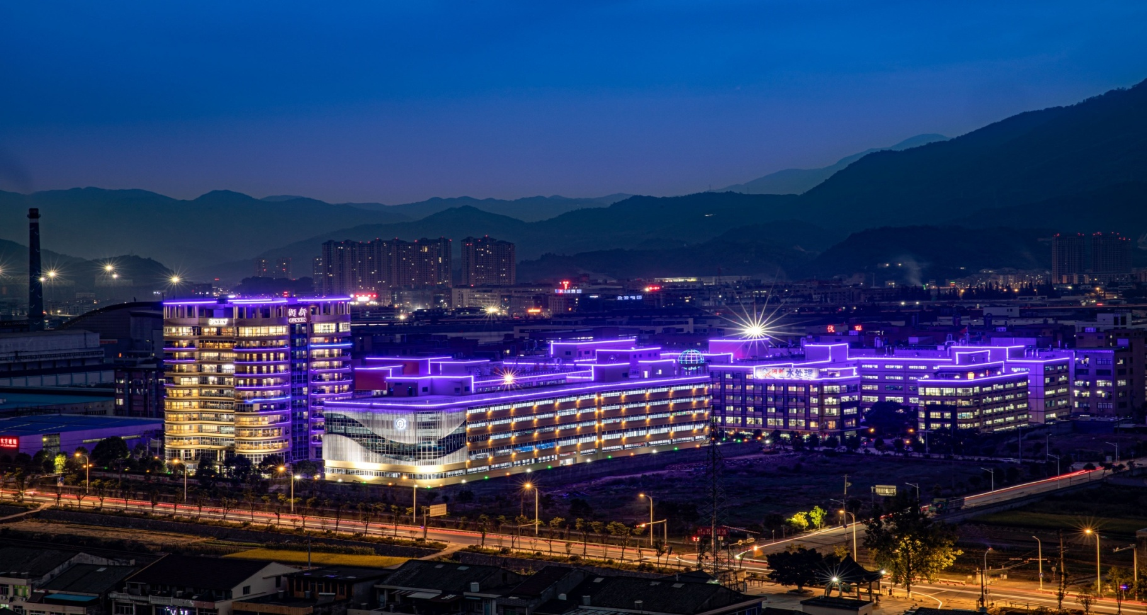
Thank you for your attention!

