Slide 1
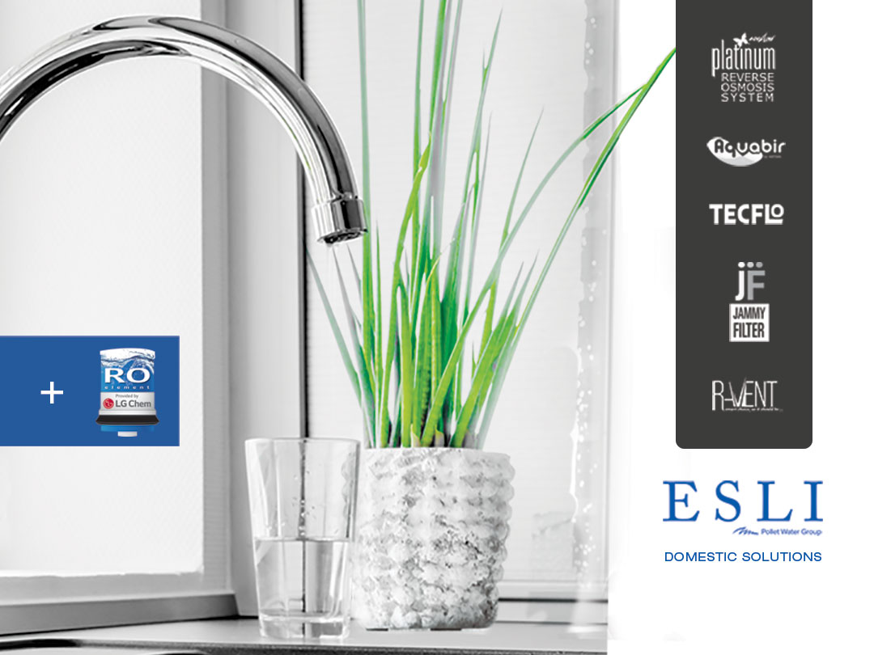

Slide 2
TO LEAD A HEALTY LIFE,
The air we breathe, the water we drink and the environment we live in are essential.

Slide 3
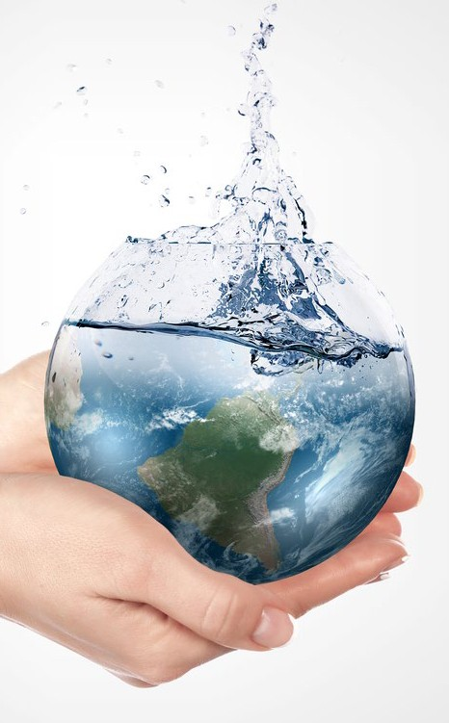
THREE QUARTERS OF THE EARTH IS COVERED BY WATER
97%
SEA
2%
GLACIERS
1%
UNDERGROUND AND SURFACE
WATER

Slide 4
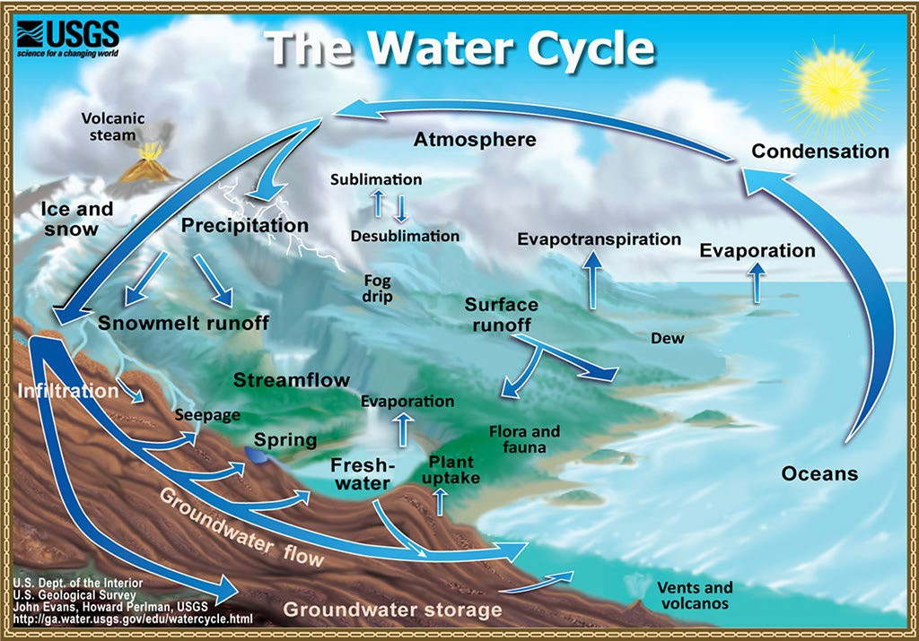
WATER DOES NOT DECREASE OR INCREASE!
“IT CIRCULATES”

Slide 5
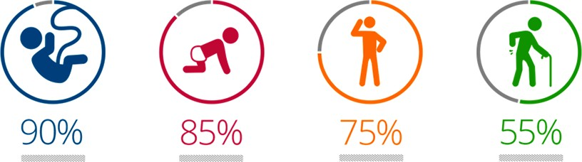
embryo
child
adult
elderly
If this rate falls below
50%
ageing and risk of death appear.

Slide 6
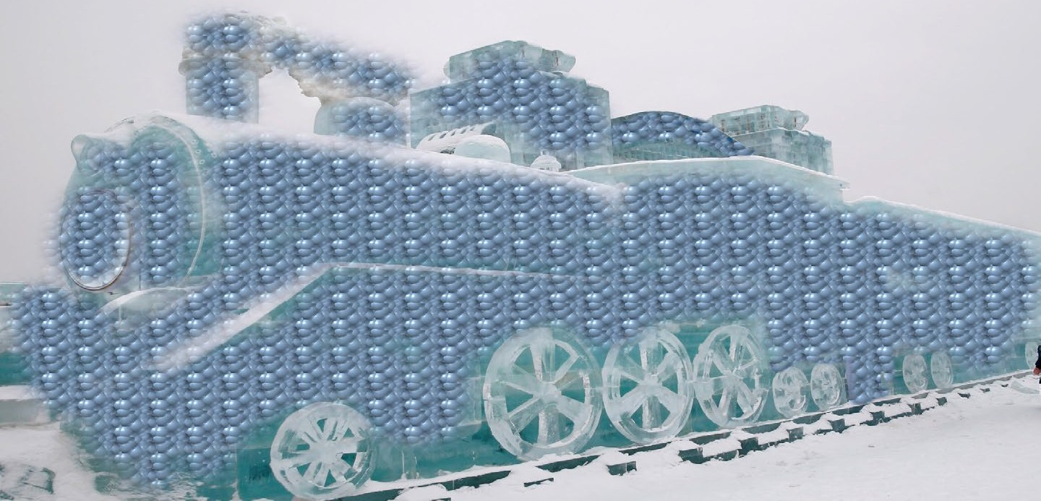
WATER; is a locomotive which is the infrastructure of a carrier system for our body.

Slide 7
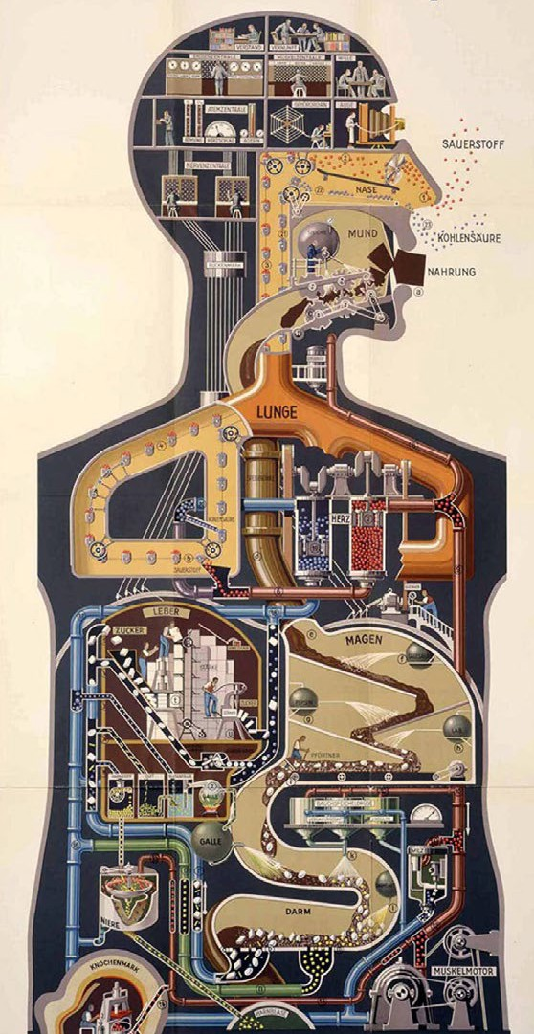
THE CELLS WORK LIKE A FACTORY
90%
Of the protoplasm of the cell is
composed of water.

Slide 8

REMOVING TOXINS FROM THE BODY
Water carries waste in the cell (toxins, fat) out of the body by means of bodily fluids such as sweat, urine, etc., as well as carrying raw material to the cell.

Slide 9
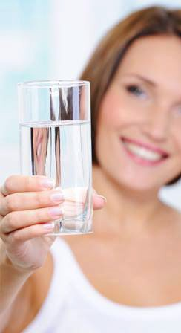
TO LEAD A HEALTHY LIFE WE SHOULD DRINK AT LEAST
2 LITERS
OF WATER
PER DAY.
The required quantity for providing energy and
eliminating waste from the cells (toxins-fat) is at least 2 liters.

Slide 10

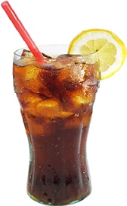
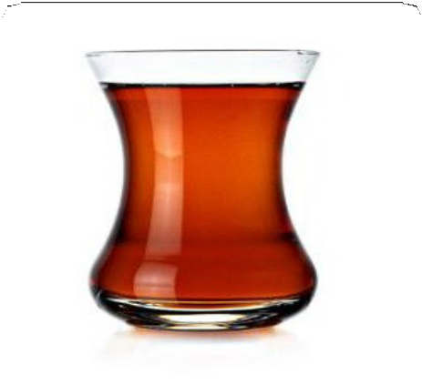

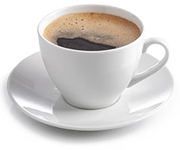
DO OTHER LIQUIDS SUBSTITUTE FOR A WATER REQUIREMENT?
tea, coffee, cola...
NOT A SUBSTITUTE FOR WATER!

Slide 11

AN INSIDIOUS ORGAN
FOR A HEALTHY KIDNEY;
Our kidneys filter 2 tons of water per day. They eliminate hazardous waste from our body with the help of water.
The hardness of drinking water must be low and ion content must be at normal values to avoid kidney stones, gravel, inflammation and renal impairment.

Slide 12
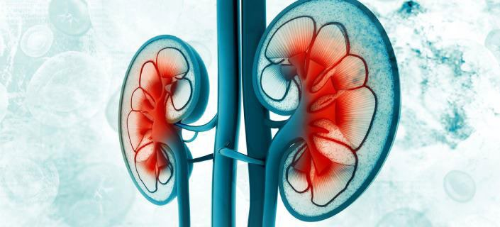
AN INSIDIOUS ORGAN
‘’Even if one of our kidneys does not function and only half of the other does function, most people will not be aware of this”

Slide 13

DRINKING WATER;
For a healthier life, we must consume healthy water!
Does the water we drink reach us in a healthy way?

Slide 14
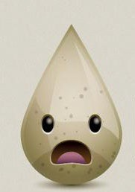
OUR WATER IS IN DANGER
Our drinking water is getting dirtier due to residential, industrial and agricultural waste.
Residential waste (human waste, wastewater, chemical cleaning products) are usually drained into natural water springs because of the increase in numbers of cities and villages established near a river system. In addition to industrial waste, animal feces and feed waste, agricultural waste such as chemical fertilizers, nitrates, pesticides and insecticides are seen in natural
water springs. Water is also filtered in dams and some chemical products are used for disinfection (e.g. chlorine) to prevent certain epidemic illnesses such as typhus, diphtheria etc.
For these reasons, municipal water carries extreme chemical products such as sodium, calcium, other
minerals, and trihalometane and chlorine, which are a
danger to our health.
  As a result of 130 scientific studies, it has been proven that
the chemical called BPA causes breast cancer in women
and prostate cancer in men, which indicates how dangerous this is.

Slide 15
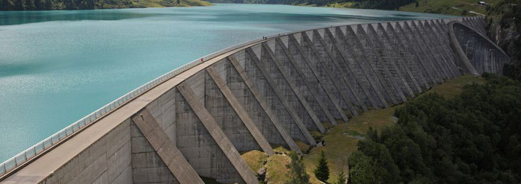
MUNICIPAL WATER;
It reaches our house or offices after a long trip.
What is the color of the water after water cut???

Slide 16
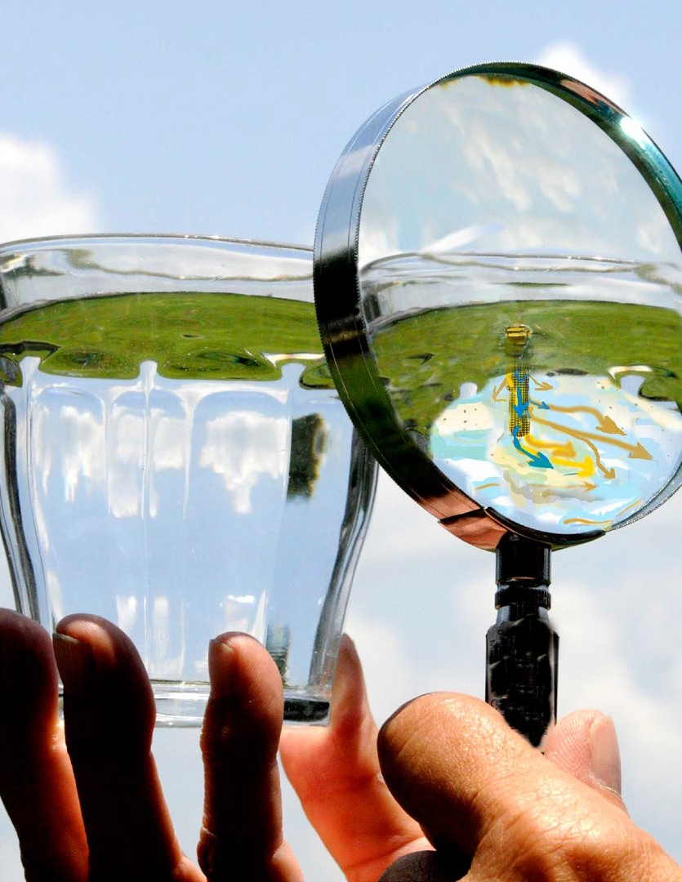
IS THE WATER PURIFIED IF BOILED?
Although living organisms in the water are removed after the water
is boiled, we can irritate chemicals (chlorine etc.) in the water and make them more hazardous.

Slide 17
SPRING WATER
How safe is uncontrolled water?

Slide 18
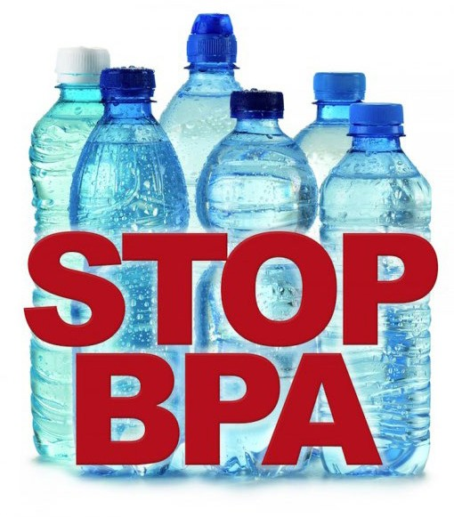
BOTTLES
According to the results of 130 scientific studies,
it has been proved
that the raw material of bottles, BPA, causes cancer...
http://deainfo.nci.nih.gov/advisory/ pcp/annualReports/pcp08-09rpt/PCP_ Report_08-09_508.pdf

Slide 19
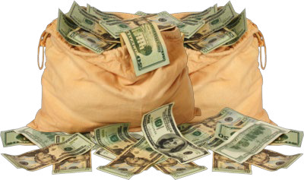
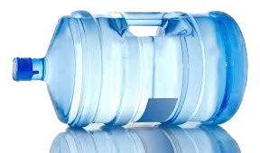
COST OF BOTTLES
Thousands are spent for consuming healthy water.
Is it really healthy?

Slide 20

SOLUTION
THE REVERSE OSMOSIS
METHOD, which is the discovery of NASA scientists, is the cutting edge of technology in water purification.

Slide 21
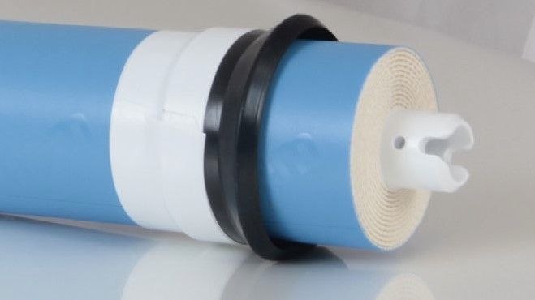
BRIEF HISTORY OF RO TECHNOLOGY
It was first developed by NASA to obtain drinking water from wastewater (urine and used water) in the space capsule.
Major source of this technology; The plant roots’ drawing water from the soil into the plant stem in nature.
In addition, the fact that kidneys in the human body filter hazardous materials and discharge them as sweat and urine helped inspire the RO system.
It has been used for the production of drinking water all over the world since 1970.

Slide 22
WHAT IS REVERSE OSMOSIS?
Osmosis is a process in which water passes through a semi- permeable membrane from a less concentrated solution into a more concentrated one.
In the naturally occurring osmosis process, reverse osmosis is achieved by pressurizing to a higher concentrated environment. If a higher concentrated environment is pressurized, water passes through the lower concentrated one.
Semi-permeable membranes used in reverse osmosis systems have a pore diameter of 8-12 angstroms. Water molecules are smaller than 8-12 angstroms and have a neutral electric charge. For this reason, water molecules can easily pass through the membranes.
However, positively and negatively charged ions and molecules in the water, bacteria and viruses cannot pass through the membranes, because they are bigger than
12 angstroms, and flow to the drain.

Slide 23
REVERSE OSMOSIS
APPLICATION
Undersink water treatment devices are designed to work with minimum water pressure. It does not require chemical use and produces quality water. It is manufactured as a compact device that can easily be installed anywhere thanks to minimum dimensions.
An RO device enhances the taste and quality of your water. It decreases odor and sediment whilst minimizing chlorine up to 99%. Reverse osmosis devices also decrease contaminants such as lead, copper, barium, chromium, mercury, sodium, cadmium, fluoride, nitrite, nitrate and selenium, which may be present in water.

Slide 24
ION REMOVAL
IN REVERSE OSMOSIS SYSTEMS
ION AND ORG. PESTICIDE | REMOVAL ( % ) | ION AND ORG. PESTICIDE | REMOVAL ( % )
Aluminium | 97-98 | Nickel | 97-99
Ammonium | 85-95 | Nitrate | 93-96
Arsenic | 94-96 | Phosphate | 99+
Magnesium | 96-98 | Potassium | 92
Bicarbonate | 95-96 | Radioactivity | 95-98
Bromide | 93-96 | Radium | 97
Cadmium | 96-98 | Selenium | 97
Calcium | 96-98 | Silica | 85-90
Chloride | 94-95 | Silver | 95-97
Chromate | 90-98 | Sodium | 92-98
Chrome | 96-98 | Sulphate | 99+
Copper | 97-99 | Zinc | 98-99
Cyanide | 90-95 | Boron | 50-70
Fluoride | 94-96 | Borate | 30-50
Iron | 98-99 | Mercury | 96-98
Lead | 96-98 | Bacteria | 99+
Manganese | 96-98 | Virus | 99+

Slide 25
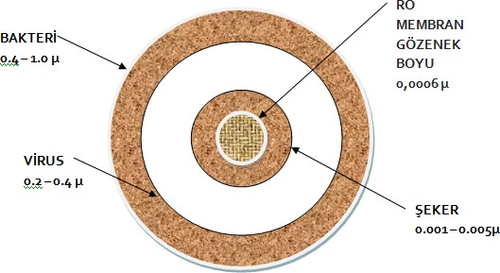
MEMBRANE FILTER
Membrane filter pores are sized 8-10 Angstrom, and 1 Angstrom equals 0.0001 micron.
The molecular diameter of pure water (H2O) is approximately 5 Angstrom and is neutral.
RO
MEMBRANE PORE SIZE
0,0006 µ
BACTERIA 0,4 -1,0 µ
VIRUS
0,2 – 0,4 µ
SUGAR
0,001 -0,005 µ

Slide 26
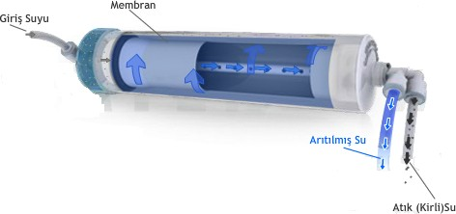
HAZARDOUS SUBSTANCES CAN NOT PASS!
membrane
water inlet
purified water
All foreign substances are thrown out through the drain line.
drain water

Slide 27
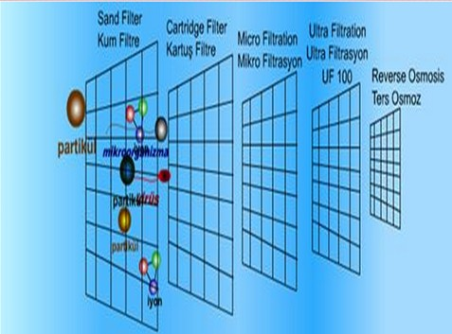
MEMBRANE SURFACE

Slide 28
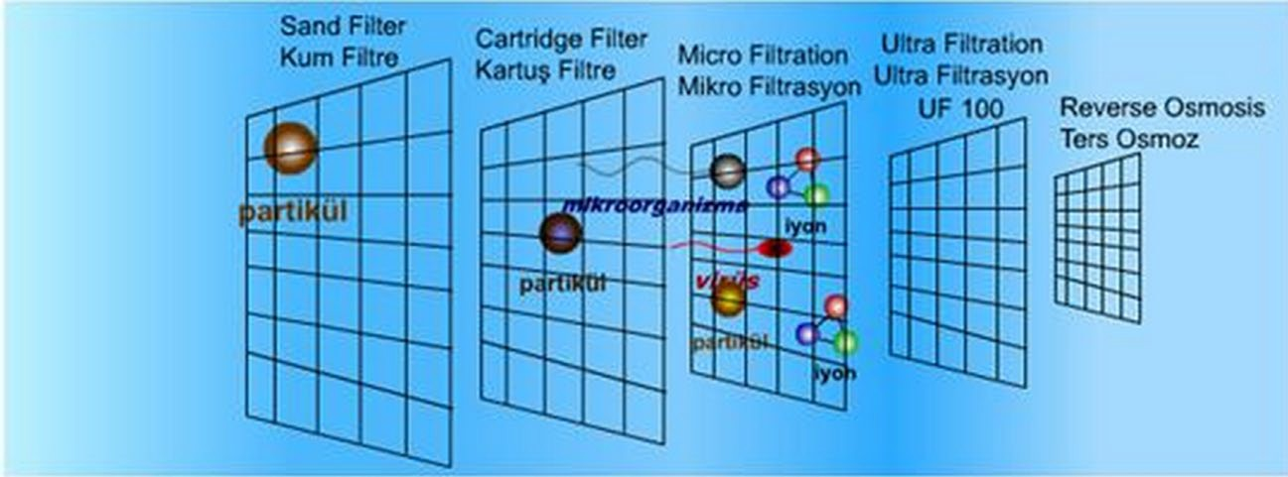
MEMBRANE SURFACE

Slide 29
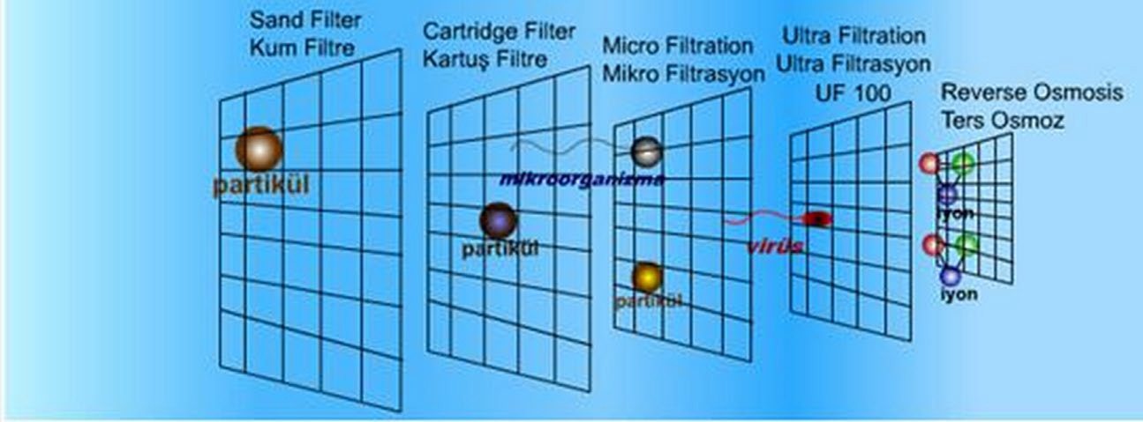
MEMBRANE SURFACE

Slide 30
CLEAN WATER PRODUCTION
PHASES OF UNDER COUNTER REVERSE OSMOSIS
Stage: 5 Micron pp Sediment Filter Sediment filter is a pre residual filter, it keeps floating substances out and it protects subsequent filter groups, especially the membrane filter.
Stage: Activated Carbon Filter
Activated carbon prevents organic substances, chlorine and chlorine components from harming human health and the membrane filter.
Stage: Block Carbon Filter
Used to adsorb floating substances and for more sensitive filtration.
Stage: Membrane Filter
8-12 Angstrom pore size and semi-permeable membranes remove 95-98% of bacteria, viruses and heavy metals in the water. The waste water is discharged to the drain.
5. Stage: Post Carbon Filter
The water passing through the membrane then passes through the post carbon and becomes perfect drinking water.

Slide 31
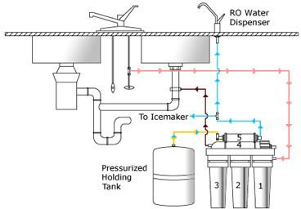
RO FLOW DIAGRAM

Slide 32
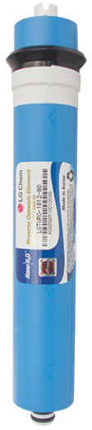




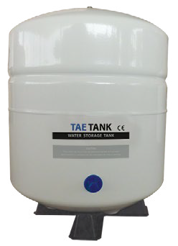
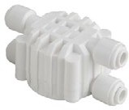
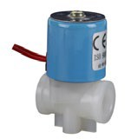
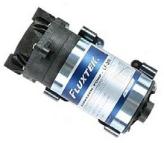

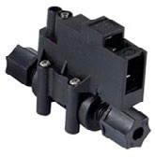

DOMESTIC R.O INTERIOR ACCESSORIES

Slide 33

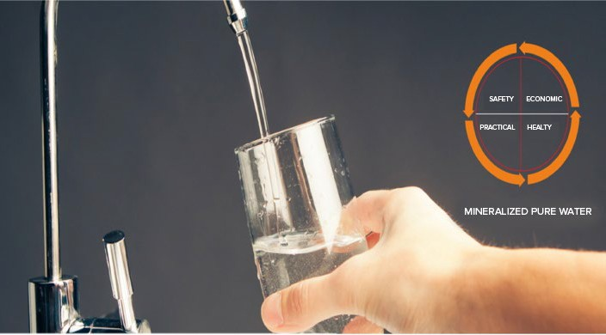

Slide 34
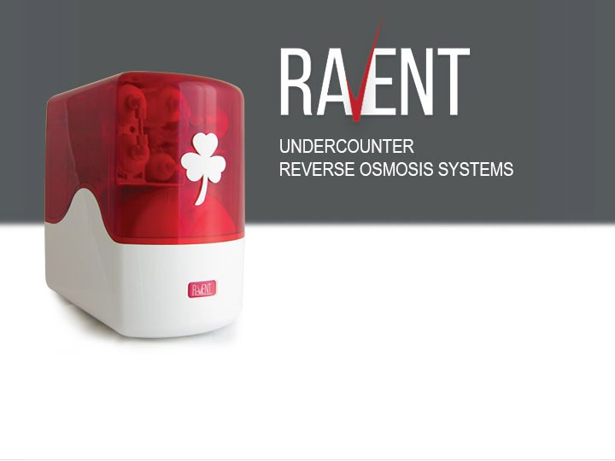







RAVENT SMART
12” Inline 5 Micron Spun (Sediment) Filter
12” Inline GAC Carbon Cartridge Filter (UDF)
LUX
W/OUT PUMP
CLASS
W/OUT PUMP
12” Inline Block Carbon Filter (CTO)
10” Inline Coconut Post Carbon Filter
75 GPD Membrane
2,2 Gallon Metallic Pressured Storage Tank
Metallic Ball Valve 3/8”
Pump
24 Volt 1,2 Amper Adapter
LG Membrane
Lux Faucet
Standard Sequence
Star Faucet
www.ravent.com.tr
HOME
Domestic Solutions
OFFICE
Commercial Solutions

Slide 35
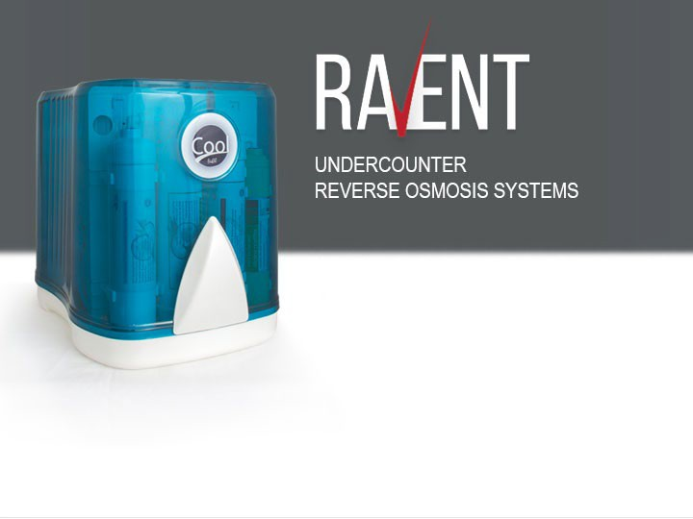
RAVENT COOL
12” Inline 5 Micron Spun (Sediment) Filter
12” Inline GAC Carbon Cartridge Filter (UDF)
LUX
W/OUT PUMP
CLASS
W/OUT PUMP
12” Inline Block Carbon Filter (CTO)
10” Inline Coconut Post Carbon Filter
75 GPD Membrane
3,2 Gallon Metallic Pressured Storage Tank
Metallic Ball Valve 3/8”
Pump
24 Volt 1,2 Amper Adapter
LG Membrane
Lux Faucet
Standard Sequence
Star Faucet
www.ravent.com.tr
HOME
Domestic Solutions
OFFICE
Commercial Solutions

Slide 36

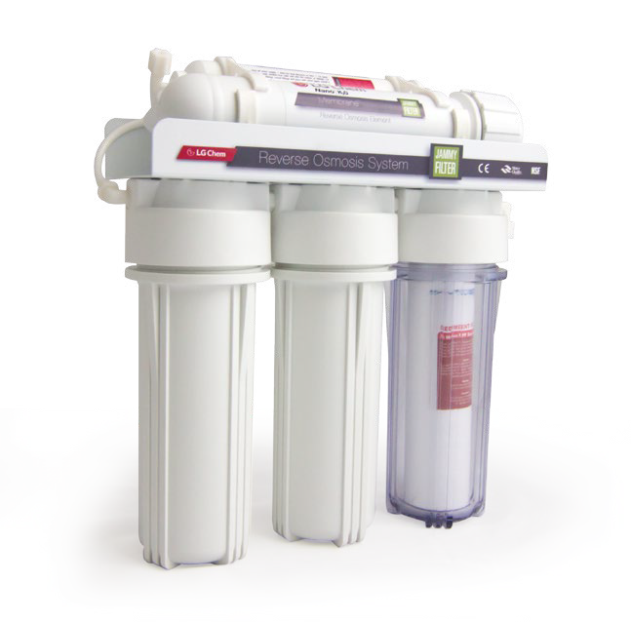

Drinking adequate and qualified water helps cells to be activated in full capacity, enhances the immune system and prevents serious diseases
JAMMY
10” Transparent Housing (Double O-Ring)
10” White Opaque Housing (Double O-Ring)
W/OUT PUMP
WITH PUMP
10” 5 Micron Spun (Sediment) Filter
10” GAC Carbon Cartridge Filter (UDF)
10” Block Carbon Cartridge Filter (CTO)
10” Inline Coconut Post Carbon Filter
75 GPD Membrane
3.2 Gallon Metallic Pressured Storage Tank
Star Faucet
Automatic Shut-Off Valve
Pump
24 Volt 1,2 Amper Adapter
www.jammyfilter.com.tr
HOME
Domestic Solutions
OFFICE
Commercial Solutions

Slide 37

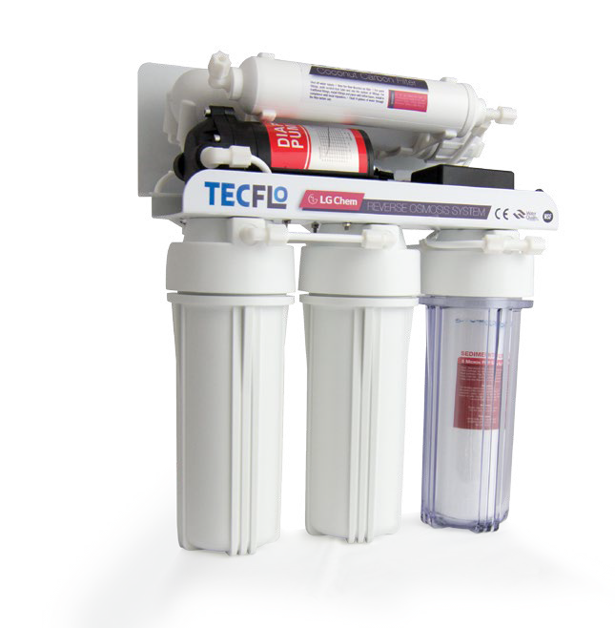
TECFLO
10” Transparent Housing (Double O-Ring)
10” White Opaque Housing (Double O-Ring)
W/OUT PUMP
WITH PUMP
10” 5 Micron Spun (Sediment) Filter
10” GAC Carbon Cartridge Filter (UDF)
10” Block Carbon Cartridge Filter (CTO)
10” Inline Coconut Post Carbon Filter
75 GPD Membrane
3.2 Gallon Metallic Pressured Storage Tank
Star Faucet
Automatic Shut-Off Valve
Pump
24 Volt 1,2 Amper Adapter
www.tecflo.com.tr
HOME
Domestic Solutions
OFFICE
Commercial Solutions

Slide 38
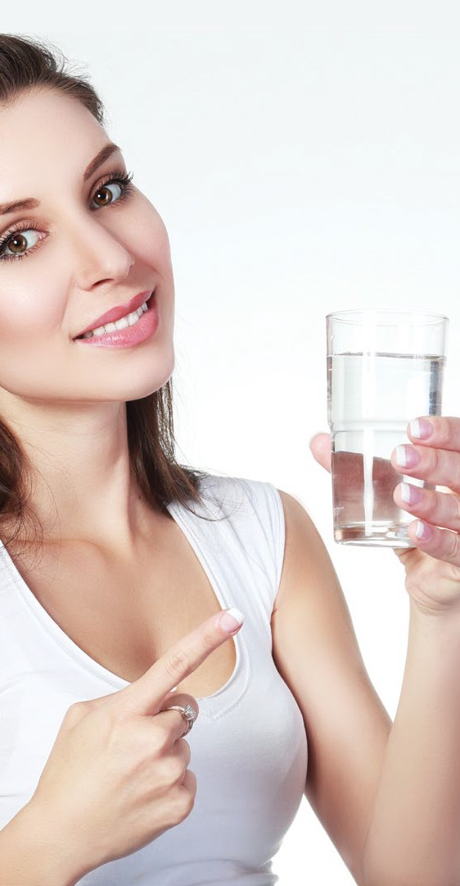
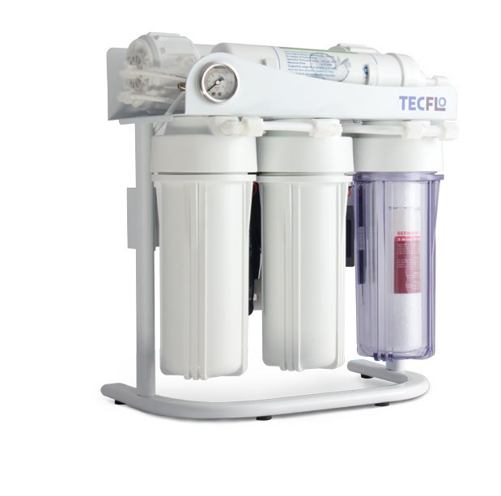


√ Softens the skin,
√ Gives life,
√ Improves sleep patterns,
√ Relieves fatigue,
√ Gives the youth energy...
FE-300 DIRECT FLOW
10” Transparent Housing (Double O-Ring)
10” White Opaque Housing (Double O-Ring)
WITH PUMP
10” Thick 5 Micron Spun (Sediment) Filter
10” Stout GAC Carbon Cartridge Filter (UDF)
10” Stout Block Carbon Cartridge Filter (CTO)
12” Inline Coconut Post Carbon Filter
300 GPD Membrane
300 GPD Pump
www.tecflo.com.tr
HOME
Domestic Solutions
CAFE
Horeca Solutions
OFFICE
Commercial Solutions

Slide 39
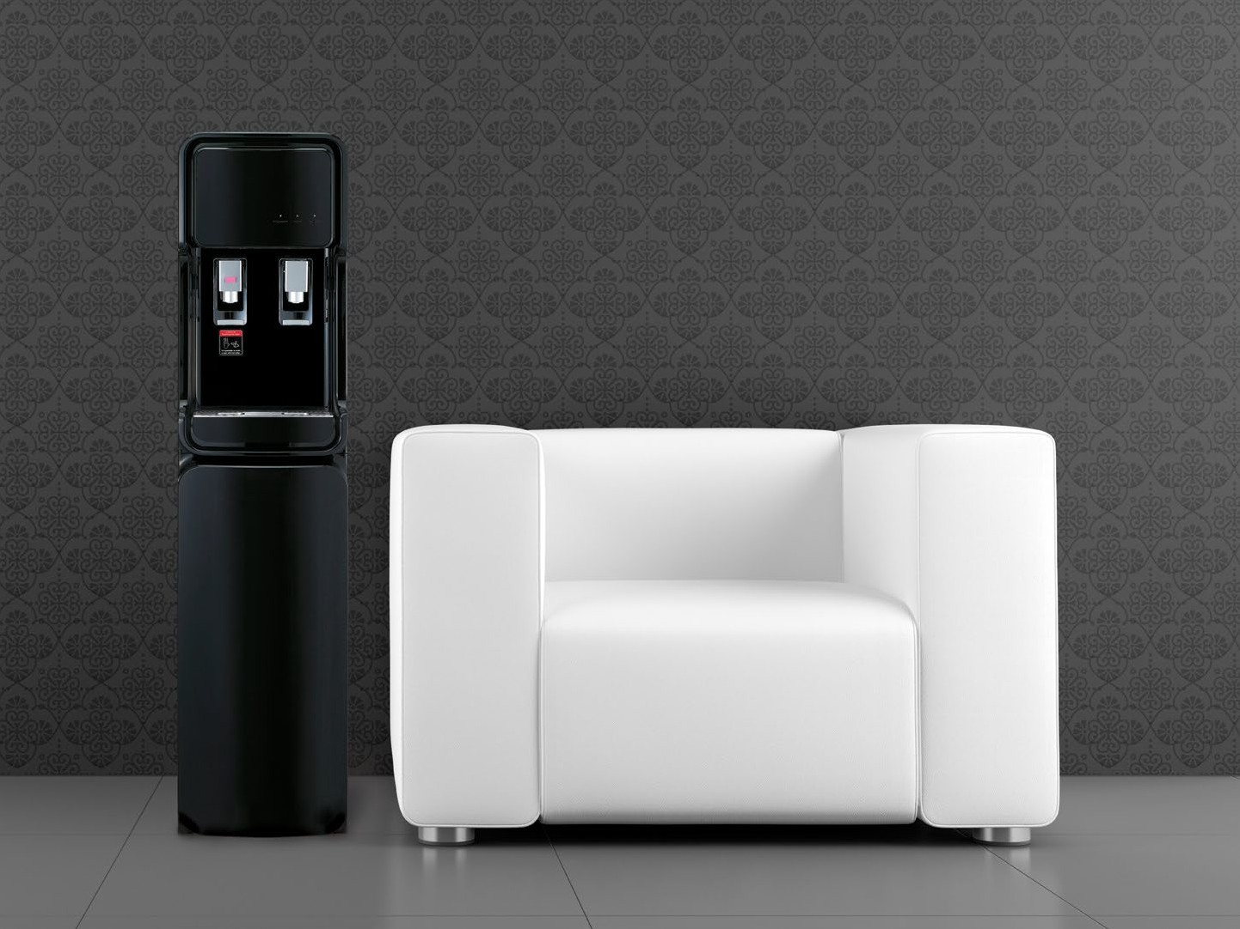
“INSTANT HOT AND COLD
WATER”

Slide 40
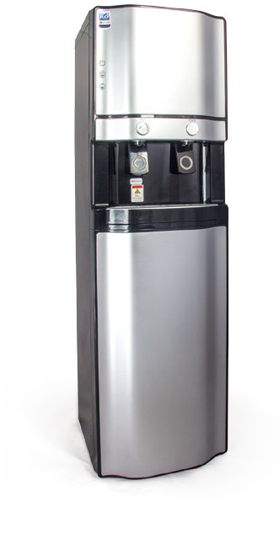
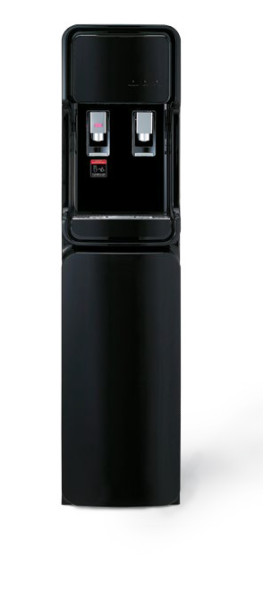
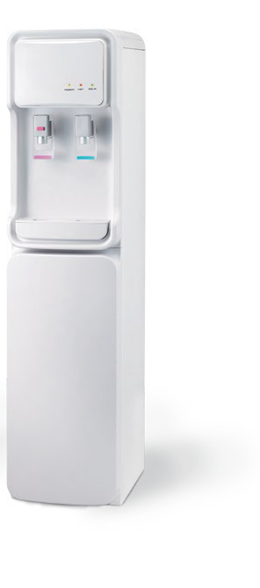
KS WATER DISPENSER
12” Inline 5 Micron Spun (Sediment) Filter
12” Inline GAC Carbon Cartridge Filter (UDF)
12” Inline Block Carbon Filter (CTO)
10” Inline Coconut Post Carbon Filter
75 GPD Membrane
Automatic Shut-Off Valve
Cold Water Tank: 3.1 Liter
Hot Water Tank: 2 Liter (Instantaneous hot water 0,5 Lt)
WITHOUT PUMP
WITH PUMP
Pumpa
24 Volt 1,2 Amper Adapter

Slide 41
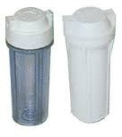
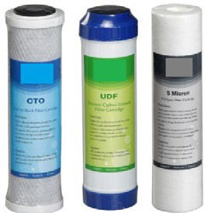
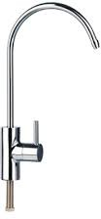
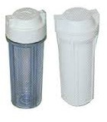
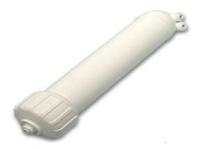
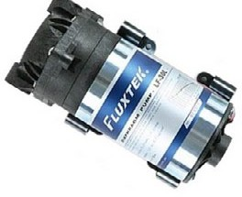
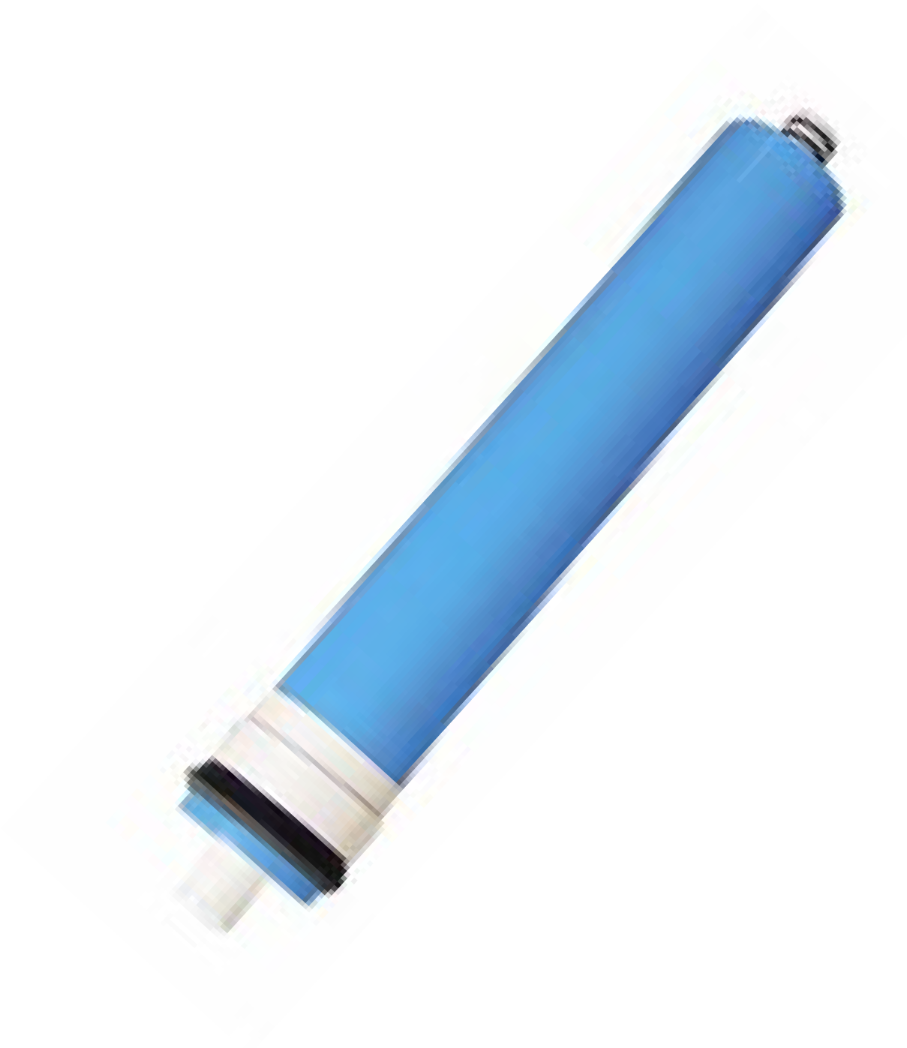
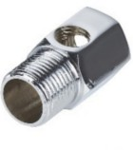
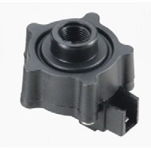




EQUIPMENT QUALITY
WATER QUALITY

Slide 42

WHO
Rates of total dissolved solids in the water
TDS
RECOMMENDATION SCALE
TDS | WATER TYPE | WATER QUALITY
0-25 | SOFT WATER | SPRING WATER
25-60 | LESS HARD WATER | I. QUALITY
60-120 | MEDIUM HARD WATER | TAP WATER
 |  | II. QUALITY
120-180 | HARD WATER | ATTENTION
 |  | III. QUALITY

Slide 43
THE AIM OF MEASURING TDS
We observe the difference between treated water by the water treatment device and untreated water as the intrinsic value.
We assess TDS measurements according to the recommendation scale that the World Health Organization (WHO) prepared.
The TDS measurement is used to measure the intrinsic value of elements in the water other than actual water molecules.
Because H2O is neutral, TDS meters cannot register pure water molecules, it will identify anything else (beneficial or harmful) except for pure water.
It does not show that the water is dirty or clean, it shows how crowded it is.
The purpose of this scale is to detect water that we can safely consume, taking into account the health of our kidneys.
Experts advise that we should consume 0 - 60 TDS water and avoid water over 60 TDS as this can cause our kidneys to deteriorate faster.

Slide 44




Before electrolysis
ELECTROLYSIS
tap water
purified water
After electrolysis

Slide 45
THE AIM OF ELECTROLYSIS
The electrolysis tool works using iron-aluminum or iron- brass rods.
Each bar has 110 volts of electricity. It consists of positive and negative poles.
When placed in water and supplied with electricity, plus and minus poles cause a reaction and iron ions precipitate in the water. It is electrolyzed with elements in water. (except water)
In this view, we evaluate density that is called TDS.
The TDS measurements of the water produced by the treatment device and the untreated water allows us to clearly evaluate the difference between both.

Slide 46
IT PROTECTCS YOUR HEALTH AND YOUR BUDGET
It prevents the migration of all foreign substances at molecular and ionic levels,
Dirt, Sand, Moss,
Mud,
Bacteria, Viruses,
Oils,
Colors,
Water lime,
Insecticide
✓It produces the healthiest water for body functions.
✓At any moment, it provides water that has the same quality as spring water.
✓Its taste does not deteriorate when used in meals and drinks.
✓ It is very benign for hyper- tension and heart disease
✓ It contributes to your budget

Slide 47
EXPERTS RECOMMEND!
The water is cleaner. It nourishes and supports cells and tissues. Water accelerates the release of toxins from the body.
Reverse osmosis filtered water is the most reliable.
(*) Prof .Dr. Osman Müftüoğlu ‘’Yaşasın Hayat’’ book page: 197

Slide 48

CHOICE OF A GREAT NUMBER OF FAMILIES!
Did you like it? • Did I make myself clear?
  Could you use it?

