Slide 1
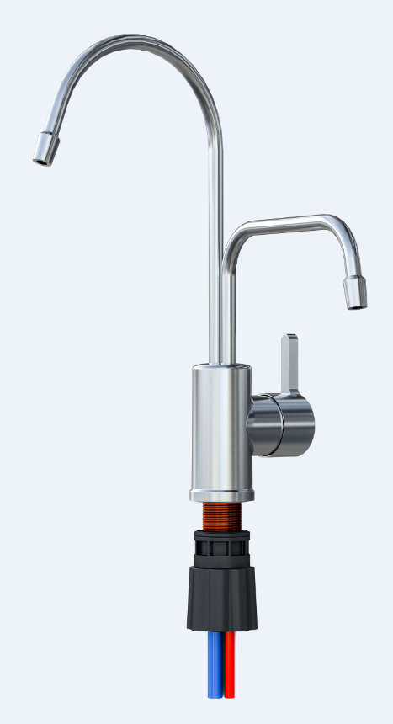
Purifying Faucet with Double Outlets and Triple Close
Notes:
三切双排净水龙头

Slide 2
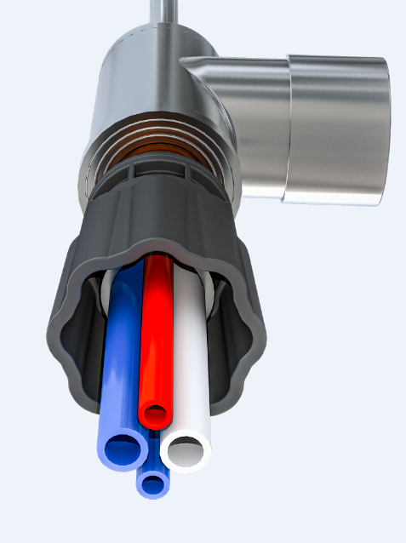

What is the Purifying Faucet？
It means that while closing the faucet，the pure water outlet，wastewater outlet and inlet of RO machine is closed at the same time. The outlet water is divided into pure water and wastewater outlet .
connect to the pure water of the RO machine（PS: change from red to white in production ）
沐浴软水机
pure water outlet
wastewater outlet
connect to raw water
connect to the water inlet of the RO machine
connect to RO machine wastewater
Notes:
三切双出龙头：就是关闭龙头时，自来水和纯水、浓水口同时关闭，出水设置纯水口和浓水口的龙头

Slide 3
Traditional Faucet
VS
Purifying Faucet

Slide 4
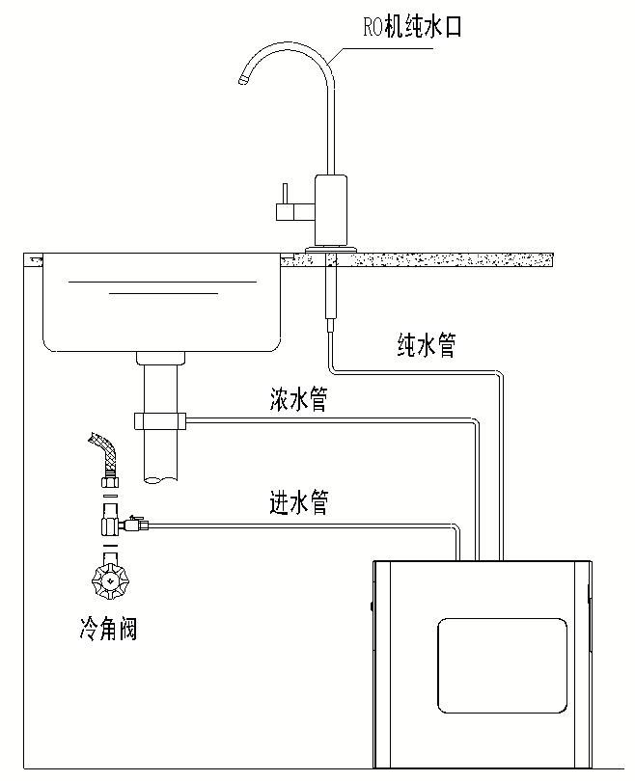
Principle Diagram of the Traditional Faucet
RO machine pure water outlet
RO machine pure water outlet
Pure water pipe
Pure water pipe
Wastewater pipe
Wastewater pipe
Inlet pipe
Inlet pipe
Cold angle valve
Cold angle valve
Service status
Close states
Notes:
传统龙头存在的问题
1.净水器始终处于承压状态、承受水锤冲击，RO机内的电磁阀、滤芯、管件等容易在水锤作用下损坏导致泄漏。
2.由于浓水电磁阀关闭不严，在停机状态下压力失压 ，水泵频繁启动。
3.进水电磁阀流阻大，通量小， 增压泵无法满负荷运转，噪音大。
4.浓水不能回收利用。（浓水相对干净，可用于拖地，洗菜等）
5.浓水口接下水道，下水道臭味反味进入RO机。

Slide 5
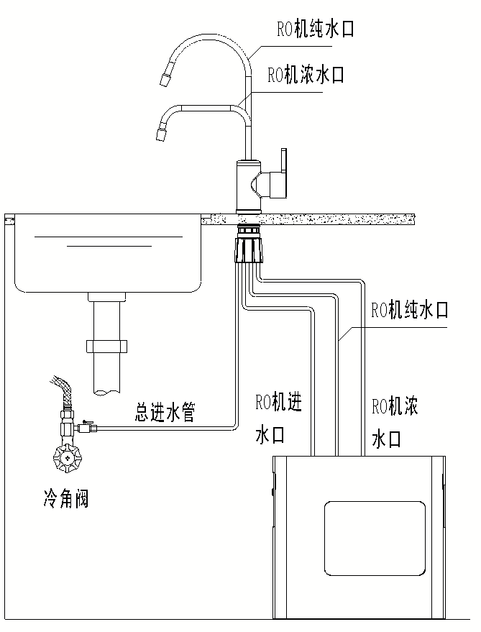
Principle Diagram of the Purifying Faucet
RO machine pure water outlet
RO machine pure water outlet
No water in and out of RO machine
RO machine wastewater outlet
RO machine wastewater outlet
RO machine pure water pipe
Total inlet pipe
RO machine pure water pipe
Total inlet pipe
RO machine wastewater pipe
RO machine wastewater pipe
Cold angle valve
Cold angle valve
RO machine water inlet
RO machine water inlet
Service status
Close states
Notes:
龙头关闭时，切断自来水进入RO机，RO机处于恒压无水锤状态，RO机不易损坏。RO机不需要配置进水电磁阀，节省成本。

Slide 6
Installation Diagram
RO machine pure water outlet
RO machine pure water outlet
Wastewater outlet is connected to the sewer
RO machine wastewater outlet
Pure water pipe
Total inlet pipe
Pure water pipe
Wastewater pipe
Wastewater pipe
Inlet pipe
Cold angle valve
Cold angle valve
RO machine water inlet
Installation Method of Traditional Faucet
Installation Method of Purifying Faucet

Slide 7
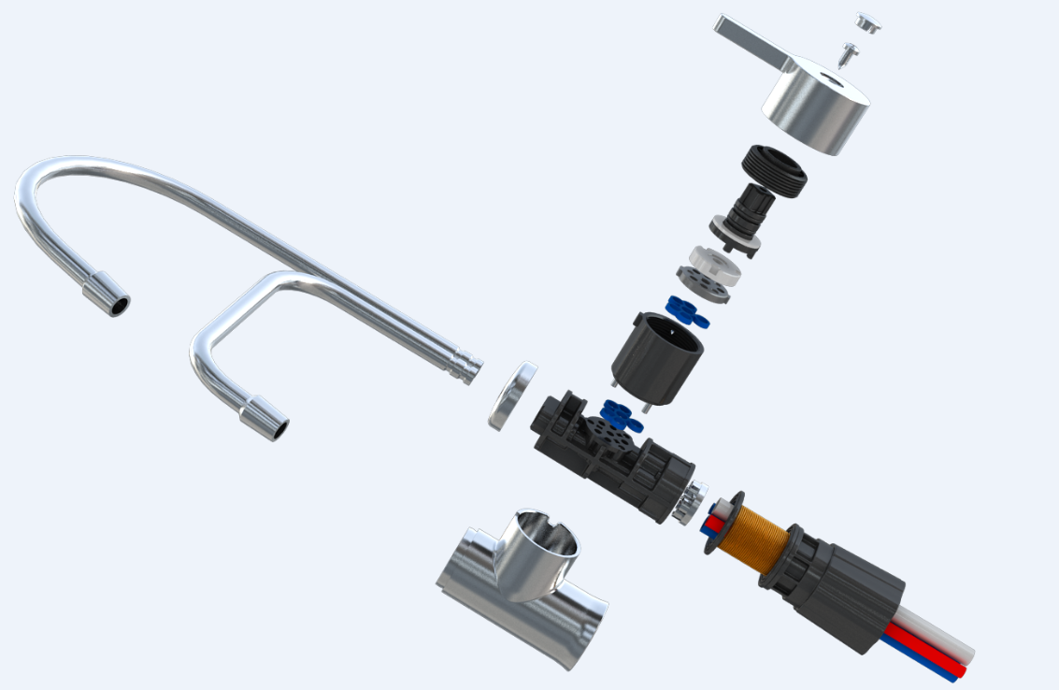
Features of Purifying Faucet
We use high-precision ceramic disk, and there is no leakage. Highly integrated waterways, open or close at the same time the three waterways of inlet water, pure water and wastewater.
Notes:
1.采用高精度陶瓷片，滴水不漏。高集成水路，同时开启或者同时关闭进水、纯水、浓水三路水路。

Slide 8
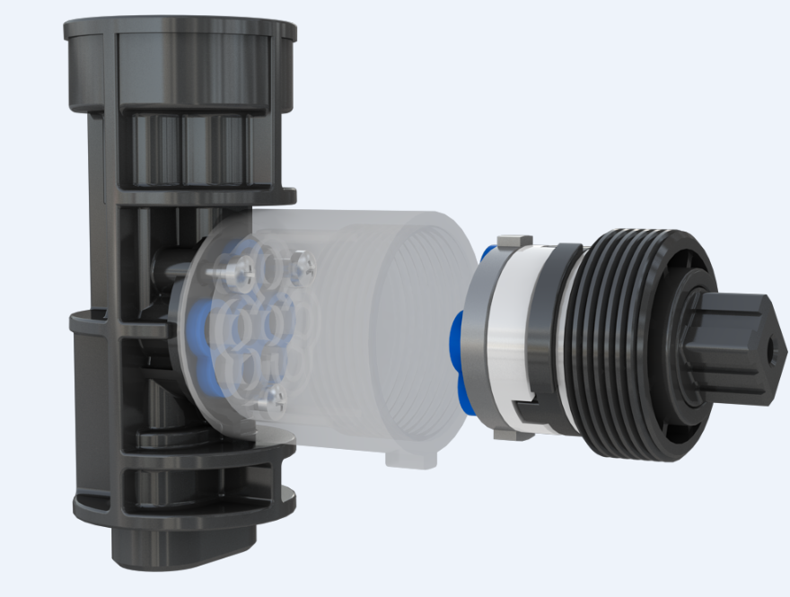
Patented product, split valve core structure.
It can still keep the integrity of the appearance， under the premise of ensuring the strength and sealing performance.
The valve body adopts high-strength PPO material, and the water hammer is 1.05MPa cycled 100,000 times, which can be easily dealt with.
Notes:
2.专利产品，分体式阀芯结构
在保证强度和密封性能的前提下，依然可以保证外观整体性。
阀体采用高强度PPO材质，水锤1.05MPa循环10万次，可以轻松应对。

Slide 9
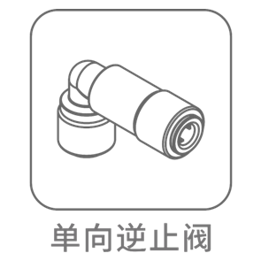
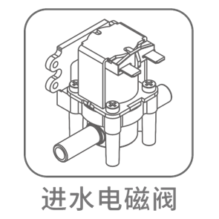
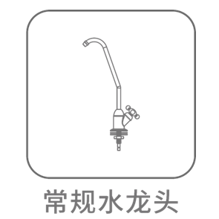
Save and reduce spare part , combined into one.
Use our purifying faucet can reduce the water inlet solenoid valve and check valve, and greatly reduce the quality risk brought by these electronic spare part.
If there is a trouble, the traditional water inlet solenoid valve machine will always draining the wastewater outlet, it will waste a lot of water resources.
Check valve
Water inlet solenoid valve
Ordinary faucet
Notes:
3.省减 配件 集成一体
使用本产品可减省进水电磁阀、逆止阀，大大减小了这些电子配件带来的质量风险。
传统的进水电磁阀如果发生故障，机器浓水口会一直排水，浪费大量的水资源。
这三个配件可省掉

Slide 10
Large flow 2/5” water inlet and outlet
It adopts 2/5" water inlet and outlet pipes to meet the full-load operation of the booster pump, the requirement of large flow of water, and the water making noise is small.
It is equipped with inlet and outlet water pipes, wastewater pipes, and pure water pipes, which can be used directly after plugging in, easy to connect.
2/5”pipe
2/5”pipe
Notes:
4.大通量三分进出水口
采用三分进出水管，满足增压泵满负荷运转，大流量出水要求，制水噪音小。
配置进出水管、浓水管，纯水管，即插即用，方便连接

Slide 11
The wastewater can be seen directly, which is convenient for recycling and reducing waste.（PS: This water can be used to wipe the floor, wash vegetables, etc. ）
Prevent the bad smell of the sewer
This means that when the faucet is closed, the channel of the wastewater pipe is also closed at the same time, and the wastewater pipe is not connected to the sewer, avoid the bad smell of the sewer from into the RO membrane.
Notes:
5.浓水可见，方便收集利用，减少浪费(可用于拖地，洗菜等)
6.防下水道反味
龙头关闭时浓水管的通道也关闭，浓水管没有接入下水道，避免下水道的臭味进入到RO膜内。

Slide 12
Problems with traditional faucets
1.The water purifier is always under pressure and subjected to the impact of water hammer. The solenoid valve, filter element, pipe fittings, etc. in the RO machine are easily damaged under the action of water hammer and cause leakage
2. In the shutdown state, the pressure loss water pump is frequently open, because the concentrated water solenoid valve is not closed tightly
3. The water inlet solenoid valve has a large flow resistance and a small flux. The booster pump cannot be operated at full load and the noise is loud.
4. Wastewater cannot be recycled
5. Wastewater outlet is connected to the sewer, and the bad smell of the sewer into the RO machine.
Notes:
传统龙头存在的问题
1.净水器始终处于承压状态、承受水锤冲击，RO机内的电磁阀、滤芯、管件等容易在水锤作用下损坏导致泄漏。
2.由于浓水电磁阀关闭不严，在停机状态下压力失压 ，水泵频繁启动。
3.进水电磁阀流阻大，通量小， 增压泵无法满负荷运转，噪音大。
4.浓水不能回收利用。
5.浓水口接下水道，下水道臭味反味进入RO机。

Slide 13
Our Products Can Solve the Following Problems
The problem of water purifier pressure, water hammer impact, and water leakage.
The problem of frequent open under pressure loss in shutdown state
The problem of water inlet solenoid valve restricts the flow. The booster pump cannot be operated at full load, and the noise is large.
The problem of difficult to collect wastewater.
The problem of bad smell at the sewage outlet.
Reduce electronic control components and reduce product failure rate
Reduce spare parts and improve production efficiency
Notes:
我们的产品能解决以下问题
1.净水器承压、水锤冲击、漏水的问题
2.停机状态压力失压 频繁启动的问题
3.进水电磁阀限流 增压泵无法满负荷运转，噪音大问题
4.浓水难收集的问题
5.解决下水道浓水口反味的问题
6.减少电控元件 降低产品故障率
7.减少了零部件 提高了生产效率

Slide 14
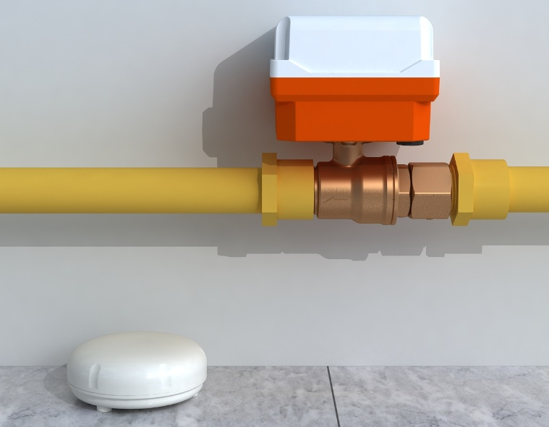
Wireless Auto Shut-off Valve
Notes:
防漏水保护自动护装置

Slide 15
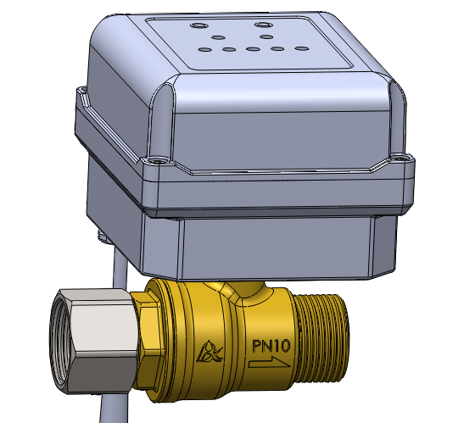
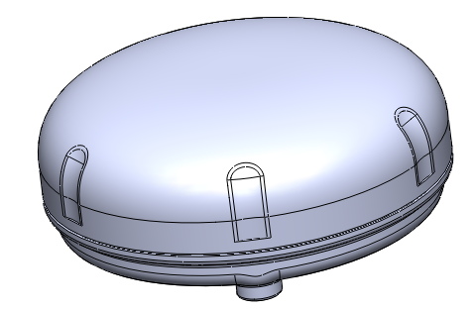
Item | Parameter | Remarks
Inlet/Outlet | G3/4
Working Voltage | DC12V
Internal battery | 12V lithium battery | Protection for 24 hours in case of power failure
Wireless detector | 12V dry battery | 420days
Number of matches | 5
Internal battery，can be protected for 24 hours after power failure
Inlet
Outlet
Wireless detector

Slide 16
Product Features
The water leakage detector adopts wireless layout, which can check the water leakage in multiple places and long-distance sensing, sensing within 800 meters.
The water leakage detector has low power consumption, and one battery can keep more than one year
Intelligent detection of monitoring points
The main control valve adopts a light torque ceramic core ball valve, which has small flow resistance and large flow.
The main control valve has a internal large-capacity lithium battery, which can still be protected for 24 hours after power failure
Low battery alarm
The waterproof design of the wireless detector prevents the internal circuit from corroding.
Notes:
产品特点
1.漏水探测器采用无线布点，可多点漏水监测、感应距离远
2.漏水探测器功耗低，一节电池可维持一年以上
3.监测点智能检测
4.主控阀采用轻扭矩陶瓷阀芯球阀，流阻小，通量大
5.主控阀内置大容量锂电池，停/断电后依然可以保护24小时
6.电池电量不足报警
7.无线探测器防水设计，防止内部电路腐蚀。

Slide 17
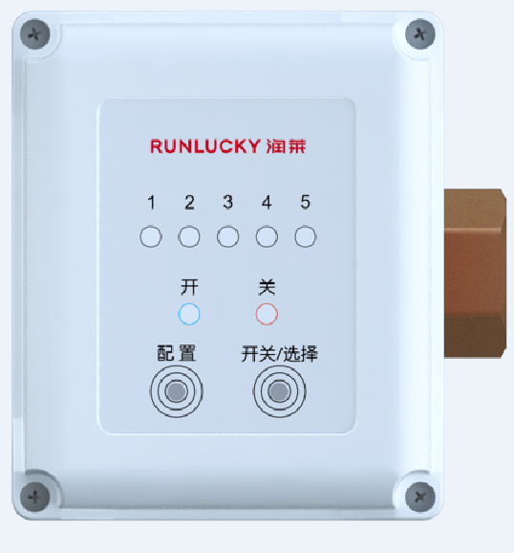
Interface display
Wireless detector indicator light
The number 1 will light up when matching the network or leaking,
Main control valve switch status indicator
Ball valve open / close state
Wireless detector matching network button
Main control valve switch/configuration number selection button
open / close the ball valve button or select the matching number

Slide 18
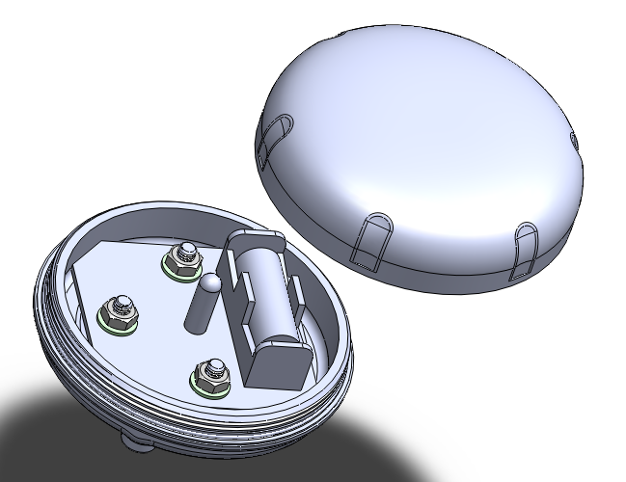
Matching network method
Match the network after installing the battery
First, long press the main control valve matching button, then short press the selection button, and then select the number you need to match. At this time, the indicator light will flash.
Reinstall the battery of the wireless detector and power on, the main control valve and the wireless detector will match the network automatically. After the matching is successful, the corresponding number LED will light on 5 seconds, and you can hear a sound “Di”.
Notes:
1.长按主控制阀配置键，再次短按选择键，指示灯选择到需要的配置编号上，此时指示灯闪烁。
2.将无线探测器电池重新上电，主控阀和无线探测器自动进行配网，配置成功后主控阀相应编号的LED灯长亮5秒，蜂鸣器长鸣1声。

Slide 19
Matching network method
Water leakage indication: wireless detector detects the water leakage, the wireless detector indicator flashes for 10 seconds; the corresponding indicator on the main control valve flashes quickly, and the buzzer keeps “Di”until the water leakage is removed, and the main control valve will switch to the close state automatically
Corresponding indicator flashes
Remove the water leakage: Clean up the corresponding wireless detectors, then press and hold the button of the main control valve to switch to the “open" state.
Long press the open/close button to switch
Notes:
漏水指示：无线探测器检测到漏水状态，无线水浸指示灯闪烁10秒；主控阀上面对应的指示灯快速闪烁，蜂鸣器一直蜂鸣，直到漏水解除，主控阀自动切换到关闭状态
解除漏水：清理干净对应的无线探测器，长按主控阀的开关键，切换到“开”状态。

Slide 20
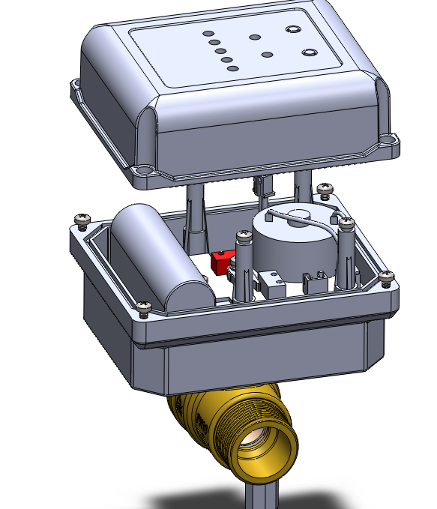
Reminder and replacement of battery shortage
Main control valve battery reminder：
There is a pair of rechargeable lithium batteries in the main control valve, which can use for 24 hours in the state of a power failure.
However, when the number of charging cycles is too large, the battery will attenuate, resulting in insufficient voltage in the fully charged state, at this time, the user needs to replace the battery by himself.
When reminding, the open and close indicator lights on the main control valve keep flashing and the buzzer “DI”.
Lithium battery
The switch indicator flashes
Notes:
电池缺电提醒及更换
主控阀电池提醒：主控阀内置一对可充电的锂电池,正常情况下断电情况下，可供主机使用24小时。但当循环充电次数较多会使电池衰减，导致充满状态下电压不足，此时需提醒用户自行更换电池。提醒时主控阀上的开、关指示灯连续闪烁，蜂鸣器蜂鸣。

Slide 21

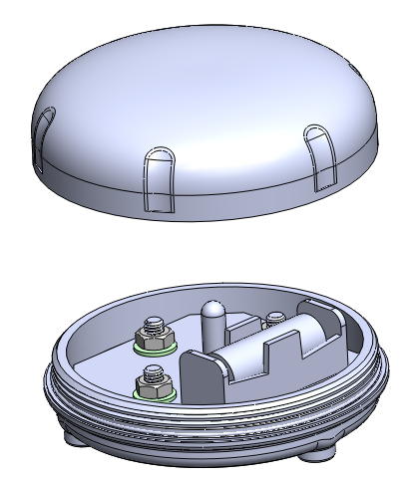
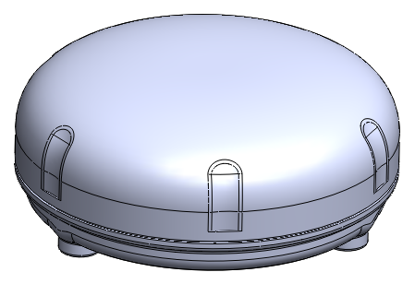
Wireless detector has no power reminder:
In theory, the wireless detector can use a battery for 420 days. When the wireless detector is out of power, the corresponding number indicator on the main control valve will flash slowly, the buzzer will “Di”, and the other indicators will display normally.
The steps to replace the battery are as follows
Corresponding indicator
battery
Open the top cover
Remove the dry battery and replace it
Notes:
无线探测器缺电提醒：无线探测器理论上可以使用420天一节电池。当无线探测器缺电时，主控阀对应编号的指示灯慢速闪烁，蜂鸣器蜂鸣，其余指示灯正常显示。

Slide 22
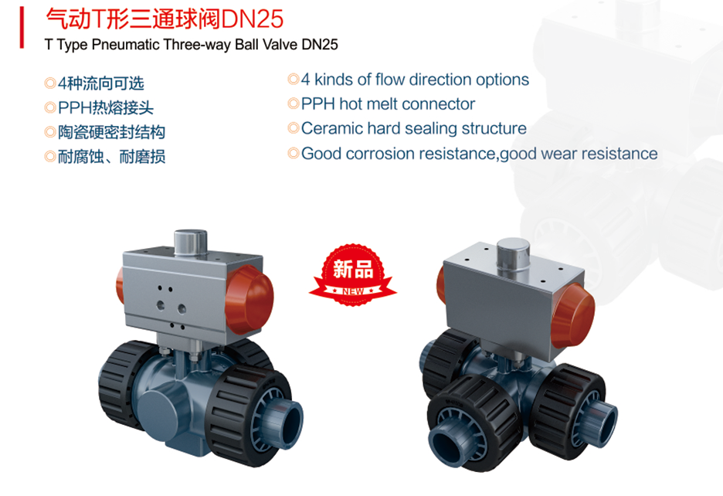

Slide 23
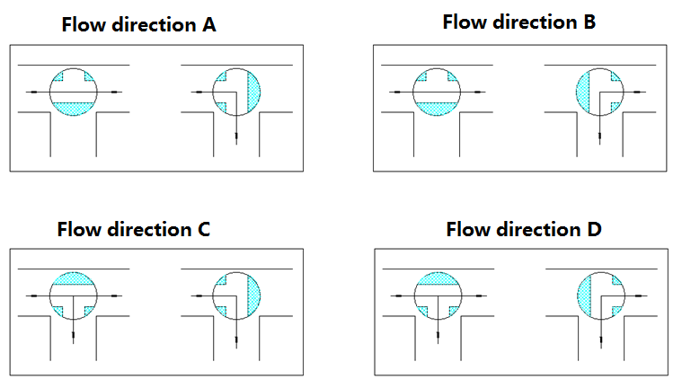

Slide 24

Thank you for your attention!

