Slide 1
New Control Valve
F139 Swimming Pool Filter Valve

Slide 2
Swimming pool filter valve introduction
01
Introduction of appearance, connector, sticker and decorative cover of F139, F139S
02
Characteristics, technical parameter and configuration of swimming pool filter valve
03
Internal structure of filter tank
04
Working principle of swimming pool filter valve
05
Different functions of valve and meaning of pointer
06
Design sketch of assembly(in Service status)
Notes:
泳池过滤阀介绍
一：F139、F139S外形、接口及面贴、装饰盖介绍。
二：泳池过滤阀特点、技术参数及配置参考。
三：泳池过滤阀沙缸内部结构。
四：泳池过滤阀工作原理。
五：档位使用及压力表指针意义。
六：实际组装效果图（运行档位）

Slide 3
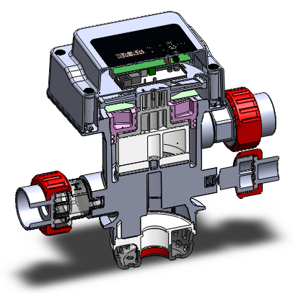
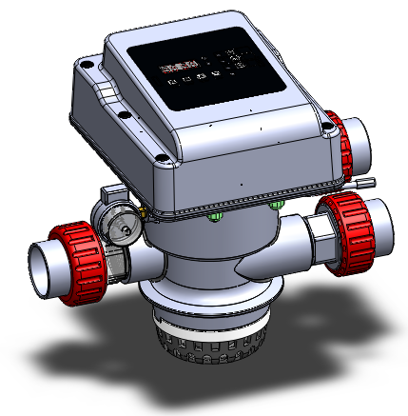
Appearance, connector of F139
Driven device
Pressure gauge
Inlet
Outlet
Drain
Transparent connector
Top strainer
Riser pipe

Slide 4
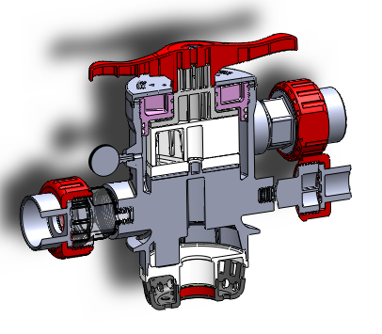
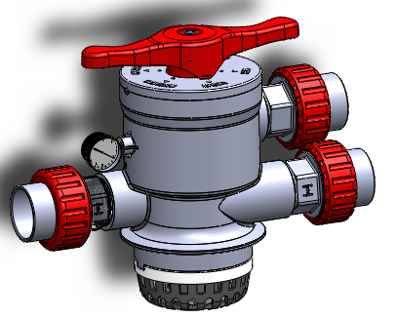
Appearance, connector of F139
Handle
Pressure gauge
Inlet
Outlet
Drain
Transparent connector
Top strainer
Riser pipe

Slide 5
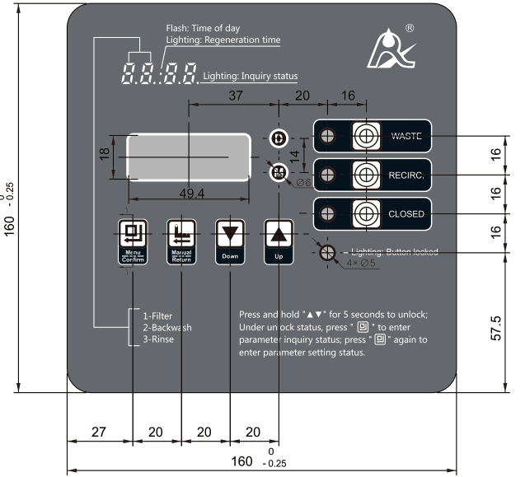
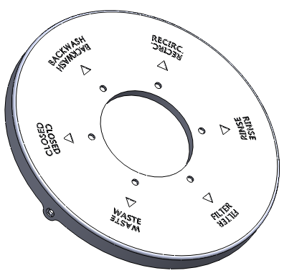
Sticker and Decorative cover of F139/F139S

Slide 6
Characteristics of F139/F139S
01
Adopt hermetic head faces structure, more wear and corrosion resistance.
02
Top-mounted (clamp connection).
03
Glue type connection for inlet/outlet and drain.
04
With 6 functions: filter, backwash, fast rinse, waste, recirculation, closed.
Notes:
采用高平面度、耐磨损、耐腐蚀的端面密封片启闭，密封可靠。
顶装（卡箍式连接方式）。
进出排水口采用胶粘方式。
具有过滤、反洗、正洗、排空、旁通、关闭等六大功能。

Slide 7
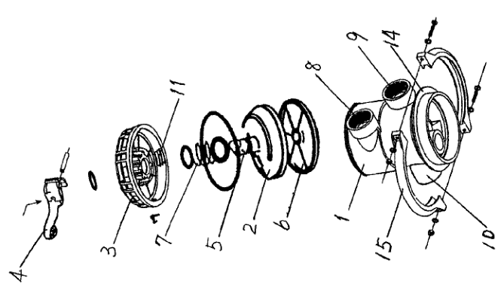
Structure of traditional swimming pool on current market:
On current market, most of the swimming pool filter valve adopt “reset spring” to switch the working status.
Notes:
市面上泳池过滤阀采用复位弹簧的方式切换工位，
而润新自主研发的泳池过滤阀依旧沿用控制阀的核心技术：端面密封原理，通过电机或手柄带动动片和定片贴合旋转，产生不同的流道，从而实现运行，反洗，正洗。

Slide 8
Parameters of F139/F139S
Model | Connector size |  |  | Backwash flow rate m3/h @0.1MPa | Remark
 | Inlet/outlet/drain Glue type connection | Base | Riser pipe
F139 | 2"D-GB (OD: 63.3mm UPVC pipe) Or 2.375"OD (OD: 60.3mm UPVC pipe) | Clamp (Suitable for tank with 150mm internal diameter) | 1.5"D-GB (OD: 50mm) or 1.9″OD (OD: 48.3mm) | 24 | Automatic (Backwash by pressure or time)
F139S |  |  |  |  | Manual
Working pressure＜0.25MPa(250kpa)；Inlet water temperature＜50℃。

Slide 9
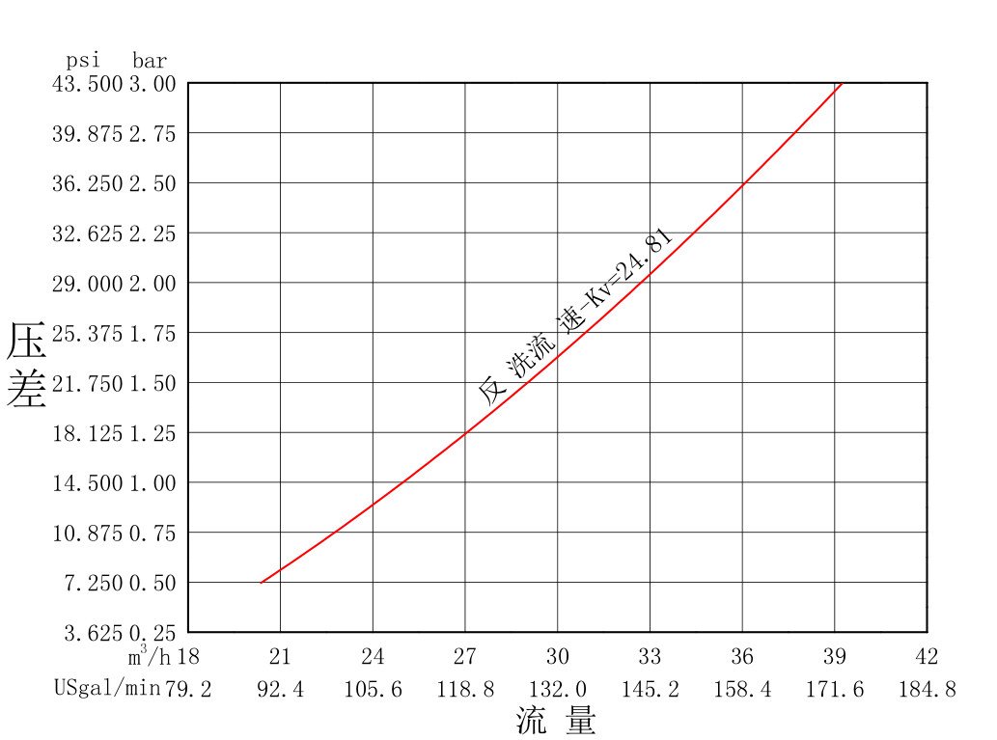
Flow rate curve of F139/F139S
Pressure Drop
沐浴软水机
Flow rate

Slide 10
Tank configuration of F139/F139S
Tank size | Filter media | Quartz sand filter
 |  | Filter flow rate (@0.1MPa) | Backwash flow rate (@0.1MPa)
mm | kg | m3/h | m3/h
φ700 | 210 | 19 | 20
φ635 | 155 | 16 | 17
φ534 | 85 | 12 | 12
φ454 | 40 | 8 | 8

Slide 11
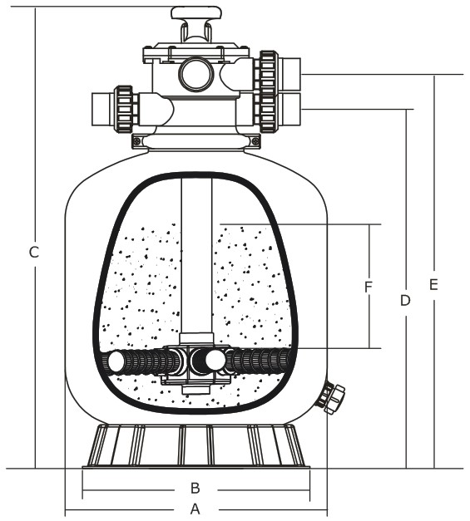
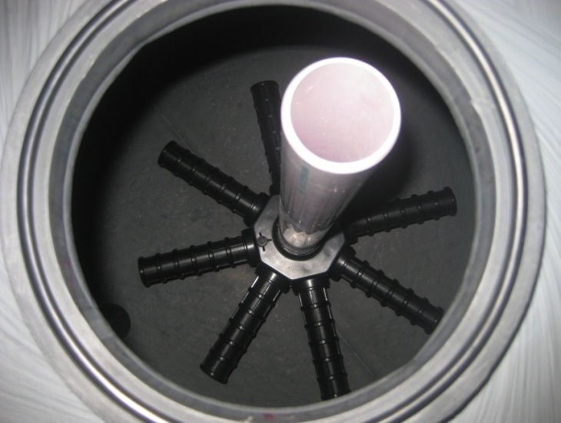
Internal structure of filter tank
Swimming pool filter valve
Quartz sand
Strainer
Drain

Slide 12
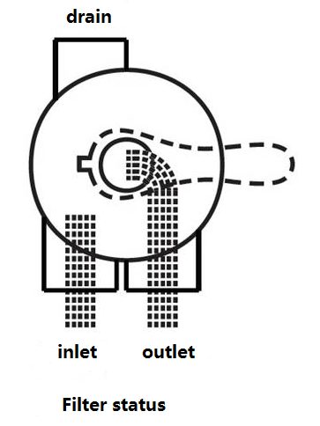
Working principle of swimming pool filter valve-- Filter
Application: Water filter of swimming pool
Notes:
运行档位：图为工作原理示意图，蓝色箭头代表进水，绿色箭头代表出水，经过石英砂过滤，布水器收集回水。

Slide 13
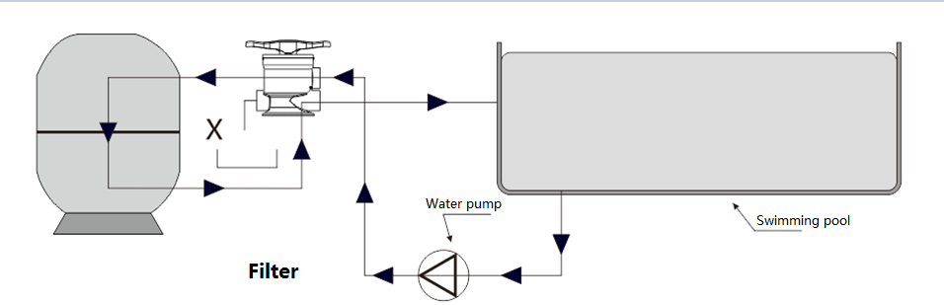

Slide 14
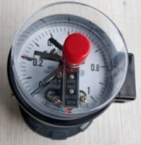
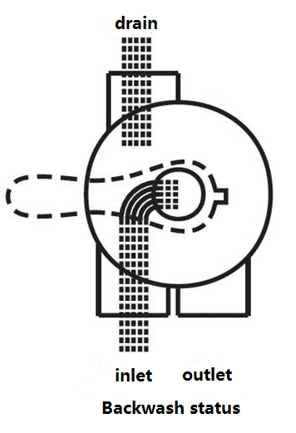
Working principle of swimming pool filter valve-- Backwash
Pressure gauge
Application: When the pressure gauge of the filter tank reaches the set value, it will backwash to wash away the internal dirt. After backwash for about 3 minutes, it can be switched to fast rinse.
Notes:
反洗档：
在运行位置当收到压力无源开关信号持续时间1分钟时，阀从运行位置转到反洗位置 。

Slide 15
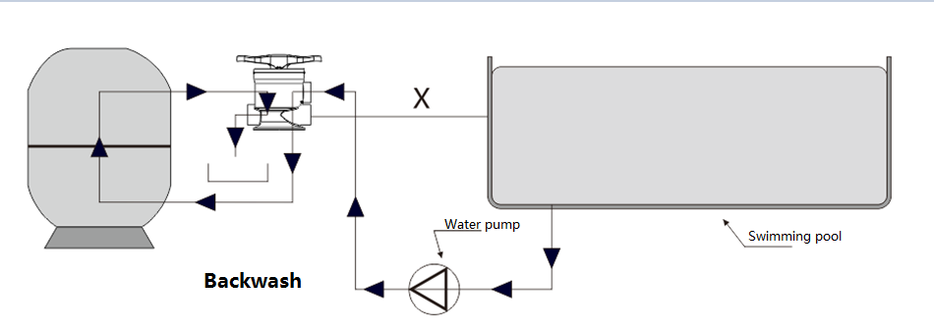

Slide 16
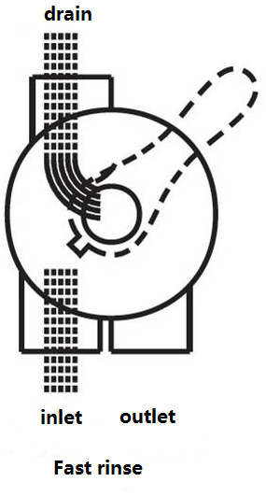
Working principle of swimming pool filter valve—Fast rinse
Application: After backwash, switch to Fast rinse status to flush the remaining sewage in the pipe, open it for about 2 minutes, and then switch to Service.
Notes:
正洗档位：图为工作原理示意图，蓝色箭头代表进水，绿色箭头代表出水，水从经缸头进入缸体，经过石英砂后排污口排出

Slide 17
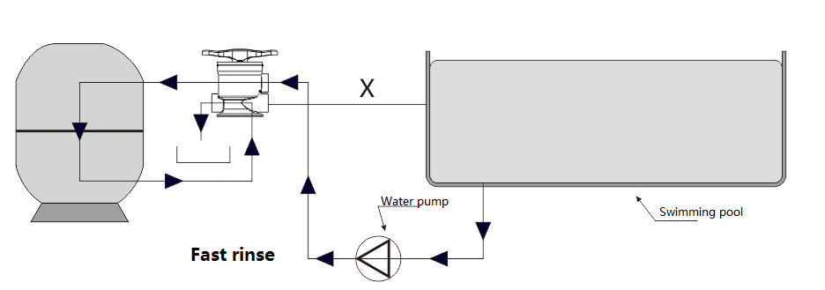

Slide 18
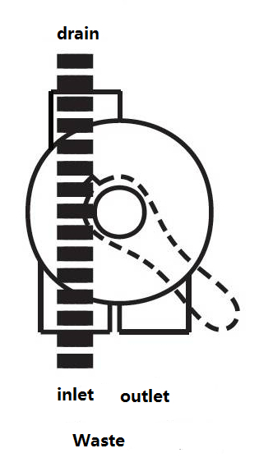
Working principle of swimming pool filter valve—Waste
Application: releasing water from swimming pool.
Notes:
排空档位：图为工作原理示意图，蓝色箭头代表进水，绿色箭头代表出水。水不用进入缸体，直接从排污口排走。

Slide 19
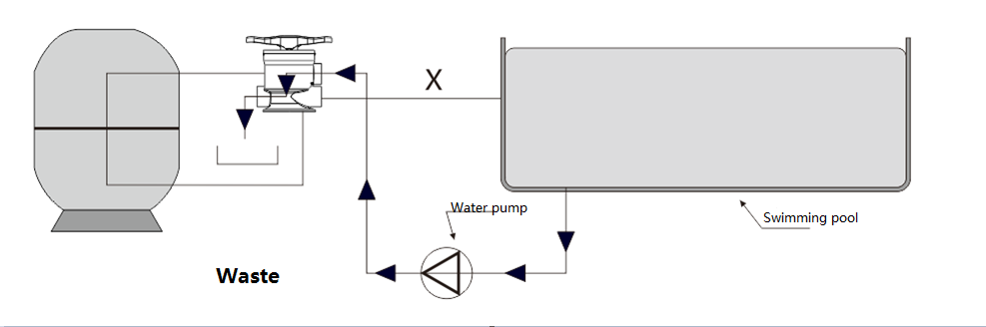

Slide 20
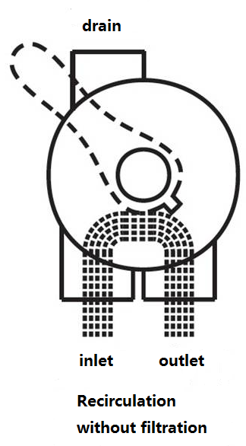
Working principle of swimming pool filter valve—RECIRC.
Application: RECIRC., suitable for where there is no need to filter pool water.
Notes:
旁通档位：图为工作原理示意图，蓝色箭头代表进水，绿色箭头代表出水。水不用进入缸体，直接从出水口回到水池。

Slide 21
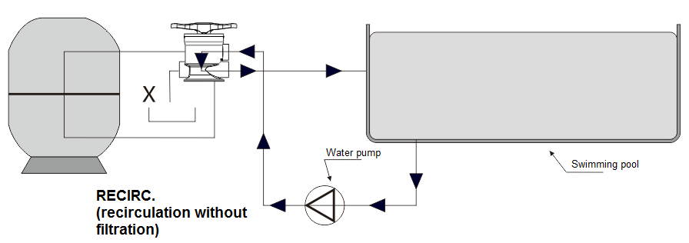

Slide 22
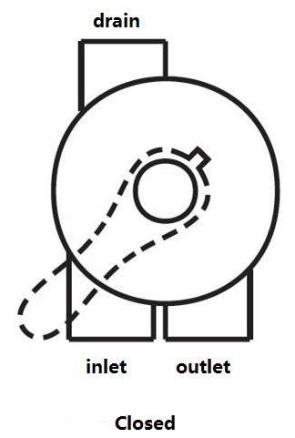
Working principle of swimming pool filter valve—Closed
Application: filter tank is stopped to use, water pump is closed.

Slide 23
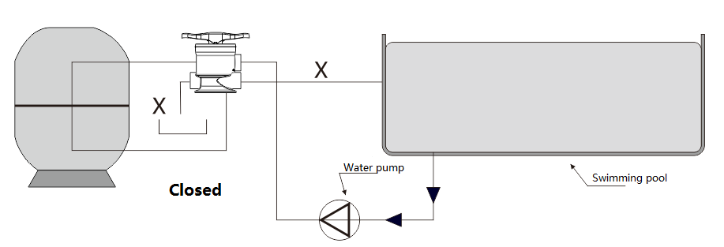

Slide 24

Different functions of valve and meaning of pointer
When it is the first time to load or replace the quartz sand, and the pressure gauge reading is higher than 0.1MPa. It is needed to switch the valve to "Fast rinse" status, after two minutes, then switch to "backwash" status, after 15-20 minutes, or if the volume of discharged water is equal to inlet water, then switch to "Fast rinse" status for 2 minutes, finally switch to "Service" status.
After backwash, when the pressure gauge reading is still higher than 0.1MPa in the normal filtration state, it is necessary to check whether the pipeline is blocked, whether the pump flow rate is too large, or whether the quartz sand has been used for a long time and needs to be replaced.
The meaning of pressure gauge pointer:
For example, when the pointer is set to 0.2MPa, when the quartz sand is too dirty due to long-term operation, and the pressure of filter tank reaches 0.2MPa, the pressure gauge will generate a passive switch signal to the control valve, and the automatic control valve will immediately change from the Service position to the backwash position.
Notes:
1. 沙缸头档位使用：第一次装石英砂、换沙、压力表读数大于0.1MPa时，先把沙缸头打到“正洗”档位，冲洗大概两分钟后，打“反洗”档位，大概反冲洗15-20分钟或者看排出来的水是否进入缸体的水差不多后，在重复“正洗”档位两分钟。然后打回 “运行”档位。
反冲洗后正常过滤状态时压力表读数仍然高于0.1MPa时，需要检查管道是否堵塞，水泵流量是否过大，或者石英砂已经使用已久需要更换。
2.压力表指针的意义：
比如把指针调到0.2MPa，当沙缸长期运行造成石英砂太脏，沙缸压力达到0.2MPa时，压力表会产生一个无源开关信号传送给控制阀，自动控制阀会立即从运行位置转到反洗位置！

Slide 25
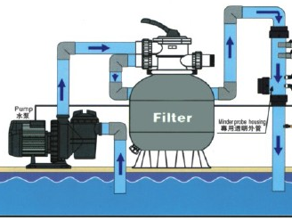
Design sketch of assembly(in Service status)

